Slide 1
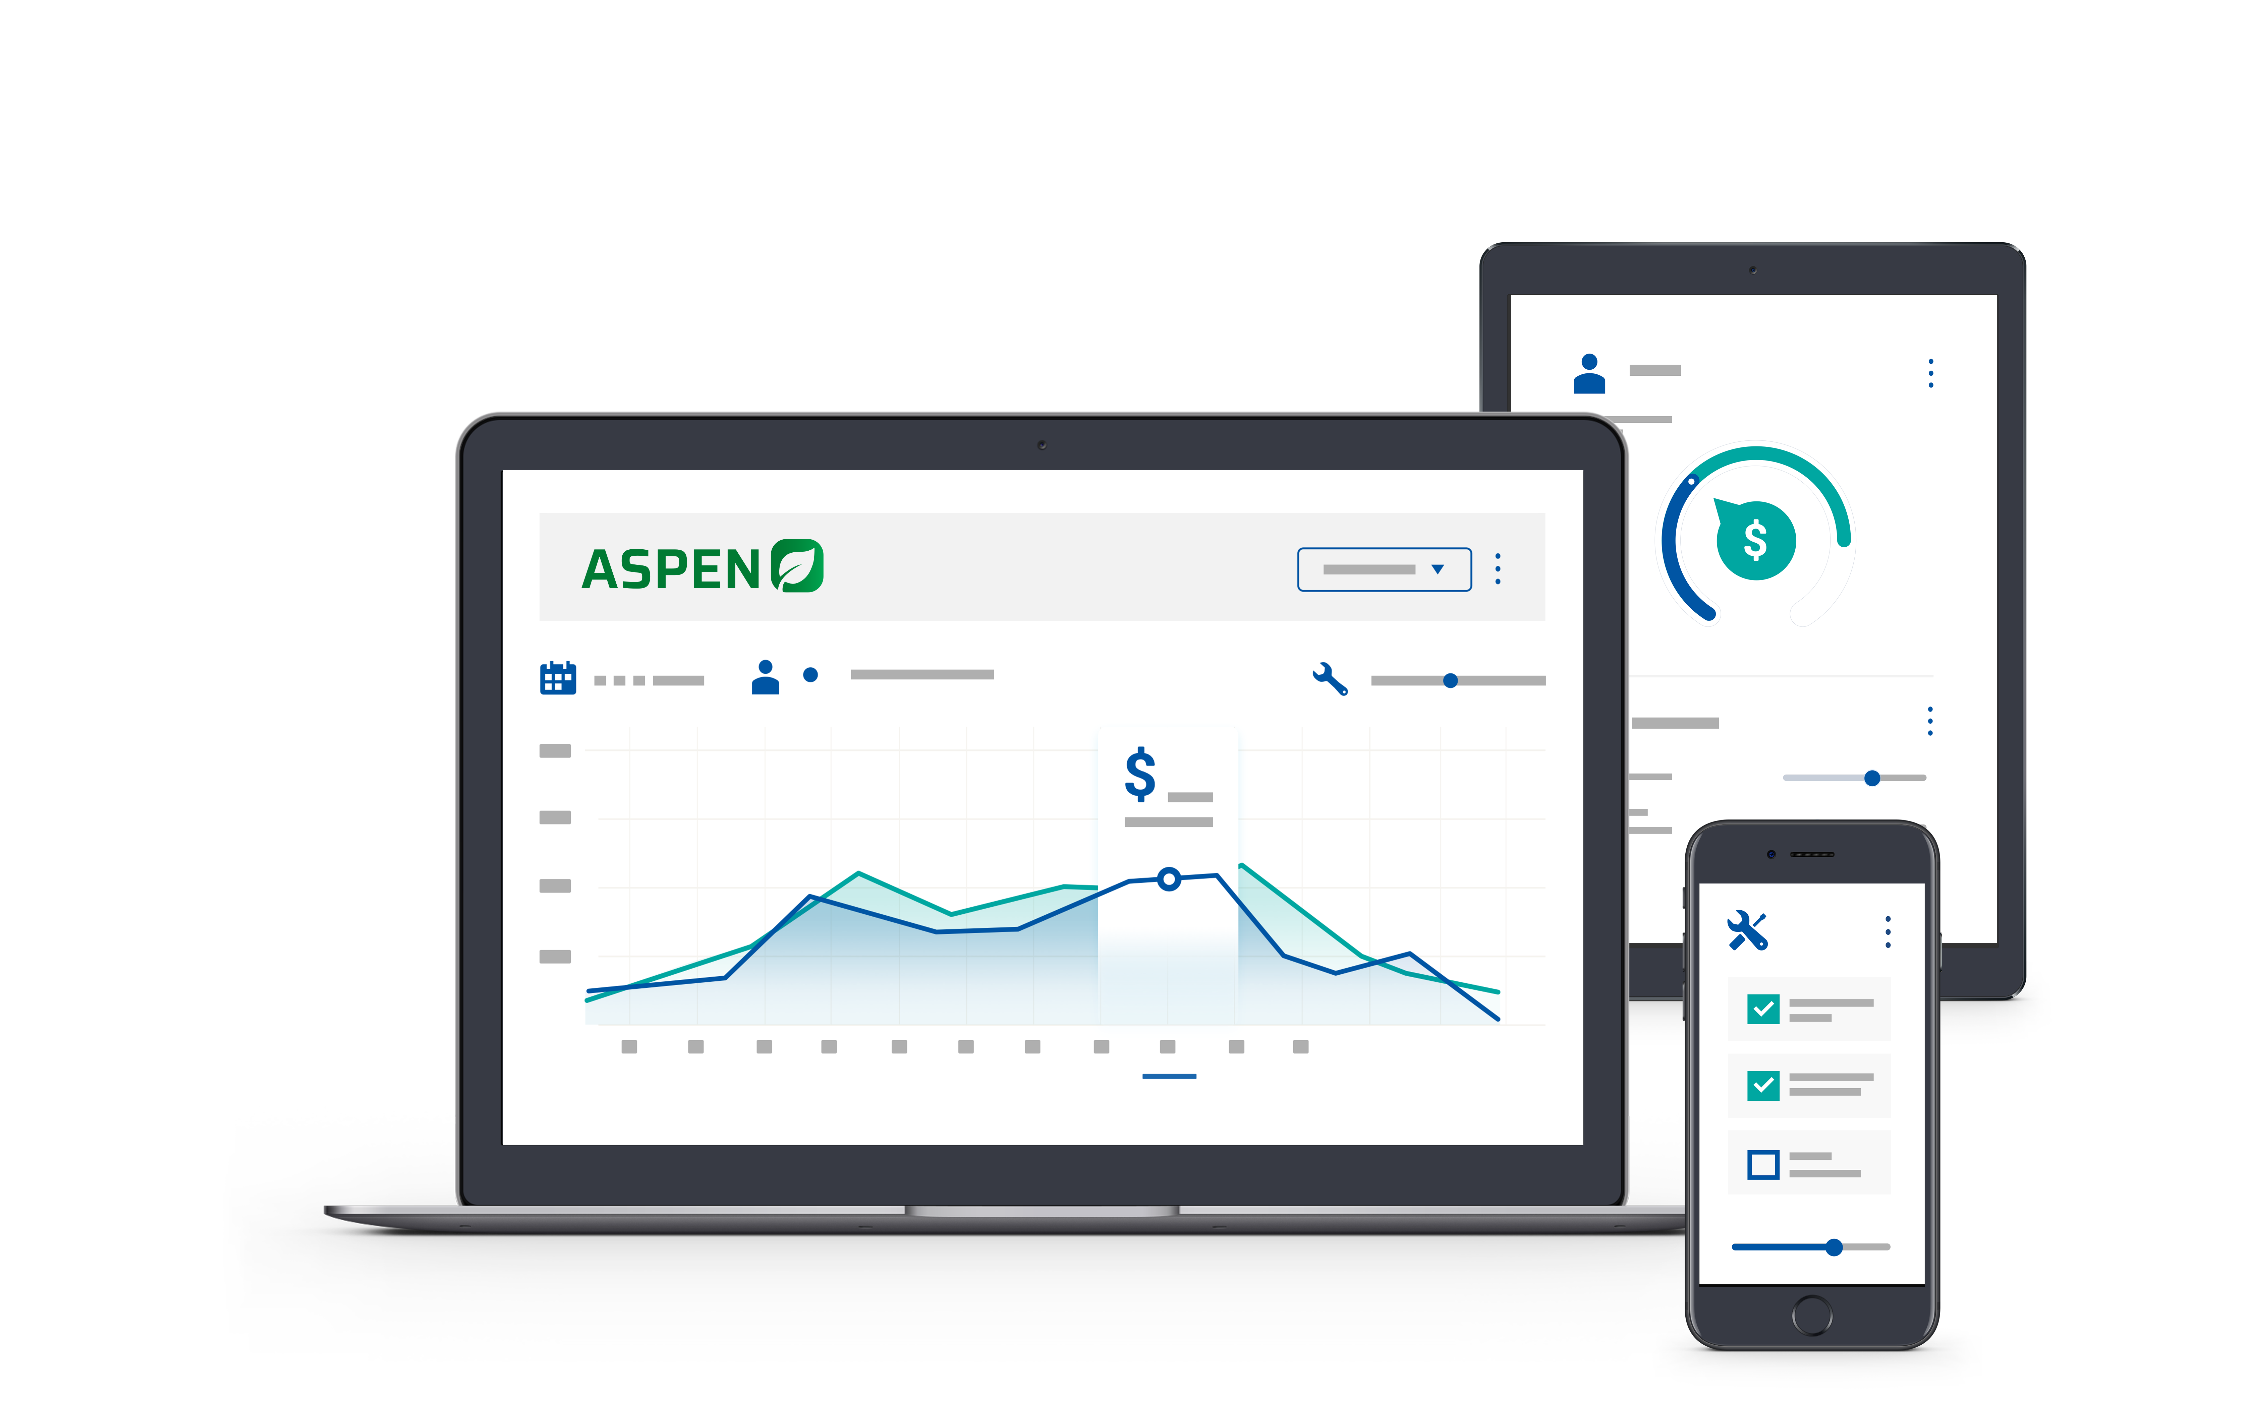


2025 User Conference
Learn & Grow at our User Conference
in Jacksonville!
February 10 - 12th, 2025
Jacksonville, Florida

Slide 2


Parts – Inventory Accuracy
How to Incorporate Cycle Counts
into Daily Routine

Slide 3


Laura Wickard
Implementation Manager

Slide 4
Agenda
1.
Overview of Parts Physical Inventory Workflow
2.
Importance of Using Count Lists
3.
Creating & Updating Count Lists – Saves Variances
4.
Establishing Routine Cycle Counts
5.
Posting Physical Count Adjustments
Notes:
Today’s Agenda includes explaining an overview of the purpose & benefits of Standard Jobs and looking at what it takes to set them up – whether from a vendor provided option or manually created.
Next, we will walk through a few workflow options.
Then we will get to see the results of being consistent by review a report.

Slide 5
Overview of Parts InventorY
Recount Variances
Post Trans
Create Count Lists
Count Parts – Update Count List
Multiple Lists
Saves Variance
Transfer to Recount
Post Transaction
Notes:
Finalize Return – Returns are finalized as soon as the parts are pulled from the inventory and packaged up to return. Some people wait to know how much they are getting. However, if you wait, your available quantities will not be accurate
Entry at Avg Cost – Remove the parts at average cost in order to keep the inventory in balance with detailed inventory value. The system Auto create the voucher if the vendor is setup to auto create it.
Voucher– These voucher will never exactly match your credit from the vendor. When the accounting team receives the credit memo, they will locate the draft voucher, edit it to match to the actual credit received and put any difference to COGS

Slide 6

Benefits of Count Lists
Manages Smaller Sections of Parts
Create Multiple Count Lists ahead of Time
Memorizes Variance of Parts Counted
Allows you to Sell / Receive Parts after Count Lists Saved
Gives opportunity for Review & Approval before Adjustments
Notes:
It

Slide 7
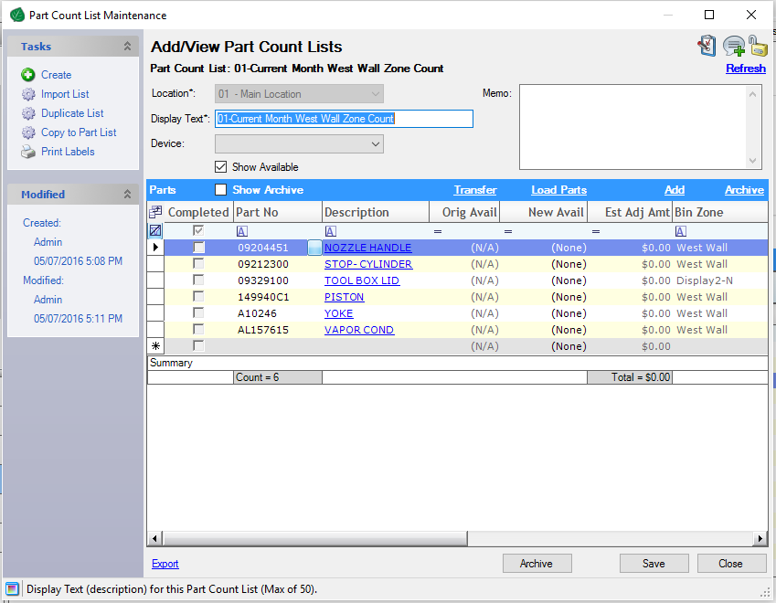
Creating Count Lists
Parts Selection Screen
  Bin Range
  Part Group
  Order Codes
  Cycle Count Settings
Live Aspen
Notes:
It

Slide 8
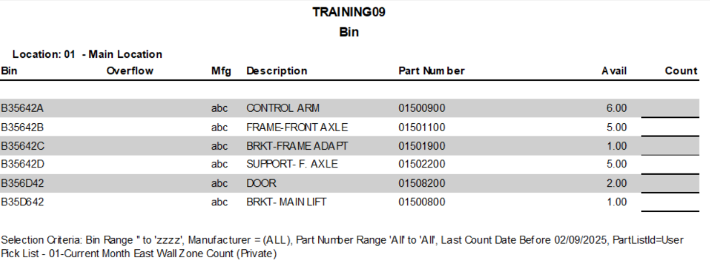
Manual Bin Report
Notes:
It

Slide 9
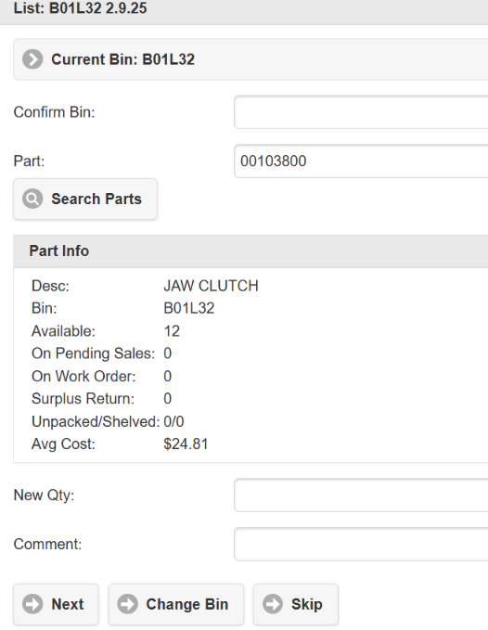
AIM – Count Lists
Confirm Bin
Enter New Qty
Add Comment
Go to Next Part in Bin
* Can Skip Bin
Notes:
It

Slide 10
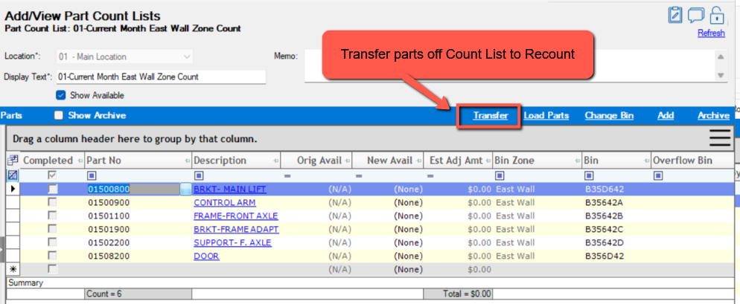
Transfer Parts to Recount
Create a Recount List
Transfer High Variances off to Recount List
Notes:
It

Slide 11
Establish Cycle Counts
Use High Volume Parts by Dollars or Quantity
Set schedule by Bin
Set schedule by Manufacturer
Create Lists of problem parts
Determine a reasonable number of parts to count each day / week
Make sure everything gets counted over time
Notes:
It

Slide 12
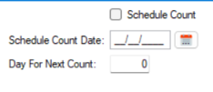
Mass Update Parts to set Cycle Counts
How Often to Count?
  Set Count Date
  Set Days to Next Count
Set Cycle Before
Posting Transaction
Screen!
Notes:
It

Slide 13
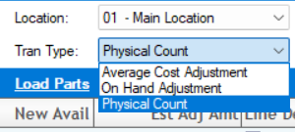
Post Transactions
Average Cost Adjustment
On-Hand Adjustment
Physical Count
ALL effect Financial Reports
Notes:
It

Slide 14
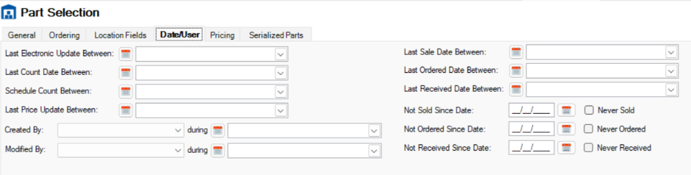
Create Count List by Cycle Count Days/Date
Notes:
It

Slide 15

Physical Inventory Overview
Create Count Lists – Count Parts – Update List
Establish Next Cycle Count by Date or Number of Days
Posting Adjustments
Effects on Financial Reports
Training Available in Lab / Scheduled Web-Training
Let’s Review

Slide 16
Questions ?

Slide 17
Thank You!

Slide 18



2025 User Conference
Learn & Grow at our User Conference
in Jacksonville!
February 10 - 12th, 2025
Jacksonville, Florida

