Slide 1
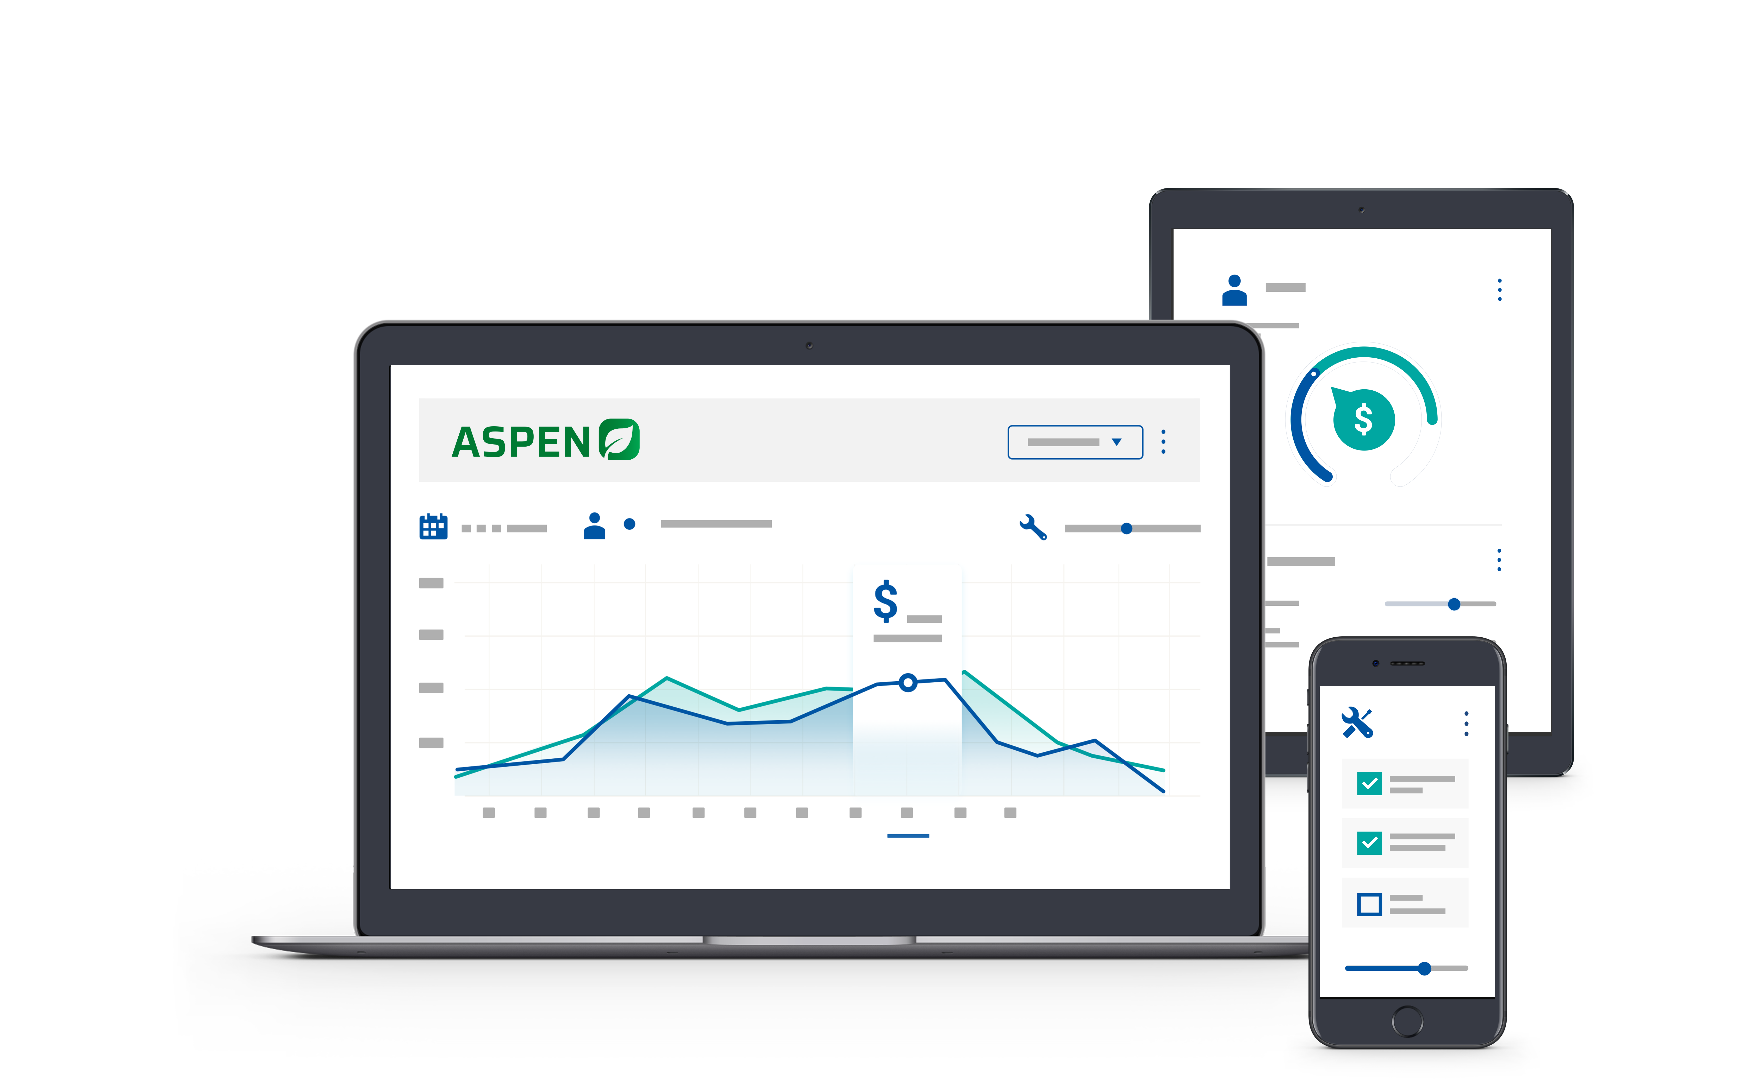


2025 User Conference
Learn & Grow at our User Conference
in Jacksonville!
February 10 - 12th, 2025
Jacksonville, Florida

Slide 2


Keeping Your Books in Order
Daily – Monthly – Annual
Reconciliations

Slide 3
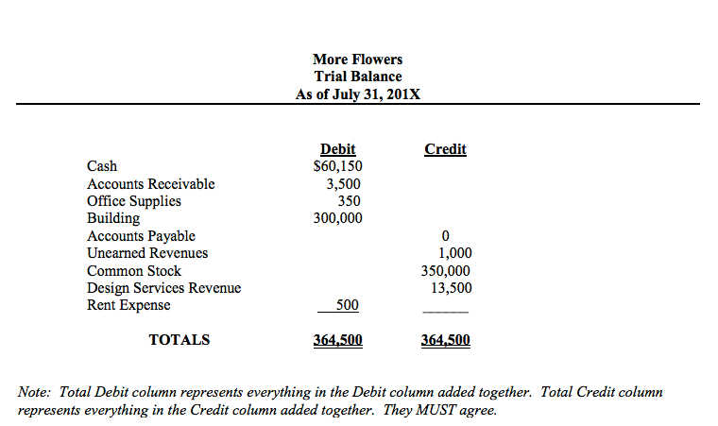
Keeping Your Books
in Order
Daily - Monthly – Annually
Reconciliations

Slide 4

Laura Wickard
Implementation Manager

Slide 5
Agenda
1.
Daily Routines – Monthly – Weekly Routines
2.
Aspen Report Card as a Guide for Reconciling
3.
Flat Trial Balance w/ Account Lists
4.
GL Entry Search Screen Tips
5.
Standard Bank Rec / Non-Standard Bank Recs
Notes:
Today’s Agenda includes explaining an overview of the purpose & benefits of Standard Jobs and looking at what it takes to set them up – whether from a vendor provided option or manually created.
Next, we will walk through a few workflow options.
Then we will get to see the results of being consistent by review a report.

Slide 6
Reconcile Financial Reports
Month End Routine
Standard Workflows to Streamline Processes
Aspen Report Card as Guideline for Reconciling
Flat Trial Balance
Regular / Non-Standard Use of Bank Rec
Notes:
Now that you have your new year in place, here are some tips for Reconciling your Financial Reports !
If you search our new Knowledge Base in our Customer Portal for “Month End”, you will find our suggested Month End Routine checklist.
There are Standard Workflows that will help your accounting processes run smoothly throughout the month to make Month End much easier.
As a guideline to help you reconcile, we have also developed an Aspen Report Card.
This addresses each type of GL Account – Bank Accounts, Receivables, Inventory accounts, and Payables – basically everything on your Balance Sheet
Flat Trial Balance – Using the Flat Trial Balance will give you visibility of all accounts that have a balance in them. This helps find when account numbers have been misused with the departments or location numbers.
Regular & Non-Standard Use of Bank Rec - Of course you will use the Bank Rec feature to reconcile your normal bank Accounts, but did you know that you can use the Bank Rec feature in aspen to help you reconcile almost any GL account?
You can use it to help reconcile any of your clearing accounts, especially your Cash on Hand (Undeposited Funds), Parts Purchase Clearing account, and even your payables.

Slide 7
Month End Routine
Print Aging & Inventory Value Reports – Time Sensitive!
  Query Tool for Scheduled Reports
Payable Reports
Reconcile Bank Recs
Review Trial Balance
*** Following are Suggested / Not Required ***
  Posting journal entries
  Closing the Month
Notes:
So, like I mentioned, we have a Month End Routine checklist in our Knowledge Base. This suggested the following reports be printed and reviewed monthly. Some of them are very Time Sensitive such as the AR Aging Reports and the Inventory Value Reports.
The Query Reports can be scheduled to run the reports at midnight of the last day of each month. You can contact Tech Support if you are interested in using the Query Tool Add-On interface.
Payable Report is not as time sensitive since you have control as to what is getting posted and paid, plus there is some report criteria to help exclude the new month’s activity on your current month’s reports.
You will want to Reconcile your Bank Recs – both for regular bank accounts and other GL Accounts like I just mentioned.
**** Explain each item listed ****

Slide 8
Aspen Workflows
Parts Orders / Receipts – Creates Draft Vouchers
Unit Orders / Receipts – Creates Draft Vouchers
Warranty Submission Types
  Process Warranty ROA & Creates Draft Voucher
Financial Report Upload
  Bobcat – CNH – John Deere - Kubota
Notes:
Here is a list of Interfaces that will help your accounting processes run smoothly throughout the month.
Parts & Unit Orders and Receipts both help streamline the accounting process and eliminates the need to start a voucher from scratch and they provide a DAILY Routine, so you don’t just wait for the month end statement to process your AP vouchers.
The warranty Submission process is one of my favorites. It is so simple to process your credits which automatically writes off any difference between amount submitted and the credit amount received.
Financial Reports Upload – We have interfaces to transmit your Trial Balance through Aspen for these Manufacturers: Bobcat – CNH – John Deere – Kubota
If you are not using any of these options, please contact us so we can help check your configuration needs and adjust your routines which will really help your month end run smoothly.

Slide 9
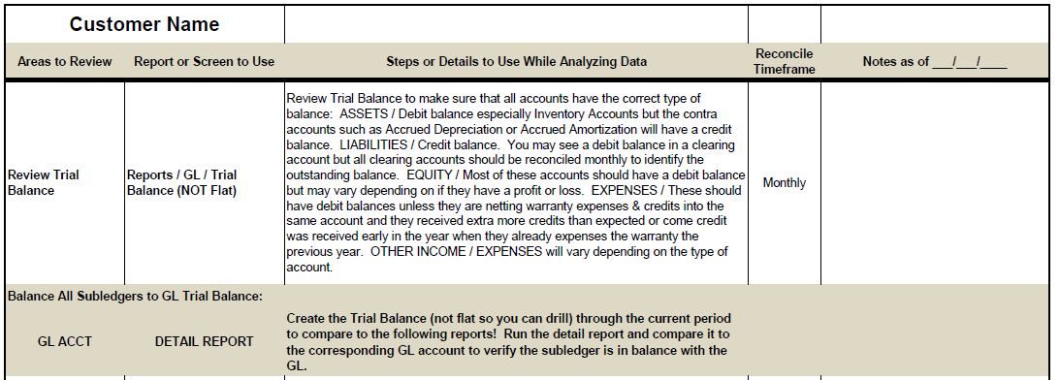
Aspen Report Card
Let’s Look at the Aspen Report Card
Notes:
I mentioned the Aspen Report Card which we created as a guide for reconciling *** (CLICK)**** let’s look at the Aspen Report Card to get you started on reconciling.

Slide 10
Flat Trial Balance
Check for Account Red/Black Values
What you see is what it is – Debit & Credit Balances
Check for Wrong Account Numbers
Notes:
Now let’s look at the Flat Trial Balance which was the first thing on the Report Card. This is always my starting point when I’m reconciling any GL Account.
The first thing that I check for is if the values are showing the correct balances as far as Debits or Credits go pertaining to the type of account it is.
For instance, Assets, receivables, and expense accounts should have a debit balance and will show in black. Liabilities and Revenue accounts will have a credit balance and are displayed in red. So, scrolling down through the Flat Trial Balance, you can quickly spot the accounts that might be out of balance if the color is opposite of what it should be.

Slide 11
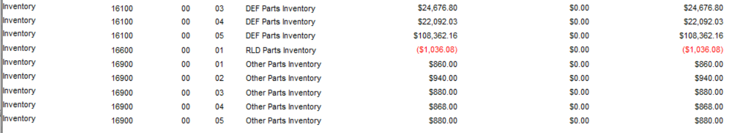
Flat Trial Balance – Negative Parts Acct
Notes:
So, when you see that Inventory Accounts are showings as RED, this is opposite of what it should be.
The negative parts inventory account shows that most likely parts were sold into a negative quantity PRIOR to the parts being receipted.

Slide 12
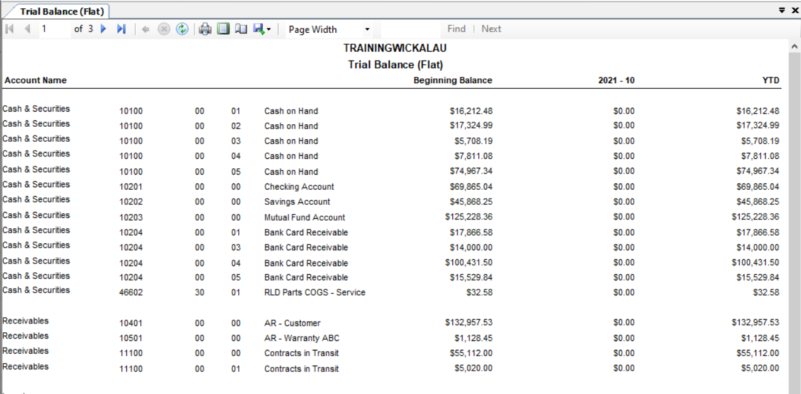
Notes:
Here you can see that some values are going to NO LOCATION for the Contracts in Transit, but you also have values in Loc 01.
***** I’m going to switch to LIVE ASPEN to scroll through the report a bit *****

Slide 13
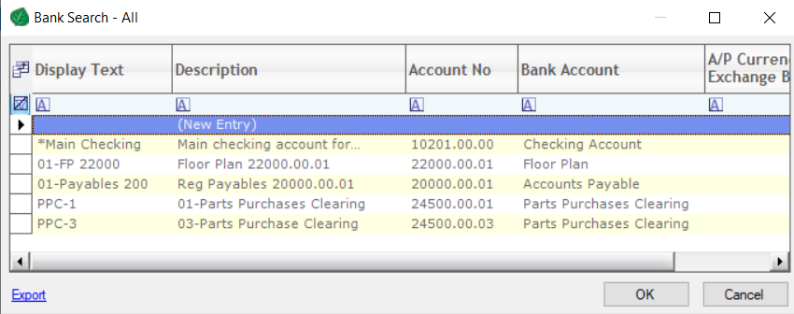
Non-Standard Bank Recs
Notes:
Bank Recs are one of my favorite features in Aspen.
You can see here that besides the normal Checking accounts, we can also use it to reconcile the Floor Plan Account – 22000.00.01, the regular payable account 20000.00.01, and also the Parts Purchase Clearing Accounts by each locaiton. Other accounts you might want to use this for is the Undeposited Funds account to make sure that all cash & check transactions are getting included on a deposit journal entry.

Slide 14
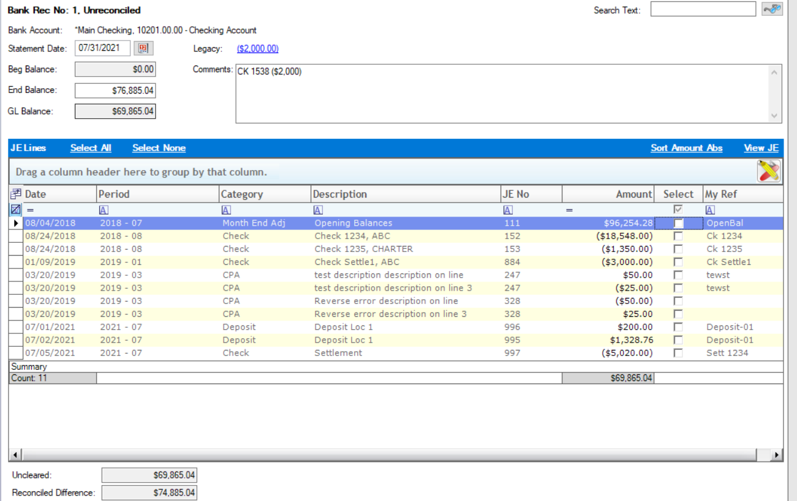
Notes:
Based on the type of account you are reconcile, that will determine how you enter the End Balance.
Bank Statements will use a positive amount (generally unless you are using your normal checking as your Credit Line Sweep Account).
Vendor Statements will use a negative amount since that account is a liability with a credit balance.
Offsetting Bank Recs for undeposited funds and PPC accounts will always use $0.00.

Slide 15
Bank Rec Workflow Tips
Rearrange and Save the Layout of the Grid
User the Filter Rows
  > $0 / Select & Verify Deposits Total First
  < $0 / Sort by Reference and Clear Checks
  < $0 / Select EFT Payments
Sort Amount ABS to find offsetting entries for Voids
Filter the Select column to see what you missed.
Notes:
Here are a few Bank Rec tips…..
**** Live Aspen for a Quick View ****

Slide 16

Notes:
Here are a few Bank Rec tips…..
**** Live Aspen for a Quick View ****

Slide 17
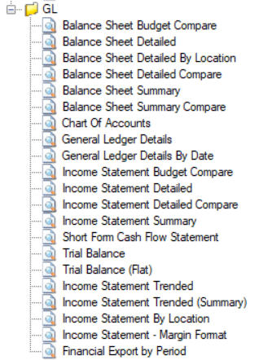
Print Financial Reports
Notes:
You can see there are several different report options depending on what your CPA or your financial institute requires.
Just remember that there is a difference of what they need for tax reporting and what you need for managing the details within your company, so we offer the ability to Expand or Collapse some of the reports.

Slide 18
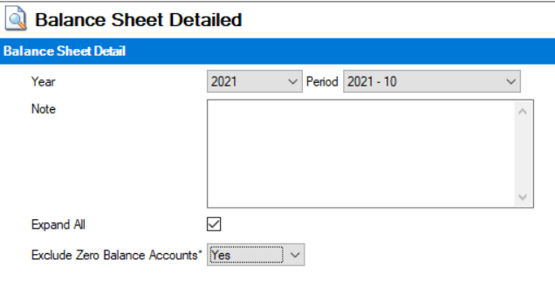
Notes:
Here is the criteria for the Balance Sheet Detailed – that shows the option to Expand ALL
If you unselect the Expand ALL, then you can choose which details you need expanded for your reports.

Slide 19
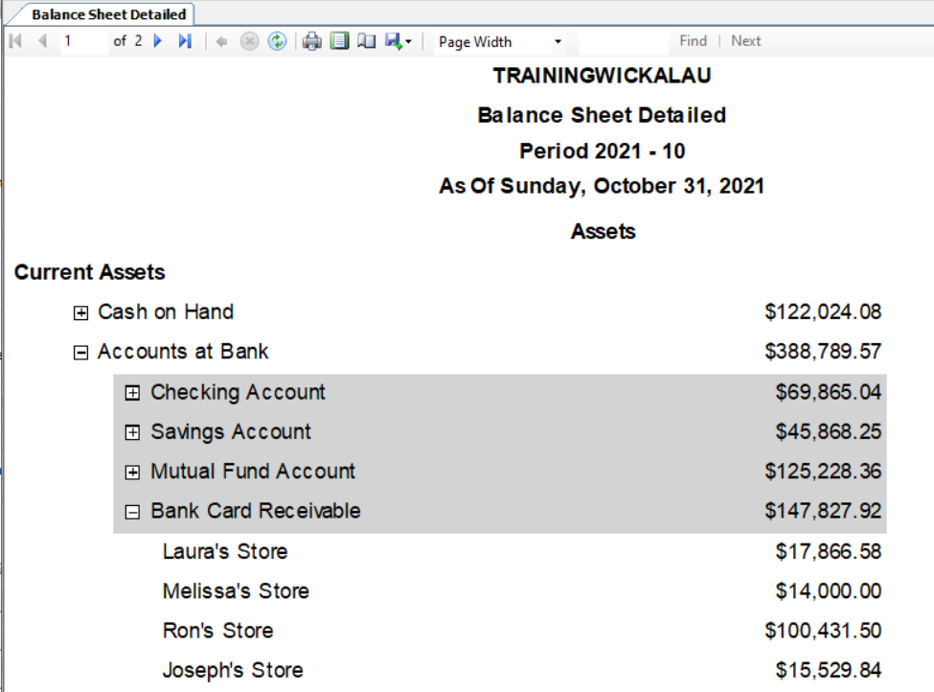
Notes:
Balance Sheet Detailed –
This shows how I started the report as NOT EXPANDED and then I just expanded the lines I wanted to open to show more levels of details.
You can see that I did not expand the Cash on Hand accounts to show all locations. I did expand the Accounts at the Bank to show the balances in the different accounts. And then I expanded the Bank Cards a bit more to even show the different locations.
So depending on if you are reconciling using the reports or printing them for your lending company, you can expand or collapse the different accounts.

Slide 20
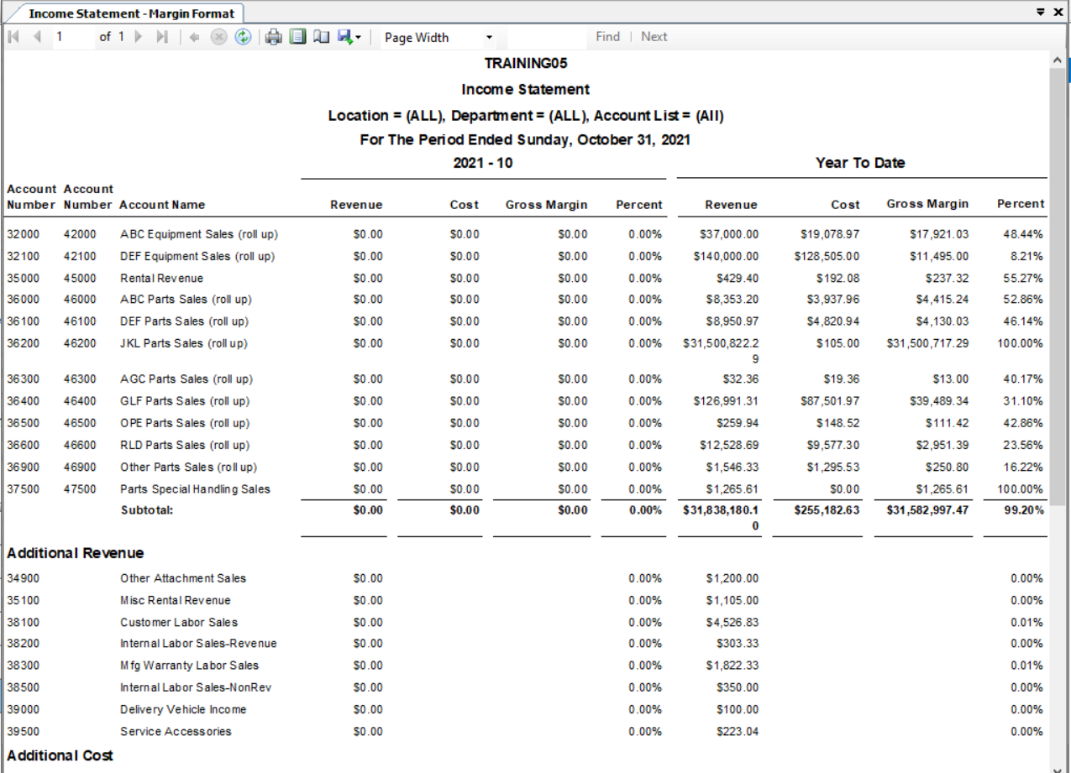
Notes:
Income Statement – Margin Format
I have found lately that people are not aware that this report has been out for a few years.
Show Revenue and COGS side by side for Gross Margin comparisons.
**** zoom into the report to show account numbers ****

Slide 21
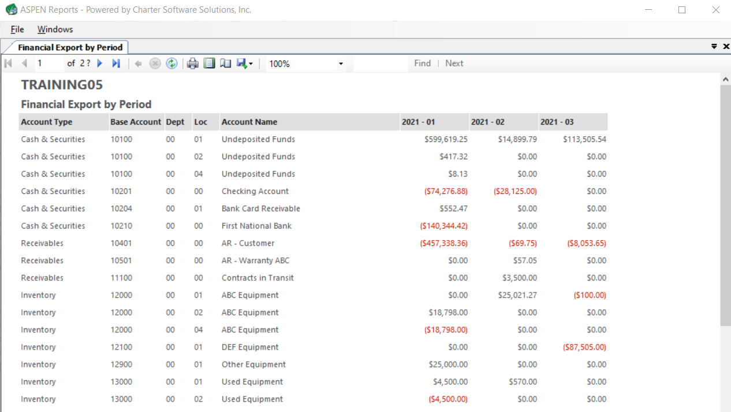
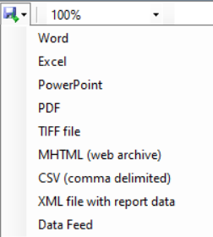
Notes:
The report displays each period Side by Side which then can be **** (CLICK) *** exported to excel to get your quarterly totals.

Slide 22
Sales Tax Recon
General Ledger Details
  Sales Tax Payable Account
  Other Income
Sales Tax Reports
  Sales Tax Summary
  Sales Tax by Invoices
Voided Invoices Listing Report
Notes:
Not let’s talk a bit about your Sales Tax Account.
I have found that people are just processing the Sales Tax Reports and not reconciling them back to their General Ledger Details for the Sales Tax Payable account.
If you work in a state that allows you to deduct some Sales Tax Collection Fee Credit from what was collected, then the amount being PAID will NOT clear out the balance in the Sales Tax Payable account.
The FULL amount collected should be debited to your Sales Tax Payable account
The Collection Fee Credit that you deduct from your payment should be recorded as a credit to OTHER INCOME.
There are several reports that you will want to use when processing your Sales Tax.
The Sales Tax Summary report will give you details based on Jurisdiction as to the amount of Gross Sales, trade credits, exempt reasons, taxable amount, and finally the Tax Due.
This report also provides Invoice Sales RECAP Totals for Invoice Gross Sales (true sales), Total Trades, Total Exempts, Total Over-allowance, and Total GL Revenue.
The Sales Tax by Invoice provides the details behind the Sales Tax Summary report.
Voided Invoices Listing Report will show all voided invoices along with the original invoice date. When you VOID an invoice instead of “Returning” an invoice, Aspen just creates a reversing JE of the origin invoice JE.
This process does NOT create a credit invoice and therefore is NOT part of the Sales Tax Report other than within the extra note at the bottom of the report in a different month than the original invoice will affect the GL Balances in different periods unless the JE is properly moved to the correct month.
Reconcile Sales Tax Payable Balance to Actual Amount Due
Collection Fee Credit is Other Income
Voided Invoices in Different Months Affect Account Balances
Use Voided Invoices Listing Repot

Slide 23
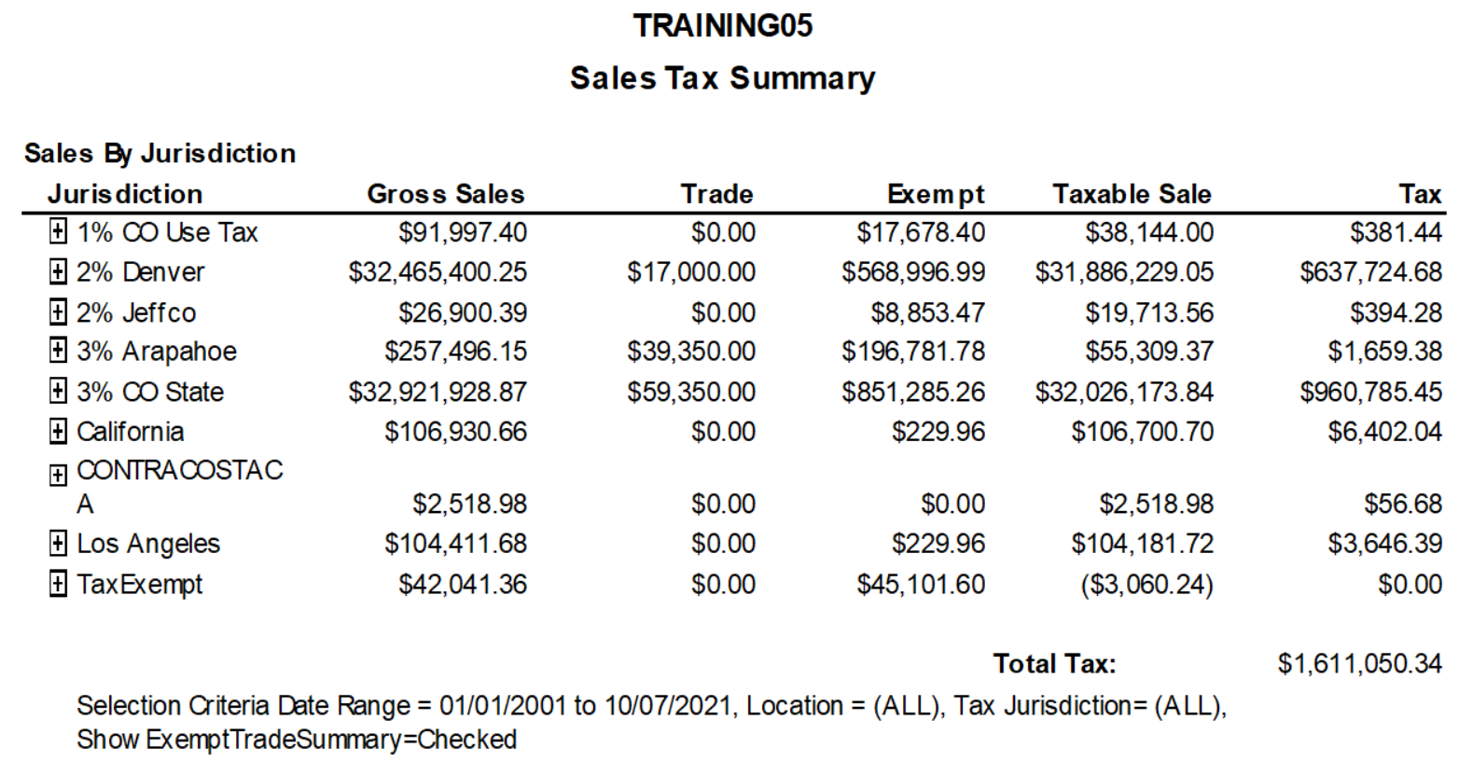
Notes:
Here is the Sales Tax Summary Report
You can see that the values are grouped by the Jurisdictions like I mentioned that were associated with the invoice transactions.
Gross Sales - Trades - Exempt - Taxable Sale = Total Tax Due
IMPORTANT NOTE: This is controlled by the INVOICE DATES and NOT the Period on the JE’s.
**** Just keep this comment in mind – I will explain this in a bit ****

Slide 24
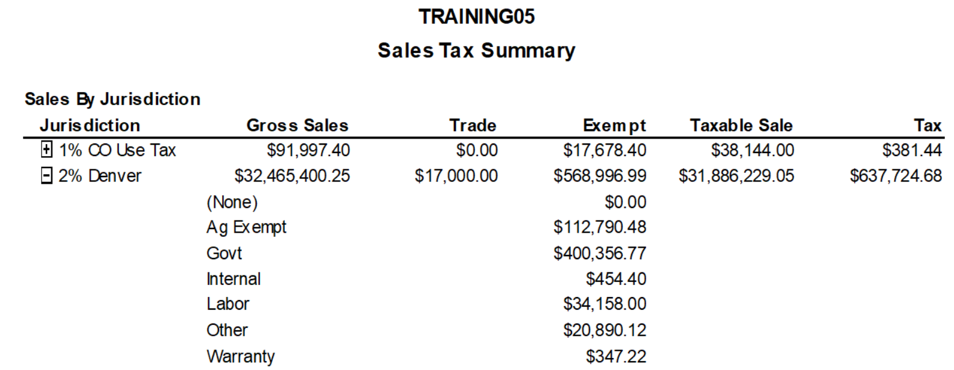
Expand to See Exempt Reasons
Notes:
If you click on the + on the left of the Jurisdiction, Aspen expands to show you the exempt reasons.

Slide 25
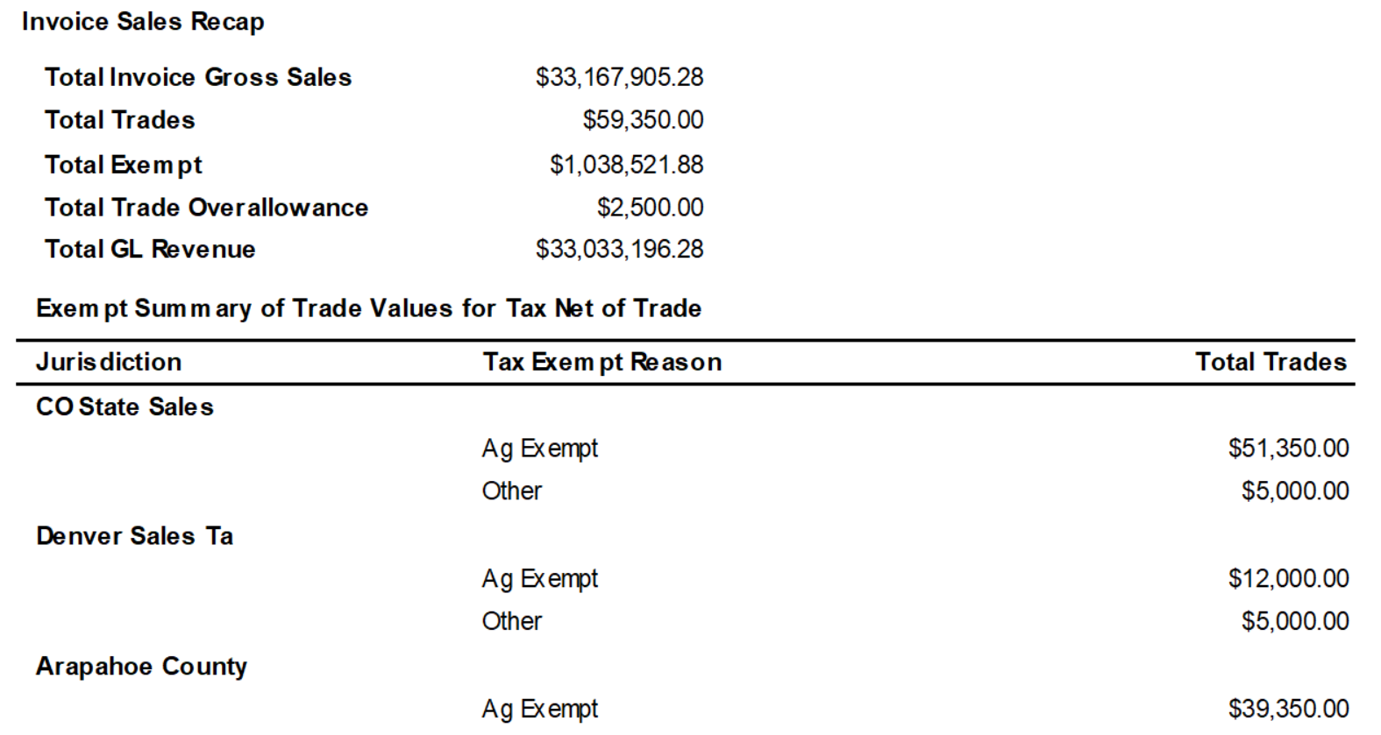
Notes:
Next, we have the Invoice Sales Recap
Notice there is a Total INVOICE Gross Sales and a Total GL Revenue
The Invoice Gross Sales is the total of everything on the Items Tab.
Sometimes you will have Misc. Charges for Trade Payoff, Dealer Participations Fees, etc. that are NOT SALE ITEMS, but since they are on the Items Tab, they are part of this total.
That is why we have the Total GL Revenue total which includes Item Lines and Payment Method hits to revenue accounts. General a payment method will NOT have revenue account, but this covers any hit to a revenue account.
Below that is the Exempt Summary of Trade Values for Tax Net of Trade.
If you ever wondered why the Total Trade in the recap doesn’t match the Trades at the top of the report, it is because IF the customer is Exempt, the whole invoice total will show in the Exempt column only and the TRADE will not be in the trade column.
This eliminates the trade value being listed in both columns.

Slide 26
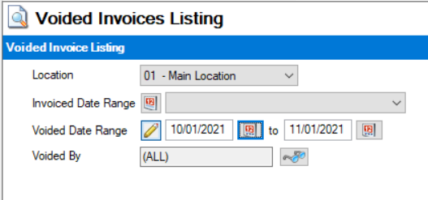
Voided Invoices Listing
Location
Invoiced Date Range
Voided Date Range
Voided By
Notes:
When selecting your criteria, I always just select the Voided Date Range to make sure I find any invoice voided since I last processed by Sales Tax.

Slide 27
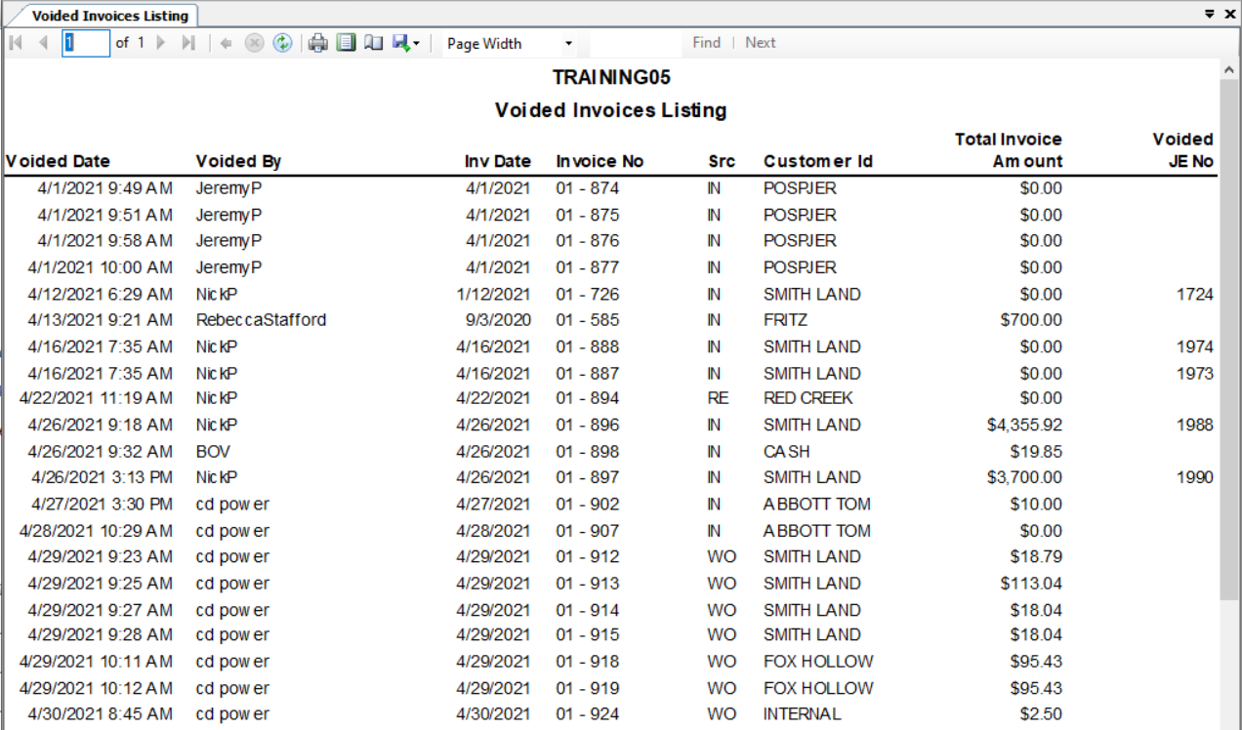
Notes:
What you are watching for is when the VOIDED DATE is in a different month than the INVOICE DATE.
You can see that on 4/12/21, someone voided Invoice 726 from January. **** (Click) ****
On 4/13/21, someone voided invoice 585 from September 3, 2020. **** (Click) ****
When this causes a problem is when you see a Voided JE NO, you know that is has affected your financial reports for the month that the voide happened.
This will also affect the Sales Tax Report if it would ever be Re-Ran for the original month of the invoice because voiding and invoice TAKES it OFF the report for the date of the invoice.

Slide 28
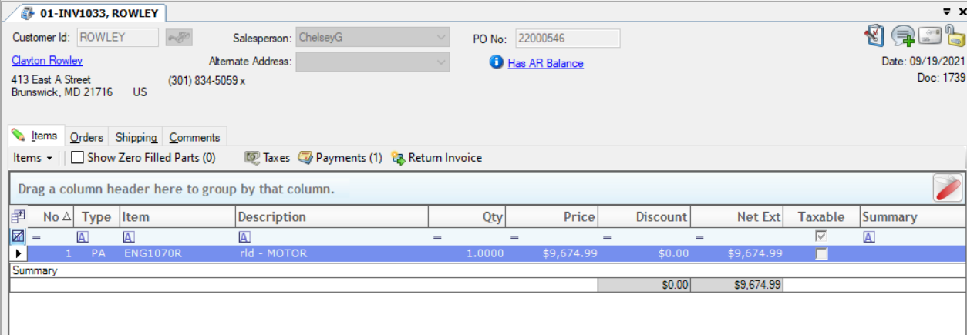
Return Invoice
Notes:
The best way to handle corrections is to use the RETURN INVOICE option which gives you control of the DATE, and it creates a credit invoice that shows on the sales tax reports.
There is a different process for Work Orders since you can’t return a Service Invoice.

Slide 29
Return Invoice
You control the DATE of the Return Invoice
Credit applied as Charge ROA to offset Original Invoice
Aspen creates a new Invoice
Credit Invoice is on Sales Tax Report

Slide 30
Closing Month
Not Required for Start the Next Month
Post JE’s After Reconciling Reports
System Settings / Fiscal Year / Close Month
Identifies Month is Closed and gives warnings
Only GL Entry (Adjust) will allow posting to closed periods

Slide 31
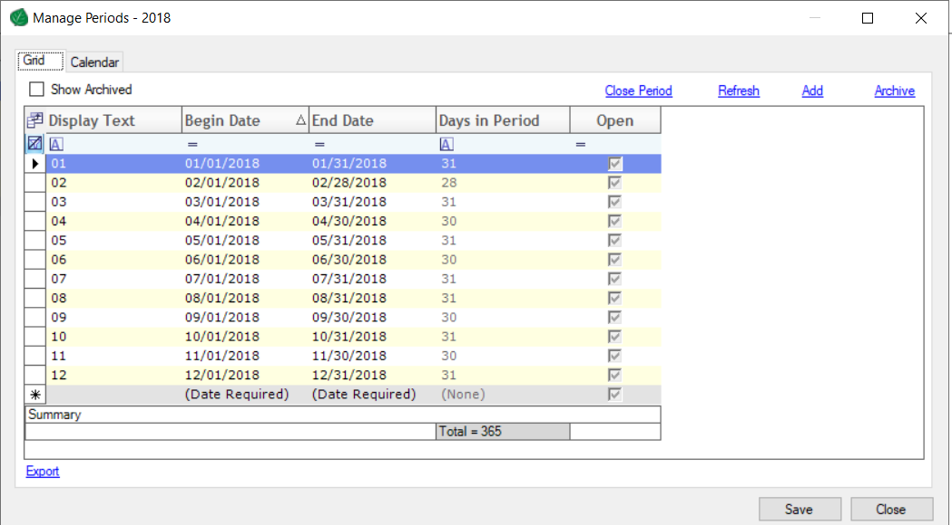
Fiscal Year – Close Period
Notes:
When you try to Close Period, it will warn you that you have unposted entries.
**** (CLICK to next slide) ****

Slide 32
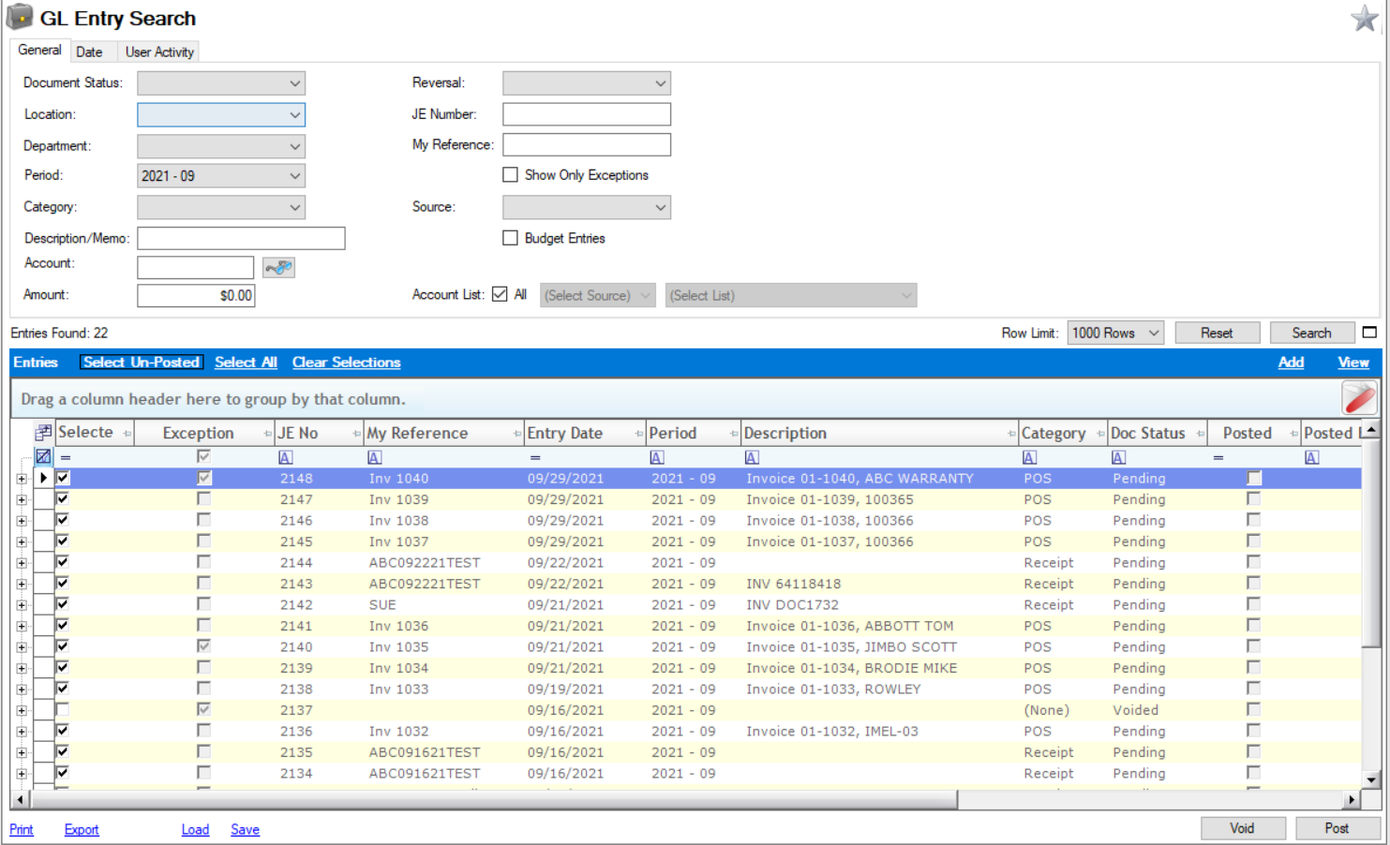
Notes:
You will use the GL Entry Screen to POST your journal entries. This is NOT Required like other programs in order to go on to the next month. It is only required if you want to mark the Month CLOSED. And you must Close the Month if you want to CLOSE the YEAR.
I first want to point out the – DON’T BE IN A HURRY TO POST JE’S – The Doc Status will show Pending for System created JE’s and Entry for manually created JE’s. This is very helpful during reconciling!!!

Slide 33
Closing Year
No RUSH
Wait for CPA’s Adjustments
All Entries are Date Driven
Notes:
NO RUSH to Close
WAIT FOR CPA Adjusting JE’s
The dates on entries is what controls what year the transaction will affect.
All Income Statement accounts balances will flow into the Retained Earning account for display purpose in the new year.
No transactions will show in that GL account unless your CPA advises you to reallocate to Owner Distributions, etc.

Slide 34
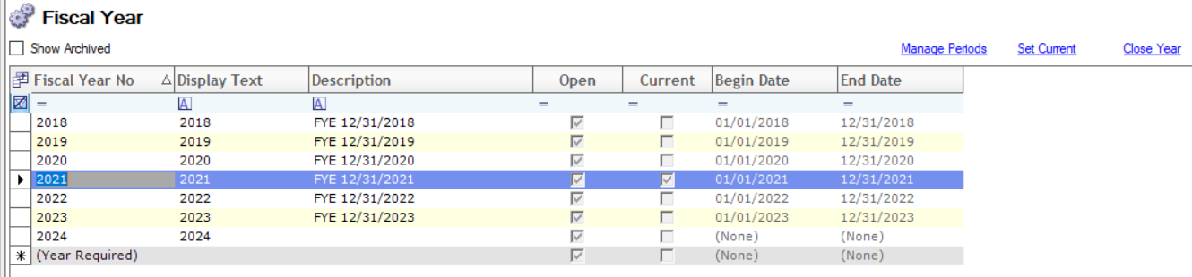
Closing Year
Notes:
Once all Year End Adjusting Journal Entries have been entered from you CPA and all JE”s are posted, then you can ***CLICK*** Close the YEAR

Slide 35
Resources
Tech Support – Short, random calls for quick questions
Knowledge Base from our Dealer Portal link
On-Demand Recorded Videos
Web Training – Scheduled training session with trainer

Slide 36
Recap
Year End Prep to Create New Fiscal Year
Reconcile / Print Financial Reports
Sales Tax Routine
Closing a Month
Closing a Fiscal Year

Slide 37
Questions ?

Slide 38

Standard Routines – Don’t Wait until Month End
Aspen Report Card as a Guide
Flat Trial Balance & with Account Lists
Reconciliation Tips – GL Entry & Bank Rec Options
Let’s Review

Slide 39
We sincerely Thank You for attending!

Slide 40



2025 User Conference
Learn & Grow at our User Conference
in Jacksonville!
February 10 - 12th, 2025
Jacksonville, Florida

