Slide 1
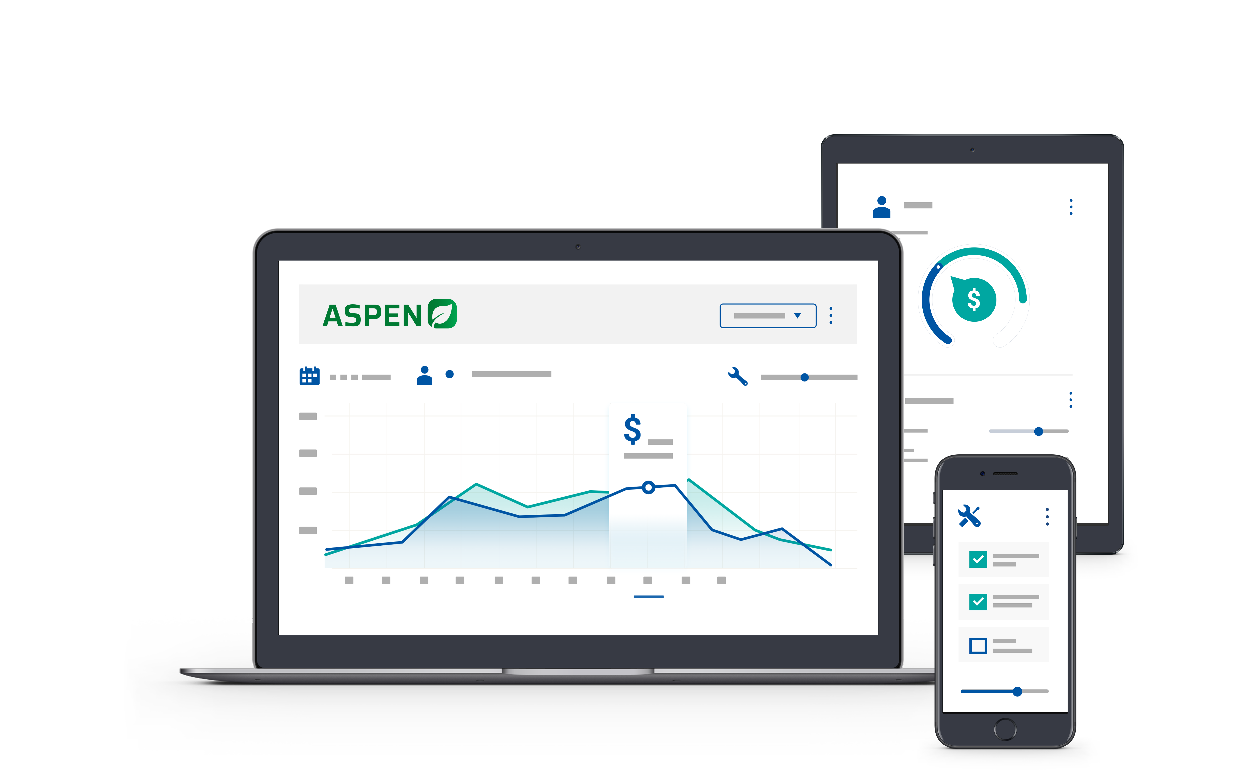


2025 User Conference
Learn & Grow at our User Conference
in Jacksonville!
February 10 - 12th, 2025
Jacksonville, Florida

Slide 2


Service – Standard Jobs
Streamline Workflow
& Drive Consistency

Slide 3


Laura Wickard
Implementation Manager

Slide 4
Agenda
1.
Standard Jobs – Overview / Basic Setup
2.
Standard Jobs – Vendor Provided / Manually Created
3.
Workflow Using Standard Jobs – Live Aspen !
4.
Reports – Completed Work Orders by Standard Jobs
5.
Other Efficiency Options – Draft Work Orders as Templates
Notes:
Today’s Agenda includes explaining an overview of the purpose & benefits of Standard Jobs and looking at what it takes to set them up – whether from a vendor provided option or manually created.
Next, we will walk through a few workflow options.
Then we will get to see the results of being consistent by review a report.

Slide 5

Standard Job Overview
It is a Job Template
Stores Parts for Specific Jobs
  Can store parts & labor by Model #
Holds Default Labor Hours
Stores Labor Details
    & Eliminates Repetitive Typing
Notes:
It

Slide 6
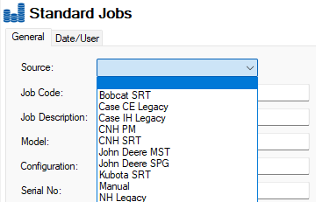
Vendor Provided vs Manual
Vendor’s Flat Rate Guides
Manually Created
  Common Seasonal Jobs
  Warranty Explanations
    Printed Memo
    Job Steps

Slide 7
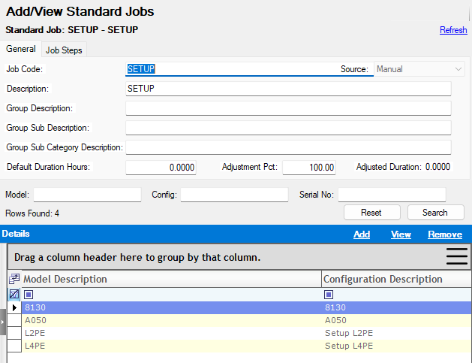
Setup – General Tab
Job Code - 75 Char
Job Description - 4000 Char
Group / Group Subs - 250 Char
Duration Hrs / Adjustment Pct
Associate Part on Manual Jobs
Model Specific Information

Slide 8
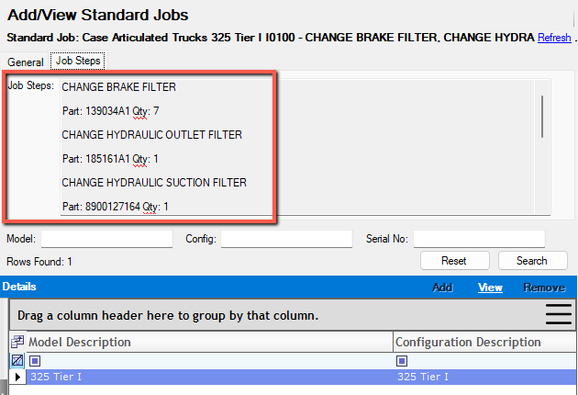
Setup – Job Steps Tab
Internal instructions for Tech
Prints on Shop Instruction
Visible from Clocking Screen

Slide 9
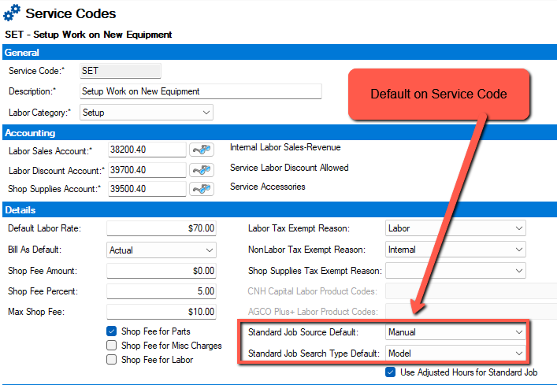
Service Code Defaults
Set Default Source
Set Default Search

Slide 10

Workflow Options
Select on a Work Order Segment
  Open Work Order or Work Order Quote
Apply to Unit Quotes to Create WO
LIVE ASPEN !

Slide 11
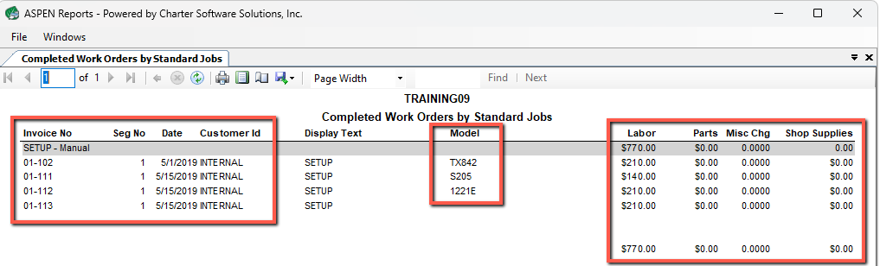
Report Option
Completed Work Orders by Standard Job

Slide 12
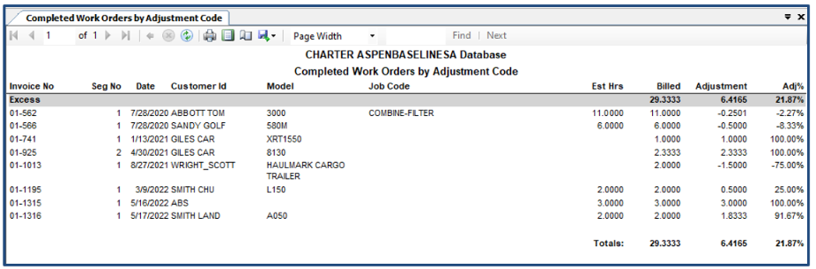
Report Option
Completed Work Orders by Adjustment Code for Standard Jobs

Slide 13
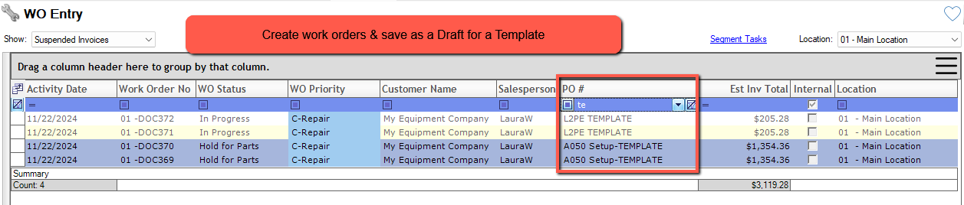
Extra Tip – Work Order Template Option:
Stores standard heading, segments details, and parts for a job
Stores Estimate or Flat Rat Labor Hours
Draft does NOT affect availability of parts or Financial Reports
Duplicate WO – Add Customer ID - Commit Document

Slide 14

Let’s Review
Basic Overview & Setup
Download or Create Manually
Apply to New Work Order or Quotes
See Results on Completed WO Report

Slide 15
Questions ?

Slide 16
Thank You!

Slide 17



2025 User Conference
Learn & Grow at our User Conference
in Jacksonville!
February 10 - 12th, 2025
Jacksonville, Florida

