Slide 1
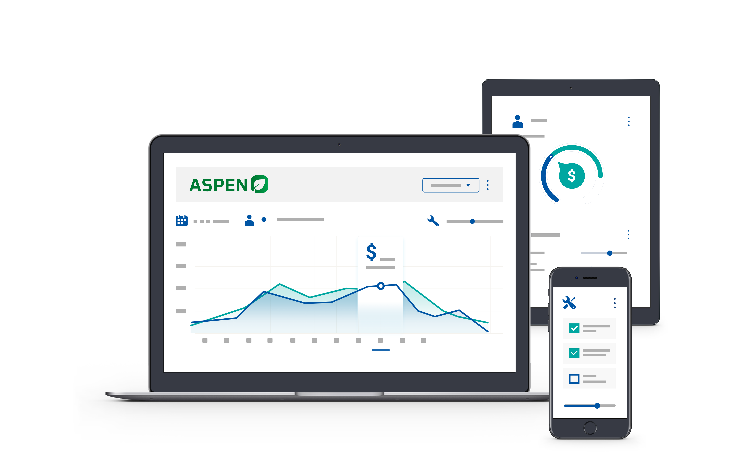


2025 User Conference
Learn & Grow at our User Conference
in Jacksonville!
February 10 - 12th, 2025
Jacksonville, Florida

Slide 2
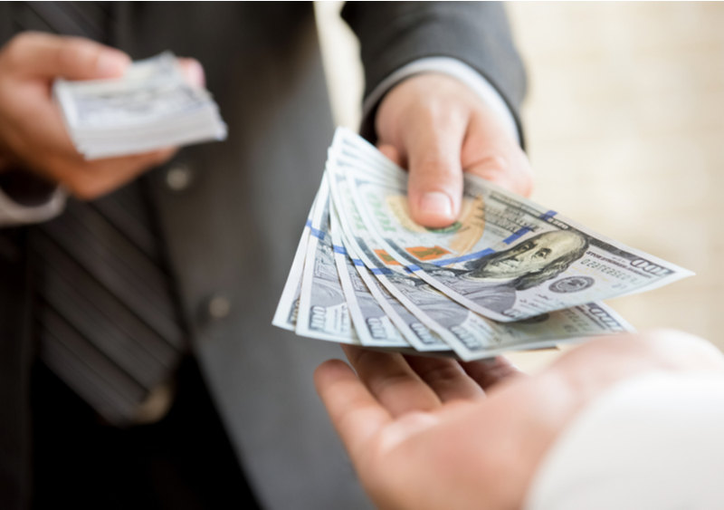

Accounting –
Customer Deposits

Slide 3
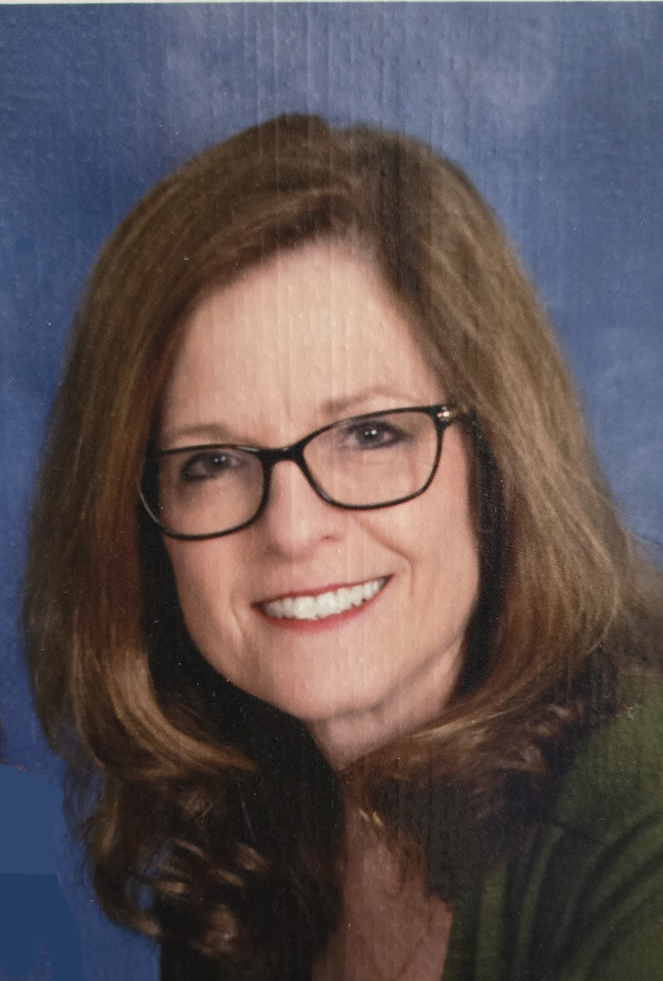

Laura Wickard
Implementation Manager

Slide 4
Agenda
1.
Deposit Payment Methods – Overview / Basic Setup
2.
Taking Deposits
3.
Tracking on Deposit Reports
4.
Using Deposits
5.
Recap & Training Options
Notes:
Today’s Agenda includes explaining an overview of the purpose & benefits of Standard Jobs and looking at what it takes to set them up – whether from a vendor provided option or manually created.
Next, we will walk through a few workflow options.
Then we will get to see the results of being consistent by review a report.

Slide 5

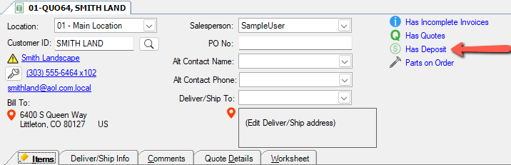
Deposit (Cust Down Payment) Overview
Tracked with Customer ID
Monitored with Deposit Reports
Point of Sale Indicator – Has Deposit

Slide 6
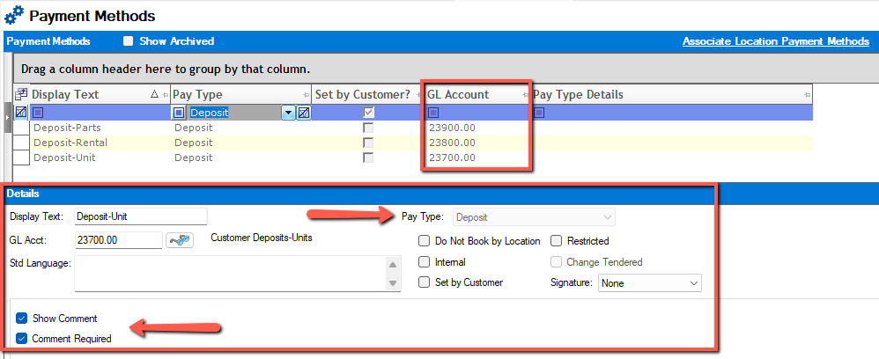
Deposit Payment Method Setup
Notes:
Deposit Payment Method is associated to a Liability Account because we OWE the customer a product.
You have the option to require a Comment when this payment method is used – both taking & using the deposit.
** I highly recommend requiring a comment for Unit Deposits at least.

Slide 7
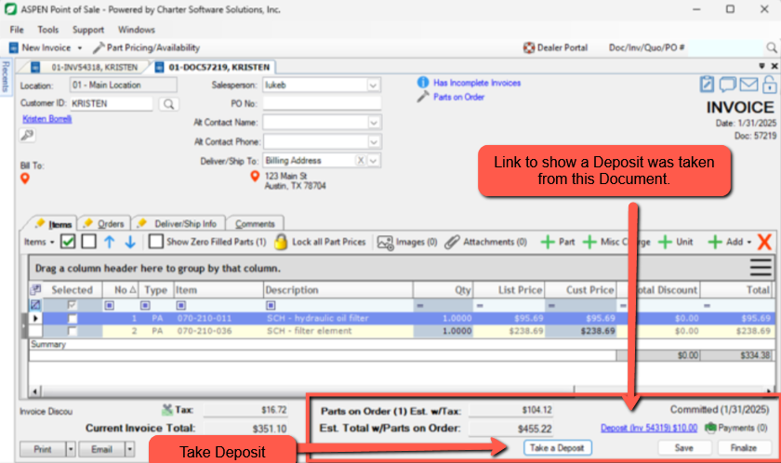
Taking a Deposit – Just Got Easier!
New Button !!!
Parts On Orders
Unit Sales – Down Pymt
Costly Service Repair
Simplified Process
Same Results
New link for Deposit Taken

Slide 8
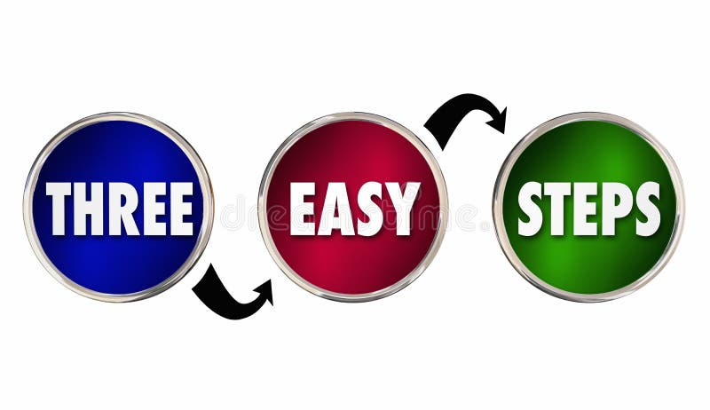
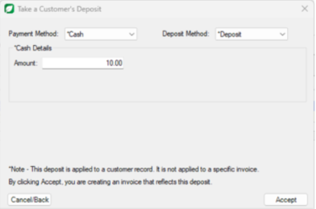
Take a Customer’s Deposit
Select Payment Method
Select Deposit Method
Enter Amount / Accept

Slide 9
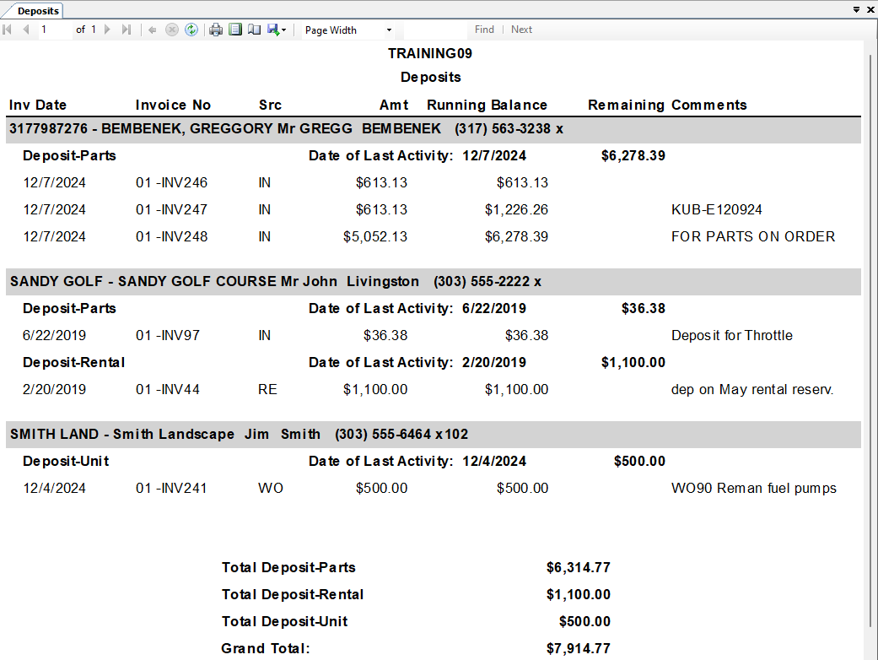
Tracking Deposits
Comments Help
to Identify

Slide 10
LIVE ASPEN !
Using Deposits
Notes:
Now that I have explained the setup and taking a Deposit - let’s pop into Live Aspen to review that and then we will also USE the Deposit again our purchase.

Slide 11

Let’s Review
Deposit Overview & Payment Method Setup
Taking Deposits – Using our new Take Deposit button.
Tracking Deposits
Using Deposits

Slide 12
Questions ?
Use our Lab – Contact us about individual training needs!

Slide 13
Thank You!

Slide 14



2025 User Conference
Learn & Grow at our User Conference
in Jacksonville!
February 10 - 12th, 2025
Jacksonville, Florida

