Slide 1
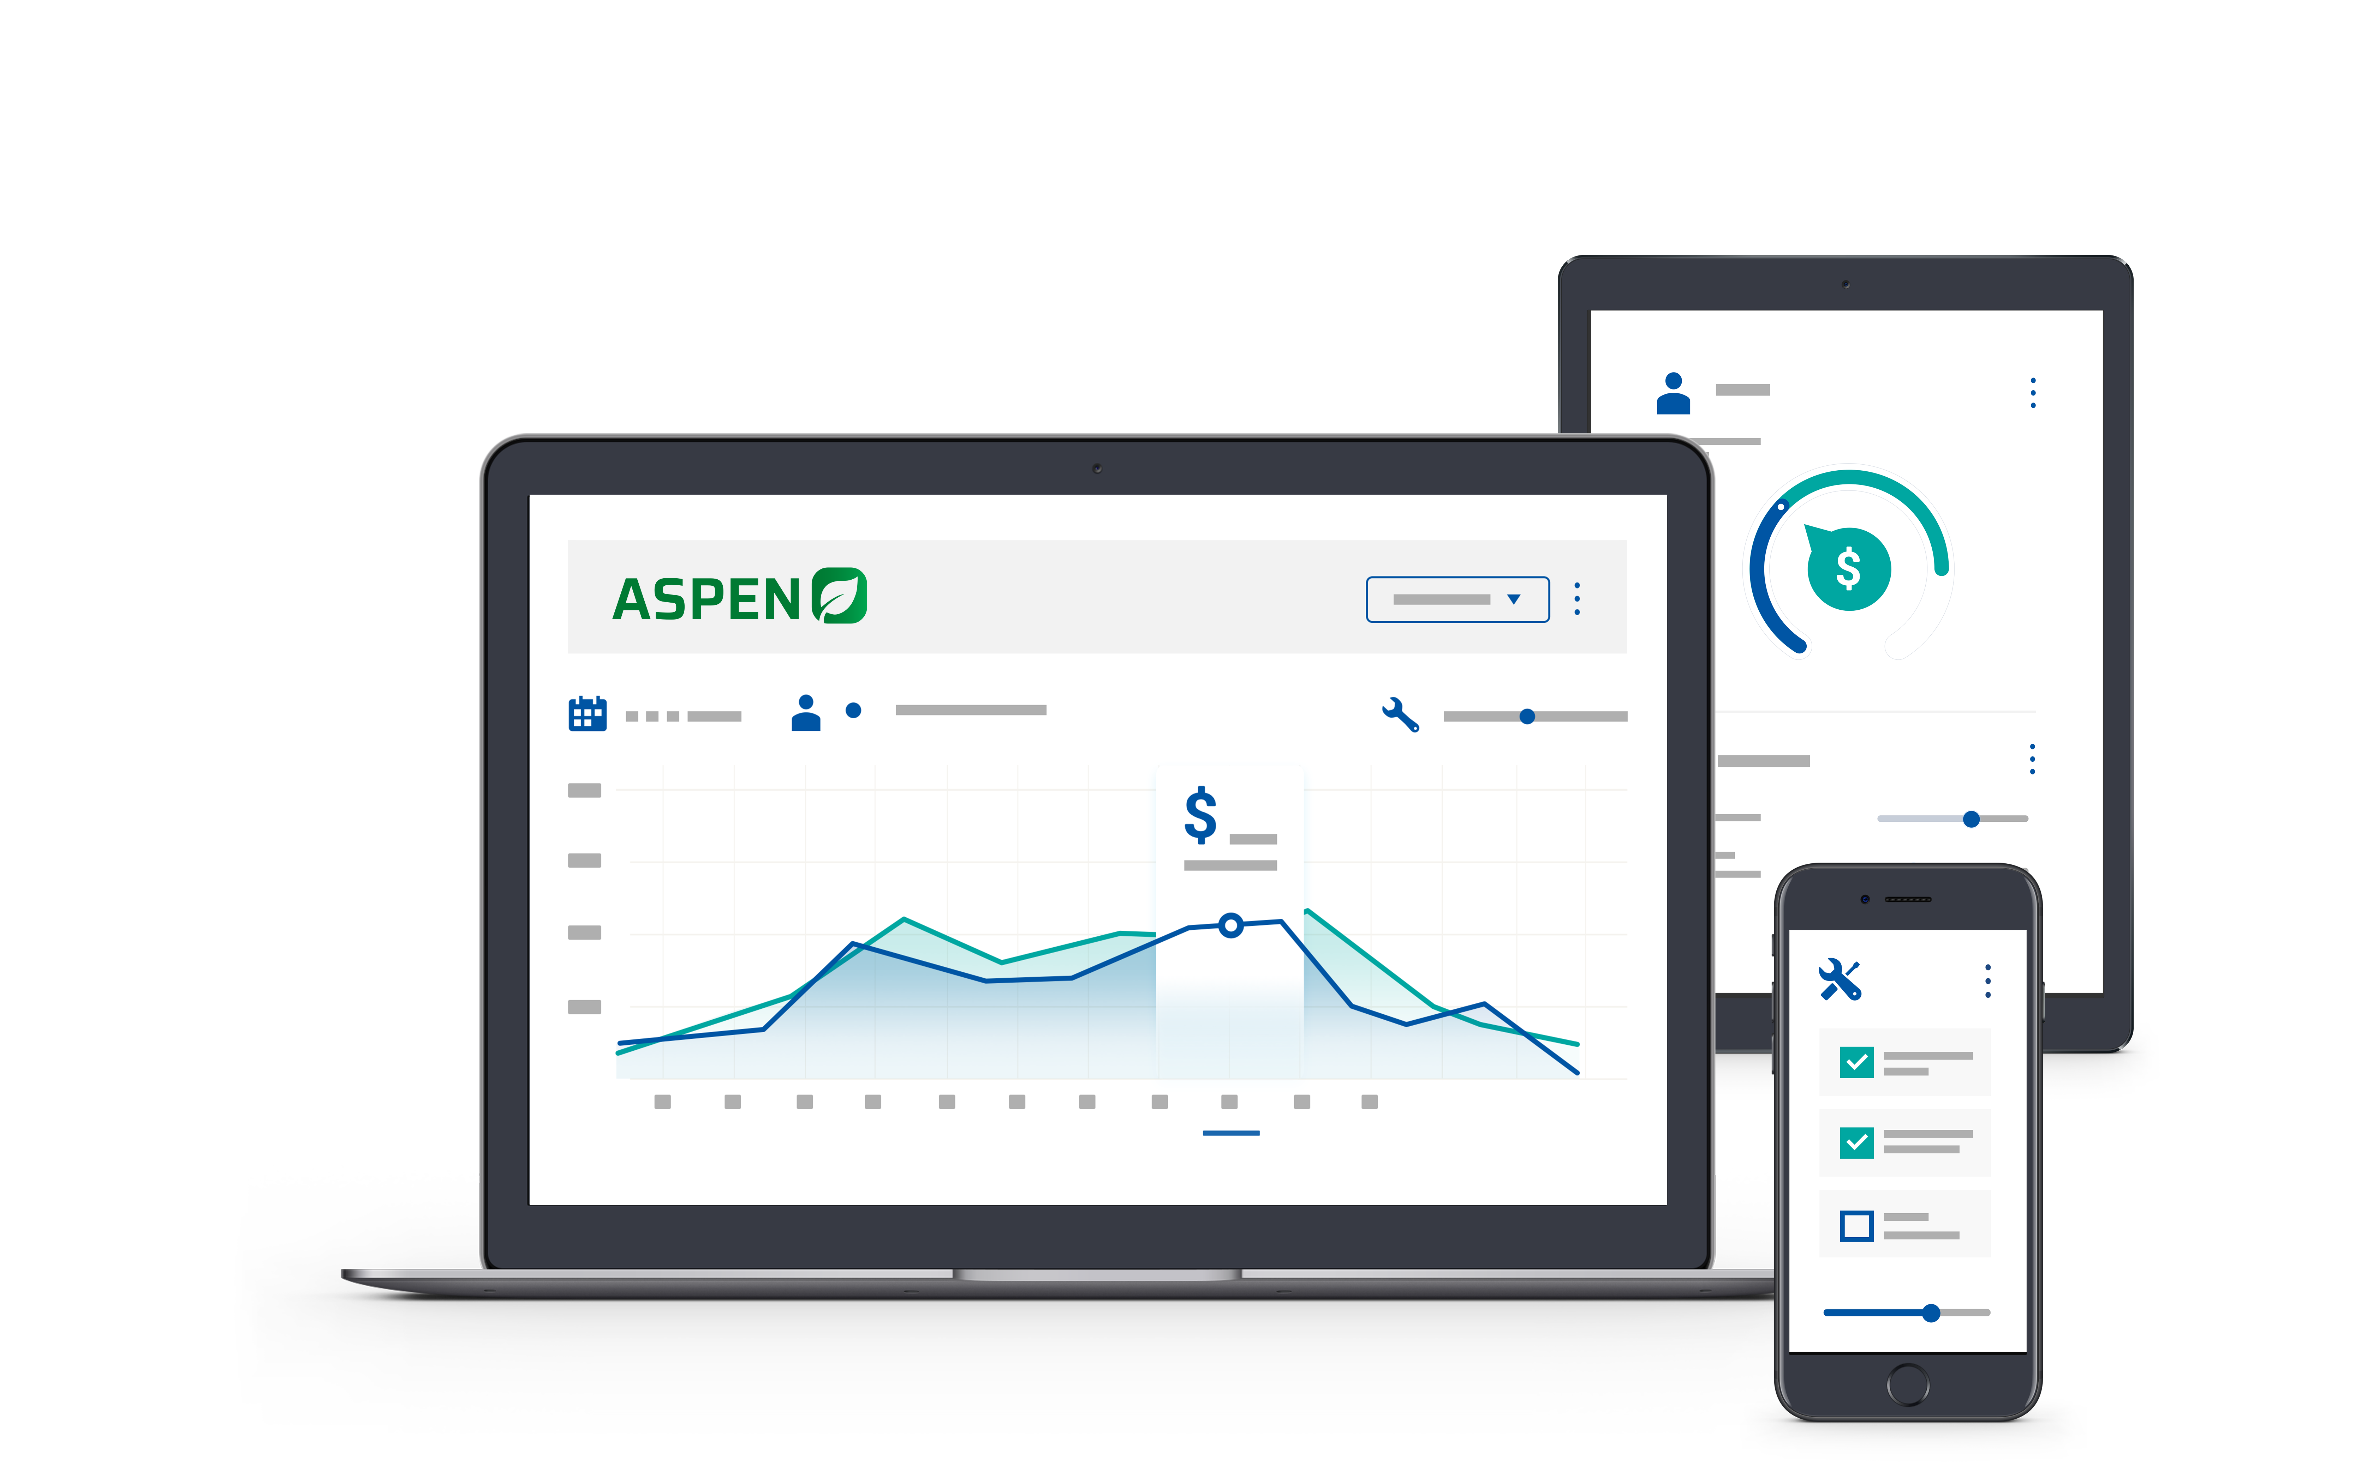


2025 User Conference
Learn & Grow at our User Conference
in Jacksonville!
February 10 - 12th, 2025
Jacksonville, Florida

Slide 2


Service Efficiency

Slide 3


Laura Wickard
Implementation Manager

Slide 4
Agenda
1.
System Settings Impact on Efficiency Reports
2.
Importance of Tracking 100% of Time
3.
Clocking Options
4.
Reviewing & Adjusting Work Orders
5.
Review the Results w/ Tech Performance Reports
Notes:
Today’s Agenda includes explaining an overview of the purpose & benefits of Standard Jobs and looking at what it takes to set them up – whether from a vendor provided option or manually created.
Next, we will walk through a few workflow options.
Then we will get to see the results of being consistent by review a report.

Slide 5

Increase Efficiency – Increase Profitability
What you track is IMPORTANT
  Labor Hours – 100 %
  Efficient Workflow
    Shop Layout
    Providing Computer or AIM Access
    Tracking Work Order Status
    Timely Review / Finalize Process
  Labor Rates – Customer / Internal
Notes:
Today we are going to focus on Labor Hours

Slide 6
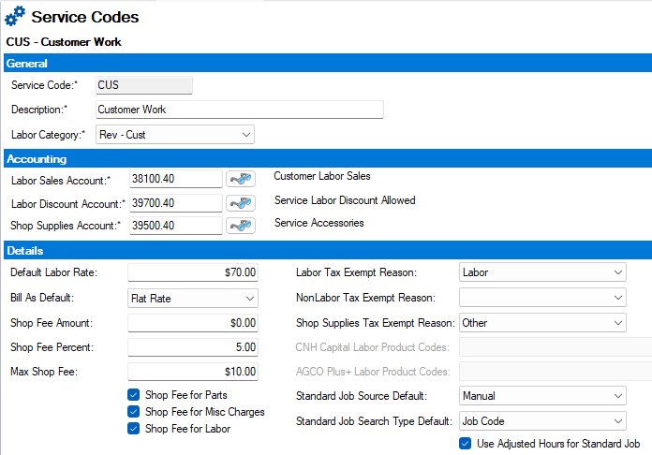

Service Code Setup
Most Powerful Tool
Identify Rev vs Non-Rev
Notes:
Today we are going to focus on Labor Hours

Slide 7
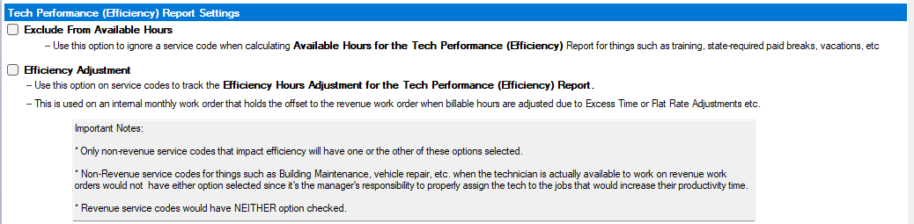
Tech Performance (Efficiency) Report Settings
Exclude from Available Hours
Efficiency Adjustment
Notes:
Today we are going to focus on Labor Hours

Slide 8
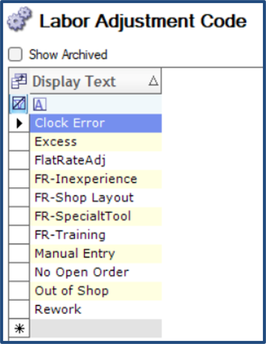
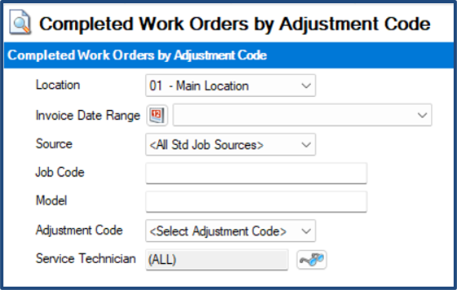
Labor Adjustment Codes
Customizable
Part of Report Criteria
Notes:
Today we are going to focus on Labor Hours

Slide 9

Clocking Options
  Clock Within Aspen
    You have to Login
  Clock from Desktop Icon
    You must use a computer
  Clock using AIM
    Remote Access
    Cell Phone
    Tablet or Ipad
    Apple Device
  Clock using TargetMobile
Notes:
Today we are going to focus on Labor Hours

Slide 10
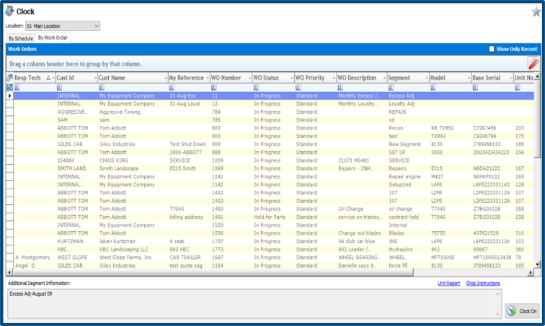
Clock within ASPEN
Notes:
Today we are going to focus on Labor Hours

Slide 11
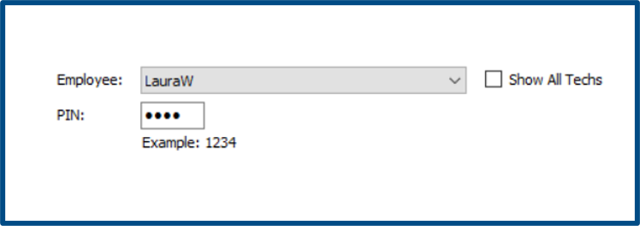
Clock from Desktop Icon
Stand Alone Icon
Multiple Users
Won’t Timeout
Notes:
Today we are going to focus on Labor Hours

Slide 12
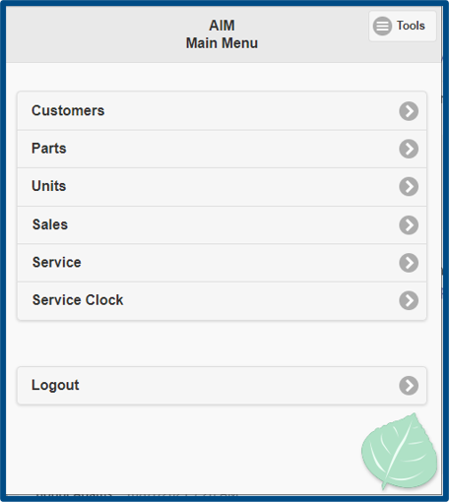
Clock Using AIM
  Remote Access to Aspen
    Cell Phone
    Tablet or IPad
    Works on Apple Devices
    AIM on your Computer
Notes:
Today we are going to focus on Labor Hours

Slide 13
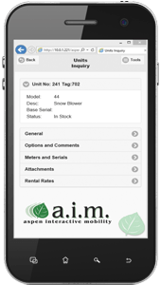


Aspen AIM & TargetCRM (Web and Mobile)
Aspen Mobile App
Target Mobile – Direct link to Aspen

Slide 14
Review & Adjust Work Orders
  Reviewing work orders
      WO Selection Screen
      WO Entry
      Control O for Fast Access
  Adjusting Work Orders
      Adjusting Billable Hours
      Transferring Parts & Segments
      Converting a POS Doc to a Work Order
LIVE ASPEN !
Notes:
Today we are going to focus on Labor Hours

Slide 15
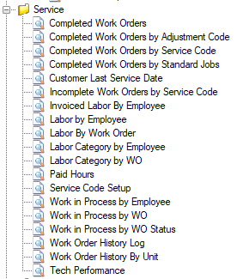

Service Reports
Widget Report for Open WO
Parts on Order Widget Report
Labor by Employee
Completed Work Order by Adjustment Code
Labor Category by Employee
Invoiced Labor by Employee
Tech Performance

Slide 16
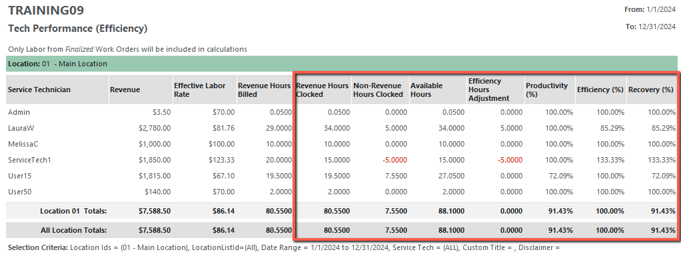
Tech Performance Report

Slide 17
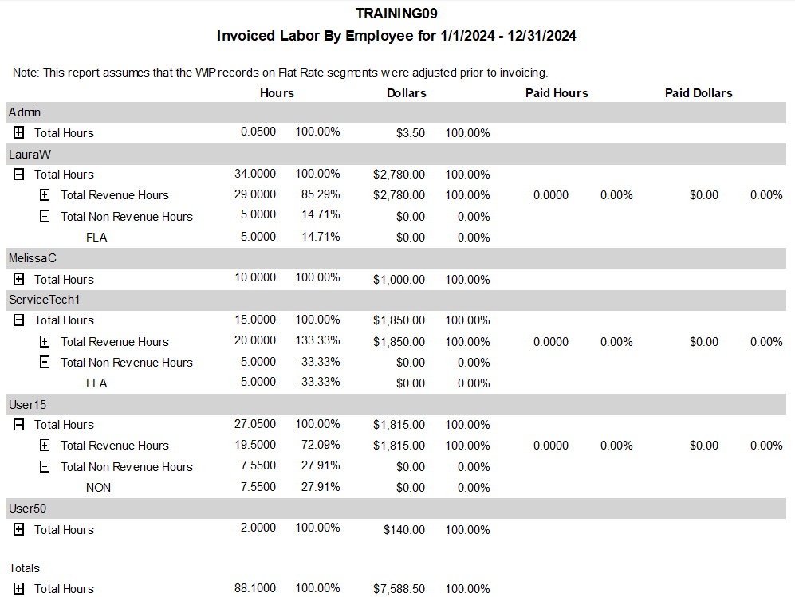

Slide 18

Potential Gross Profit Margin
  Sales Dept - 4% TO 25%
  Parts Dept - 25 to 40%
  Service Dept – 70% or More
    $25/hr. Wage
    $90/hr. Labor Rate
    $65/hr. Gross Profit
    73% GP%
Minor Improvements in Billable Time = $$$ to Bottom Line

Slide 19

Let’s Review
Reviewed Setup Requirements for Tech Efficiency
Tracking 100% of Time through Clocking
Record Adjustments to Track Efficiency
Reports Show the Results

Slide 20
Questions ?

Slide 21
Thank You!

Slide 22



2025 User Conference
Learn & Grow at our User Conference
in Jacksonville!
February 10 - 12th, 2025
Jacksonville, Florida

