Slide 1



2025 User Conference
Learn & Grow at our User Conference
in Jacksonville!
February 10 - 12th, 2025
Jacksonville, Florida

Slide 2


Receiving
Equipment
How to Reduce Errors
& Save Time

Slide 3


Laura Wickard
Implementation Manager

Slide 4
Agenda
1.
Setup Needs to Streamline Unit Receipt Process
2.
Update multiple fields on multiple unit lines on one Unit Receipt – 1 Post / Updates All Units
3.
Receipting Options – Create Multiple Vouchers / Create Unit List
4.
Posted Voucher add Cost to Units
5.
Adding Units without Unit Orders
Notes:
Today’s Agenda includes explaining an overview of the purpose & benefits of Standard Jobs and looking at what it takes to set them up – whether from a vendor provided option or manually created.
Next, we will walk through a few workflow options.
Then we will get to see the results of being consistent by review a report.

Slide 5

Quoting Template Benefits
Holds Unit Details for Header
Contains Base Cost - Retail - Margin %
Stores All Options w/ Costs
Default Options to Print on
Quote & Invoice
Notes:
If you attended Melissa’s Quoting Class, she explained the benefit of using Quoting Templates to quickly add unit lines to Unit Quotes

Slide 6
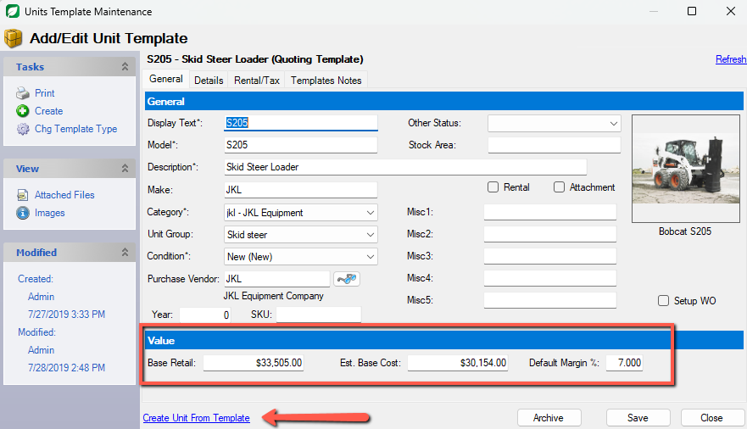
Quoting Template
Notes:
You can have your Base Retail and Est. Base Cost on the Template, which becomes part of the Unit Quote calculations, but then that is what also controls the COST that gets defaulted on the Draft Voucher that gets created from a Posted Unit Receipt.

Slide 7
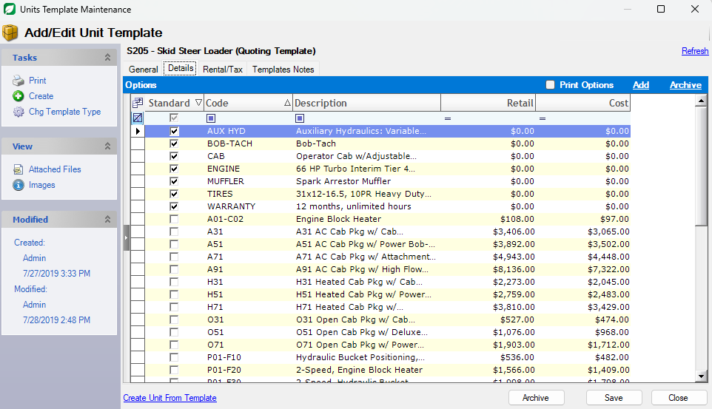
Unit Options
Notes:
You can also store Options what include both Retail and Cost so you can select which options you want on the units being ordered.

Slide 8
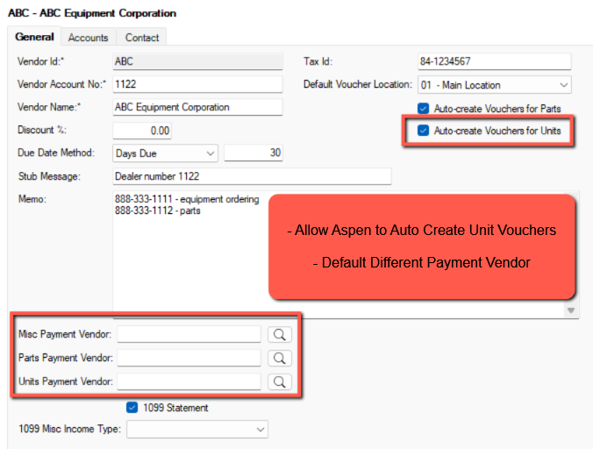
Vendor Setup
Auto Create Vouchers
Select Default
Payment Vendor
NOTE: Liability account is
determined by Purchase
Vendor & Voucher Type
Notes:
As far as the Vendor record goes, this is where you determine if you want Aspen to automatically create a Unit Voucher.
NOTE: If multiple units are on one receipt, selecting the Auto create vouchers will create 1 voucher for each unit.
You also have the option to select a different Payment Vendor if needed, however, the liability account is determined by the Purchase Vendor & Voucher Type.

Slide 9
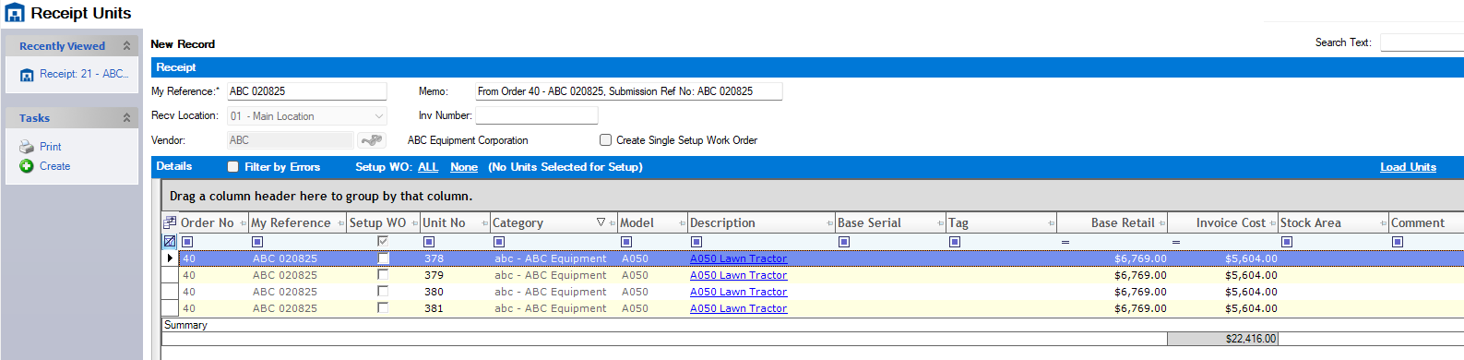
Receipt Unit
Add Serial Numbers – Tag – Costs on the grid to update ALL Units

Slide 10
Unit Vouchers
Draft Voucher can be created from Posted Receipt
Associated with Unit Record
Does not add Cost until Posted
Draft or Posted is Visible from Unit Record
Paid or Unpaid Report from Unit Record

Slide 11
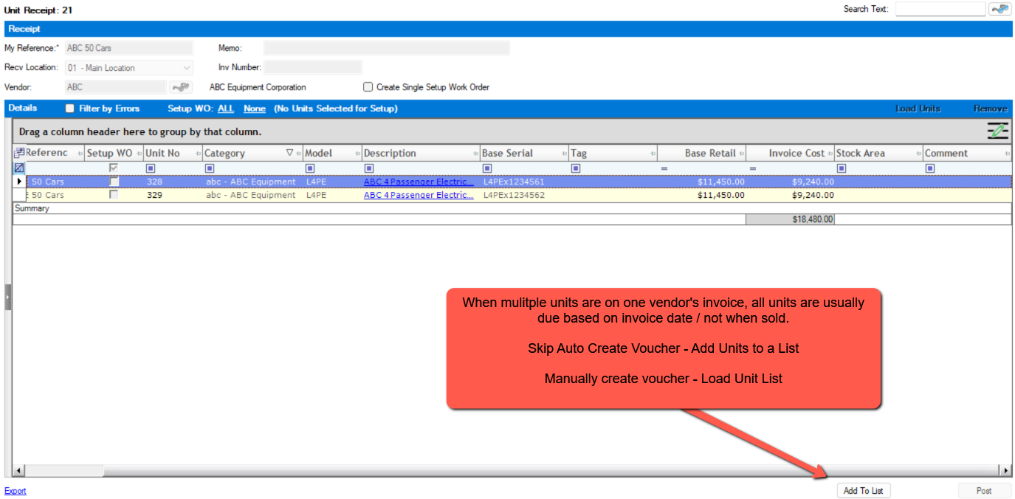
Receipt Unit – Don’t Auto Create Voucher
Create a Unit List
Live Aspen !

Slide 12
Create Unit while Creating Voucher
Skip Unit Order
Start on Voucher
Create Unit while adding Unit Line – Use Unit Templates
Leave Unit Cost Group blank for Base Cost
How to use Memo Amount Column

Slide 13

Report Options
Unpaid Unit Vouchers
Units Listing with Owed Amounts
Unpaid Vouchers on Sold Units
Voucher Selection Screen as Reporting Tool

Slide 14

Vendor Setup & Quote Templates to Streamline Workflow
Update all Unit lines from Unit Receipt Screen
Posting Vouchers add Cost to Units
Manually Create Voucher & Unit
Unit Payables Report Options
Let’s Review

Slide 15
Questions ?

Slide 16
Thank You!

Slide 17



2025 User Conference
Learn & Grow at our User Conference
in Jacksonville!
February 10 - 12th, 2025
Jacksonville, Florida

