Slide 1
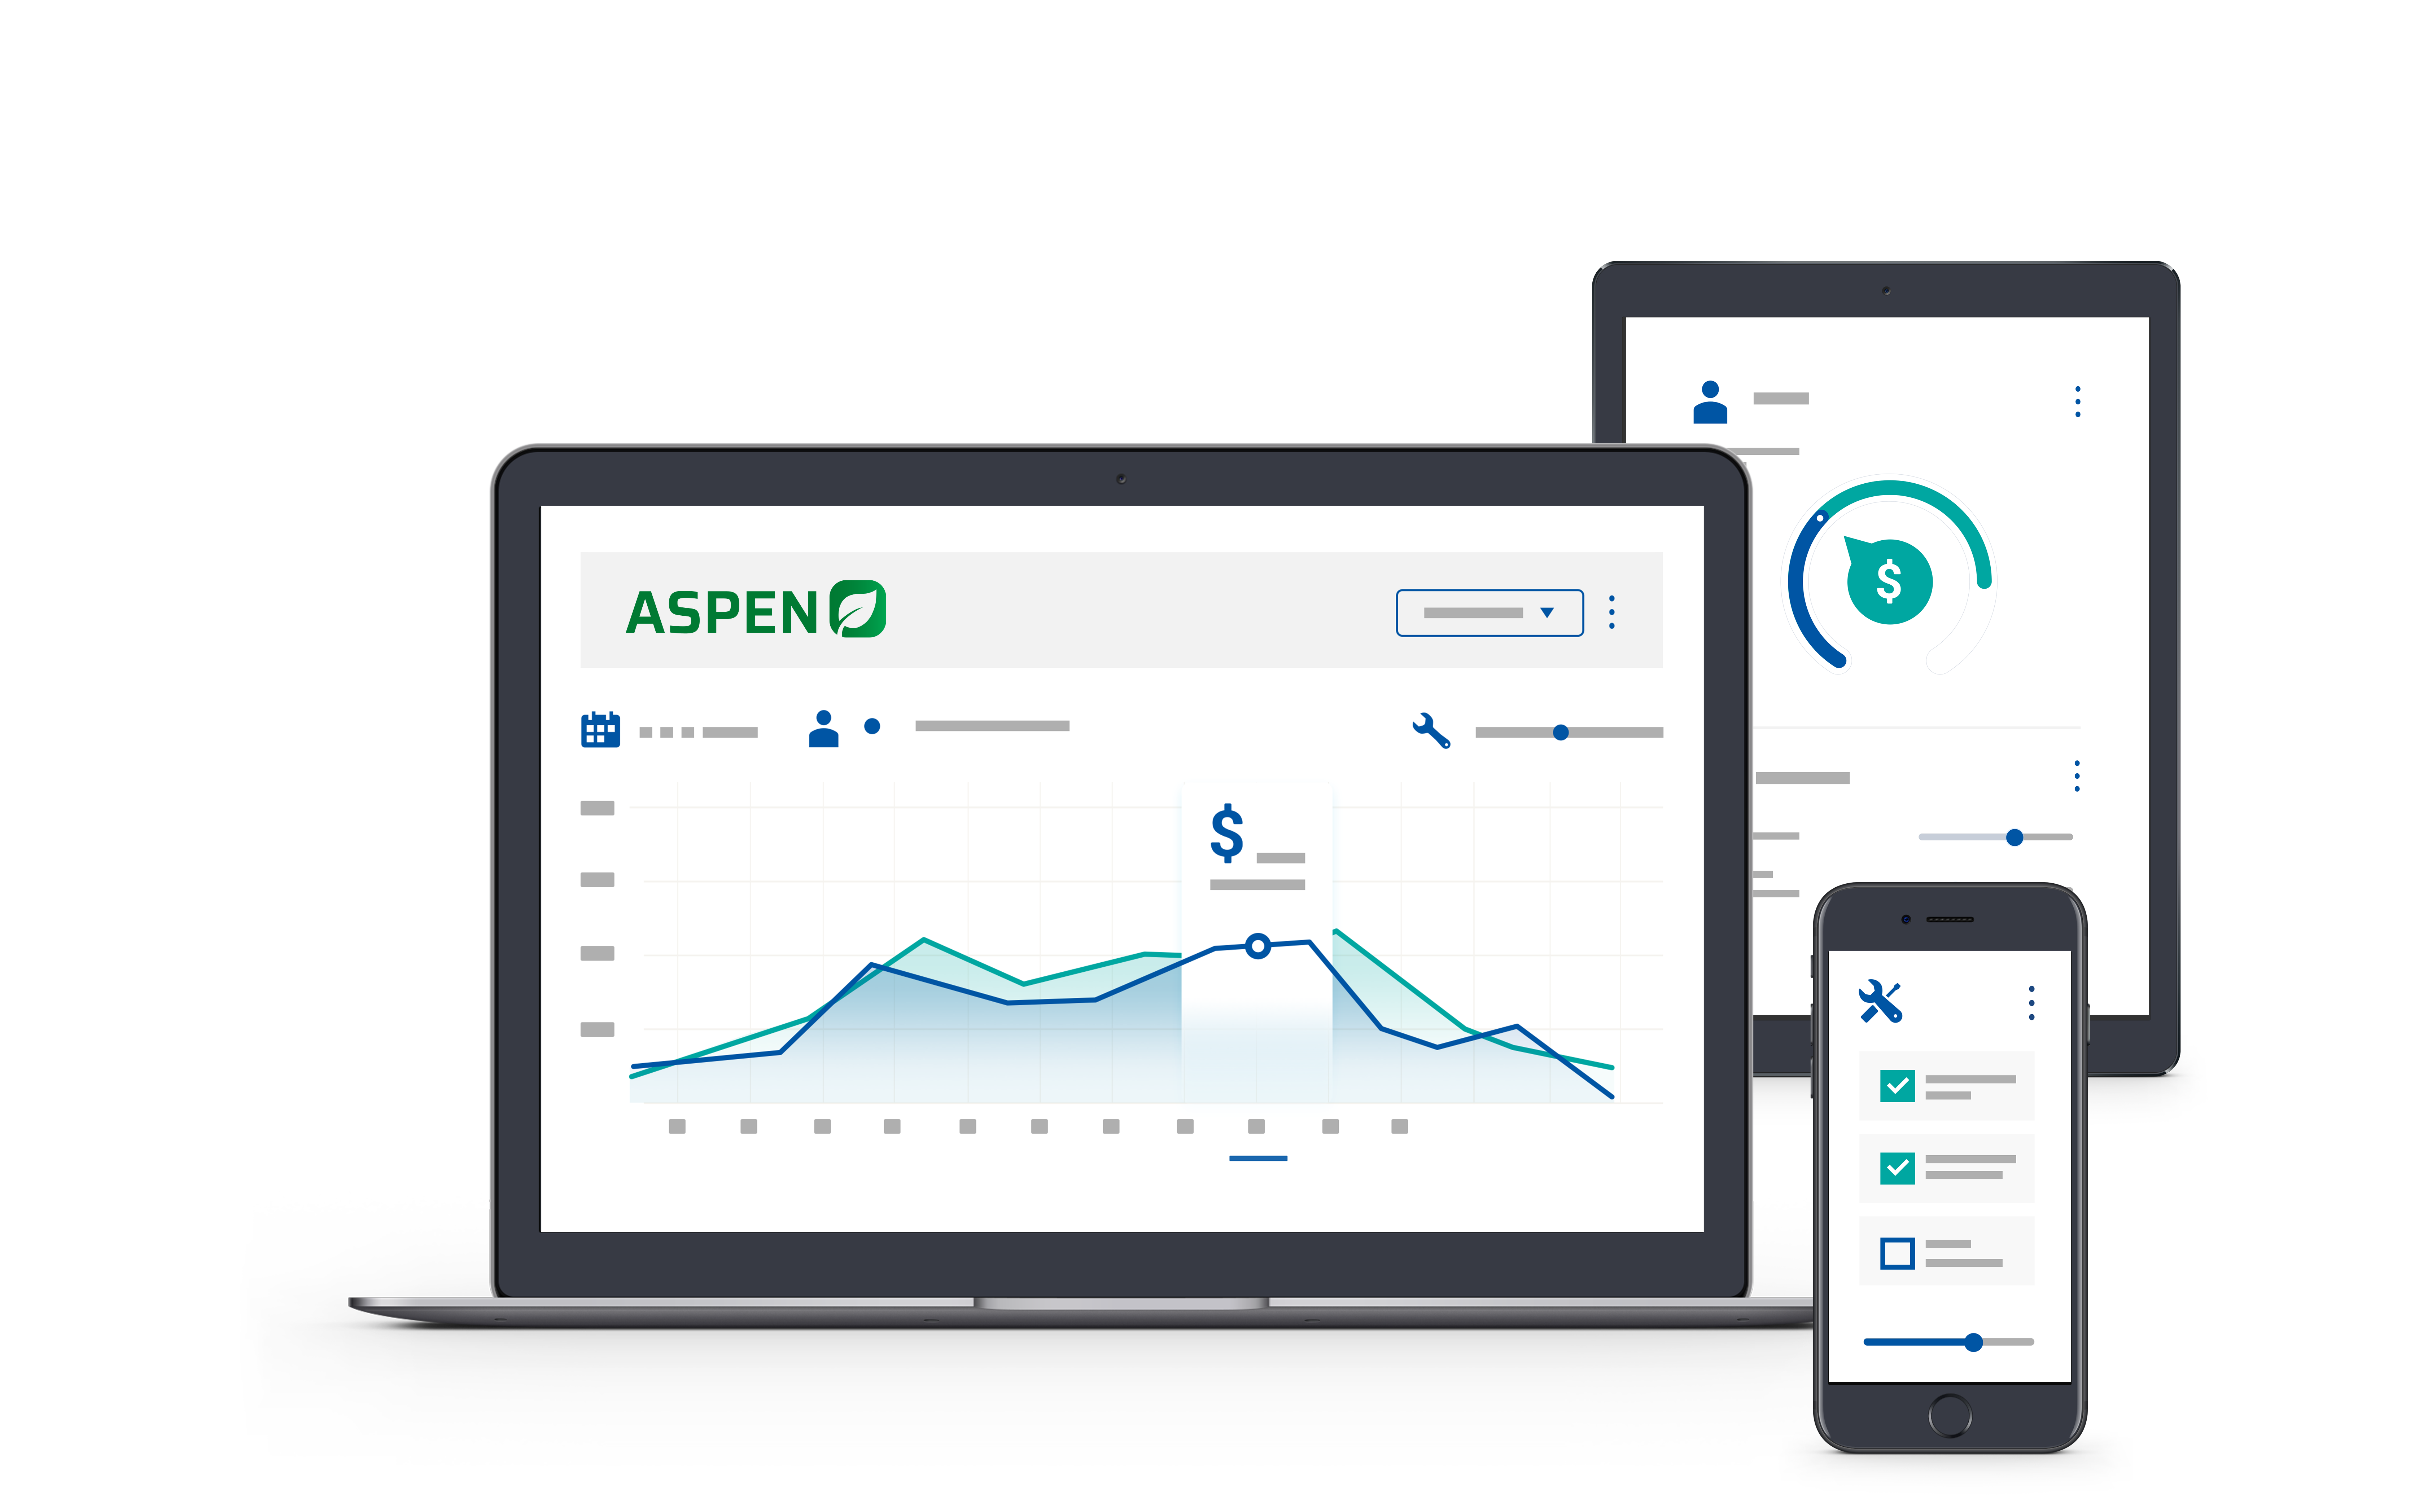


2025 User Conference
Learn & Grow at our User Conference
in Jacksonville!
February 10 - 12th, 2025
Jacksonville, Florida

Slide 2


Get Paid Faster!
Utilizing Customer Statements in Aspen

Slide 3

Melissa Cason
Implementation Specialist

Slide 4

Agenda
Customer Statements – using the newest tool available to streamline your process for maximum revenue collection
Can email statements directly from Aspen!
  No more stuffing envelopes!
  Measurable cost savings from supplies and postage
  Documented record of communication
Can include invoice copies with statements
  Streamline customer experience
  Reduce time spent re-submitting invoices to customer for payment
Can generate monthly statements for all customers, a single customer, or a Customer List at any time

Slide 5
Benefits of Emailing Customer Statements
Mailing Statements | Emailing Statements
Time Consuming | Can process multiple statements at one time
Costly | Saves cost for paper, envelopes, postage
No documentation | Each email is a logged communication
Customers may not receive in time – slow mail | Customers receive on date of statement – faster processing of payments
Can’t be updated | Can run an updated statement at any time

Slide 6

Customer Statements
  Located under the Customer Menu to the Left of the Navigation Pane
  Select the Payment Method for Statements – can select multiple or singular. These will be grouped on the statement
  Select the Statement Print Date – Today/End of Month/1st of month
  Memo – This will print on all statements. It does not replace the standard language set by the payment method. Great for holiday messages!

Slide 7

Customer Selection
Can generate statements for All Customers having open A/R items
with selected Payment Method
Can utilize search function to select single customer
Can select a Range of Customers
Can use a Customer List
Can run by Location (driven by the customer’s Default location)
Can select by Customer Class

Slide 8

Statements – Options
  Select exclusions for Credit Balances or $0.00 Balances
  Select Format:
  Statements
    Shows total due for each payment method
  Includes a Past Due Box with Aging on last page
  Consolidated Statements
    Shows Total Balance due for all Payment Methods (not itemized by term)
  Does not include Past Due Box with Aging on last page
  Choose whether to include Payment Details and/or to attach invoices
  **Note: customers having 50+ individual invoices will only receive a
  statement via email due to size and attachment restrictions by most email
  providers. However, the print option will print all invoices, regardless of number

Slide 9
Statements – Extras
Can export results to Excel
Printing will print statement and invoices
Emailing will send to all contacts set to
receive statements on the customer record
Sent statements will be logged as
Communications on the customer record
Use the statements tool to easily locate
customers with $0 or credit balances

Slide 10
Let’s Review
  Best Practices – Track claims for ALL Vendors
  Warranty Setup – Service Codes - Payment Methods - Submission Types
  Warranty Workflow – Finalize W/O when work
  Parts Pricing Options – Retail Price is Recommended
  Using Standard Jobs for Warranty Segments – Speeds up process
  Tracking & Finalizing – Warranty Request Selection Screen
  Recording Credits Received – Reconciliation Tab & Complete Claim
Emailing customer statements saves time and money
Customers receive statements promptly, which speeds up payment processing
Communications are logged, providing documentation
Valuable tool for reviewing customer accounts for credits and $0 balances

Slide 11

Q & A

Slide 12


Slide 13



2025 User Conference
Learn & Grow at our User Conference
in Jacksonville!
February 10 - 12th, 2025
Jacksonville, Florida

