Slide 1



2025 User Conference
Learn & Grow at our User Conference
in Jacksonville!
February 10 - 12th, 2025
Jacksonville, Florida

Slide 2

Quotes
Track deal economics & quote faster using ASPEN Quotes and Templates

Slide 3

Melissa Cason
Implementation Specialist

Slide 4


Agenda
1.
Creating Unit Templates
2.
Working with existing templates
3.
Using templates to improve quoting times and accuracy
4.
Utilizing the Worksheet feature on Quotes to track deal economics

Slide 5

Unit Templates
Can be created from scratch or from an existing unit
Can be Quoting Template or Unit Template
Can include all possible options for the model
Can be imported from Excel to quickly populate base unit and options on template

Slide 6
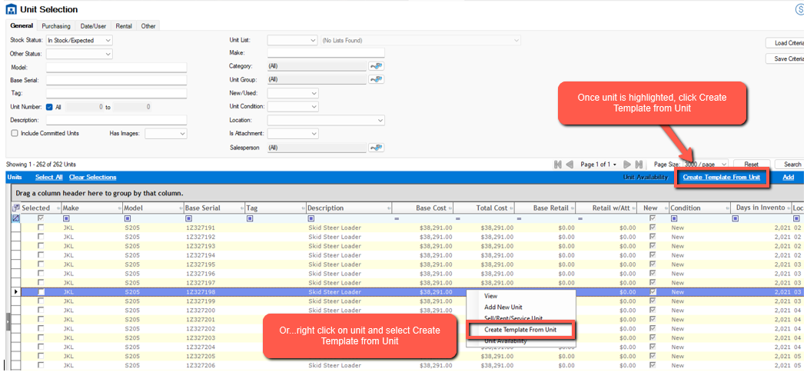
Creating Templates from Existing Units

Slide 7
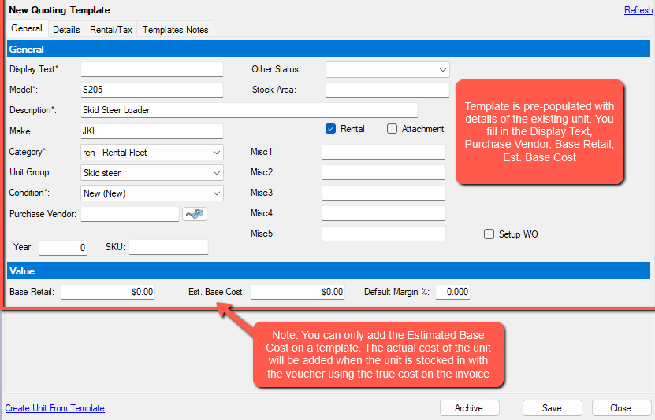
Creating Templates from Existing Units

Slide 8
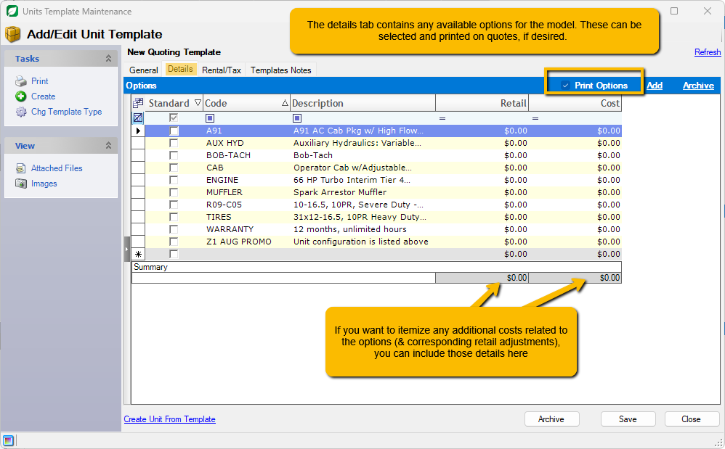
Creating Templates from Existing Units

Slide 9
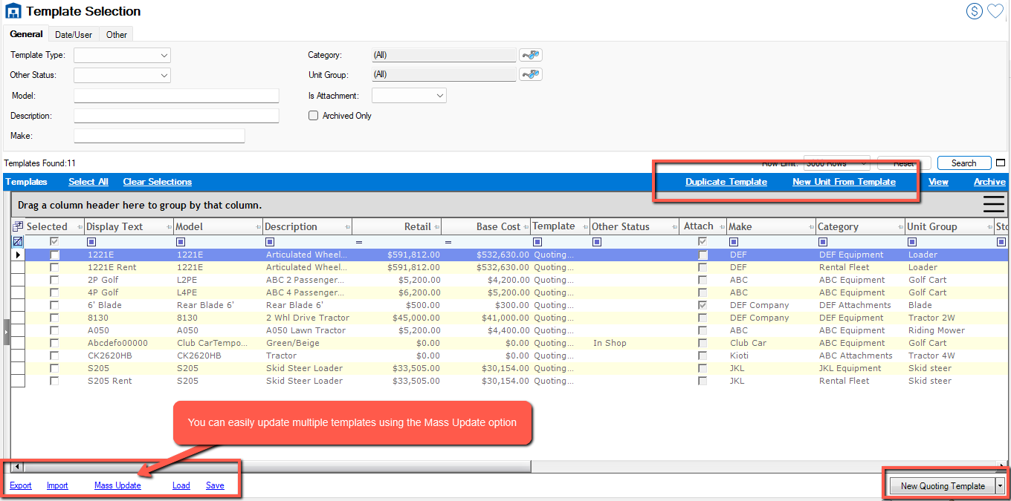
Working with existing templates

Slide 10
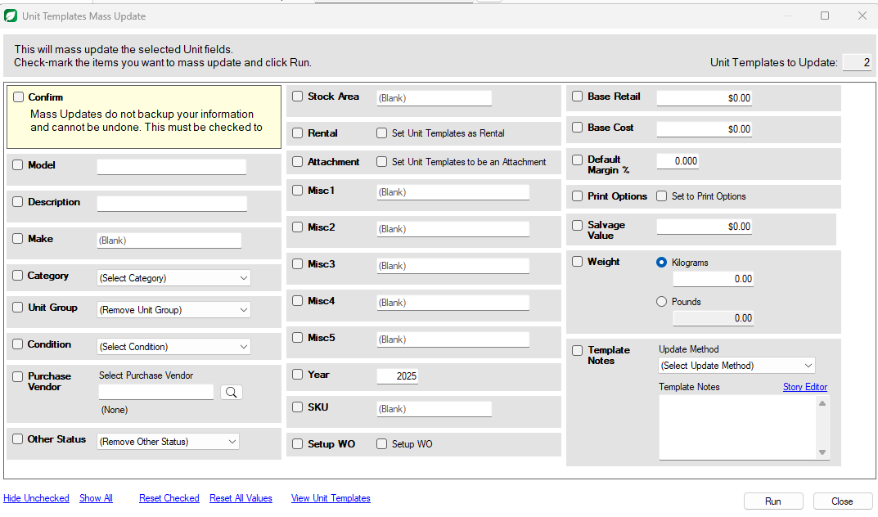
Mass Update Template Information

Slide 11
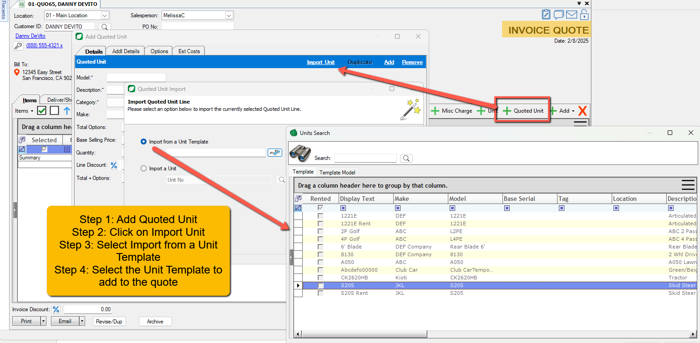
How templates assist with Quotes

Slide 12

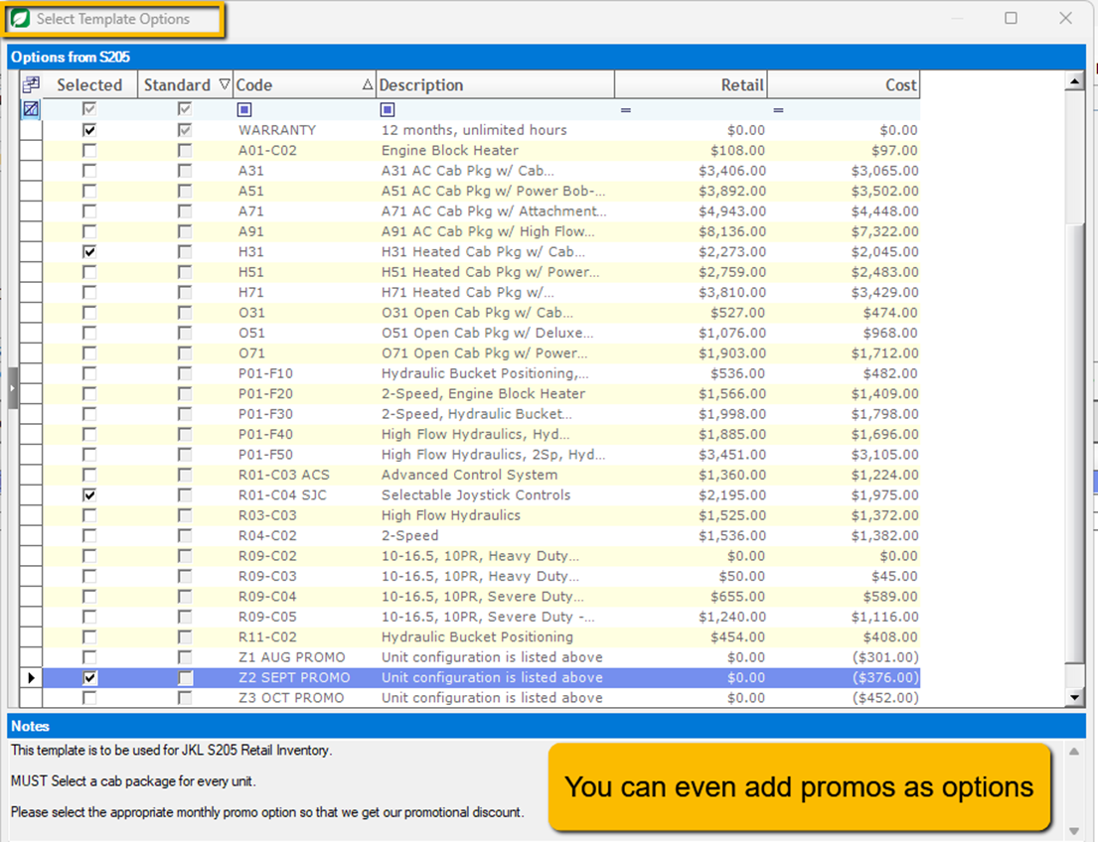
Select Options to Quote

Slide 13

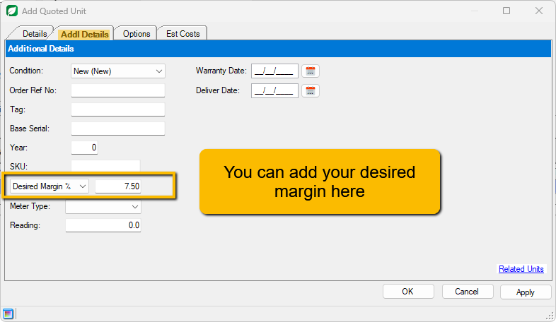
Add Details

Slide 14
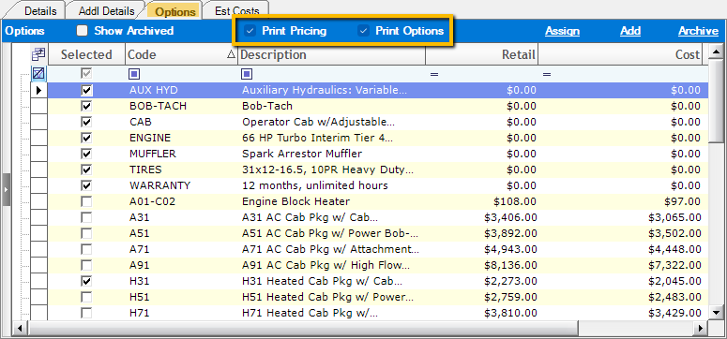
Select Options to be shown

Slide 15
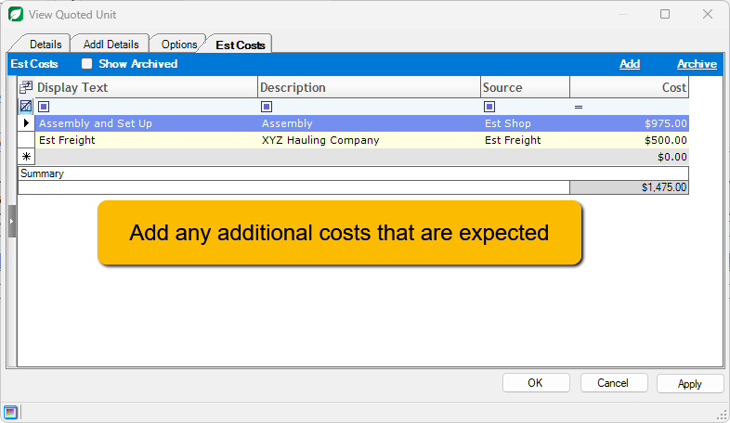
Add Cost Details

Slide 16
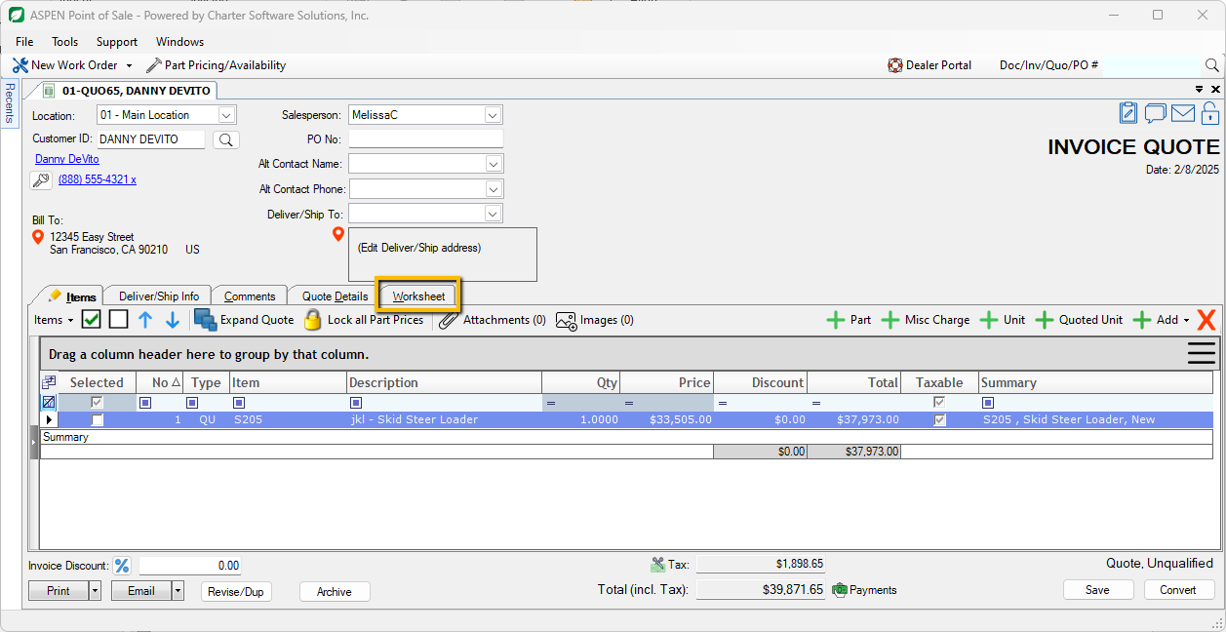
Quote Created

Slide 17
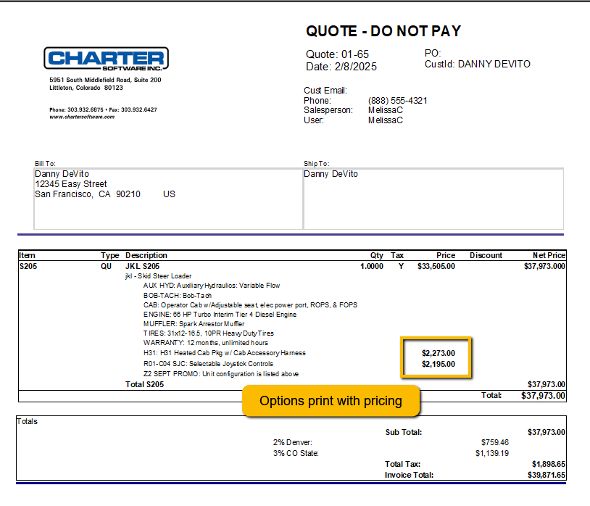
Quote Created
Using the template allowed us to quickly add the unit and adjust options
If you choose to print options but not pricing, the total retail price will reflect the total of base price plus all options
Customer cannot see our estimated costs or desired margin
Can send the pdf quote directly from Aspen to the customer
Able to print a Sales Contract directly from the quote

Slide 18
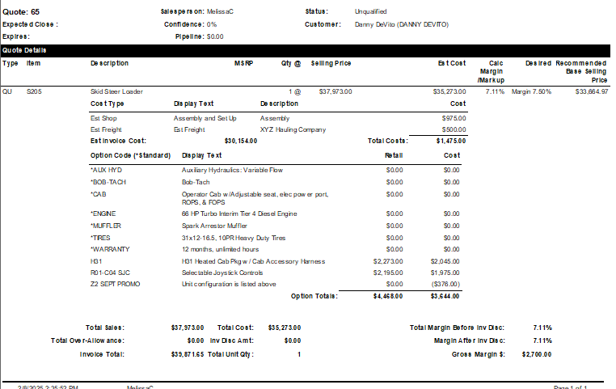
Quote Worksheet
Not customer-facing
Will account for over-allowance on trades
Updates in real time as quote adjusted
Able to be printed/saved

Slide 19

Let’s Review
  Unit Templates – contain all pertinent information for a particular model
  Templates can be created from scratch or an existing unit
  Adding a template to a quote allows consistency with options and pricing
  Using templates allows for customization of options for equipment
  Can print options and pricing or just itemized options
  Using the Worksheet function in the Quote gives a detailed breakdown of
  Margin/Markup including over-allowance and estimated costs

Slide 20
Questions?

Slide 21
Thank you!

Slide 22
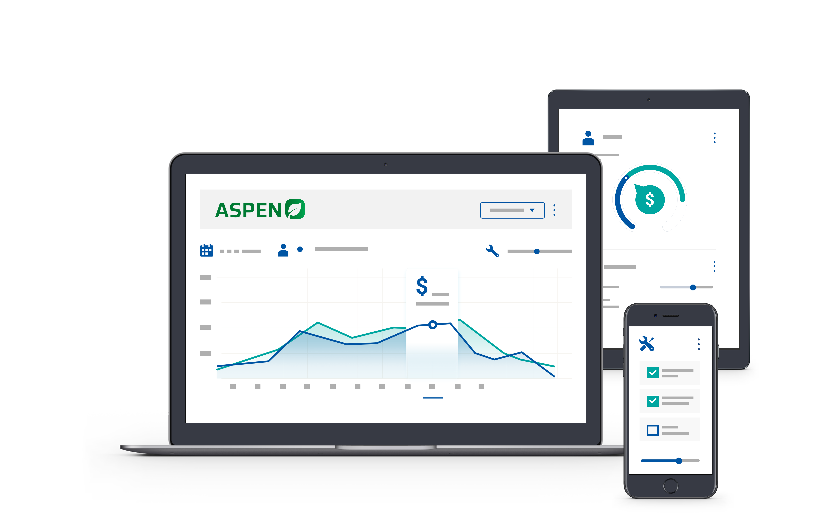


2025 User Conference
Learn & Grow at our User Conference
in Jacksonville!
February 10 - 12th, 2025
Jacksonville, Florida

