Slide 1
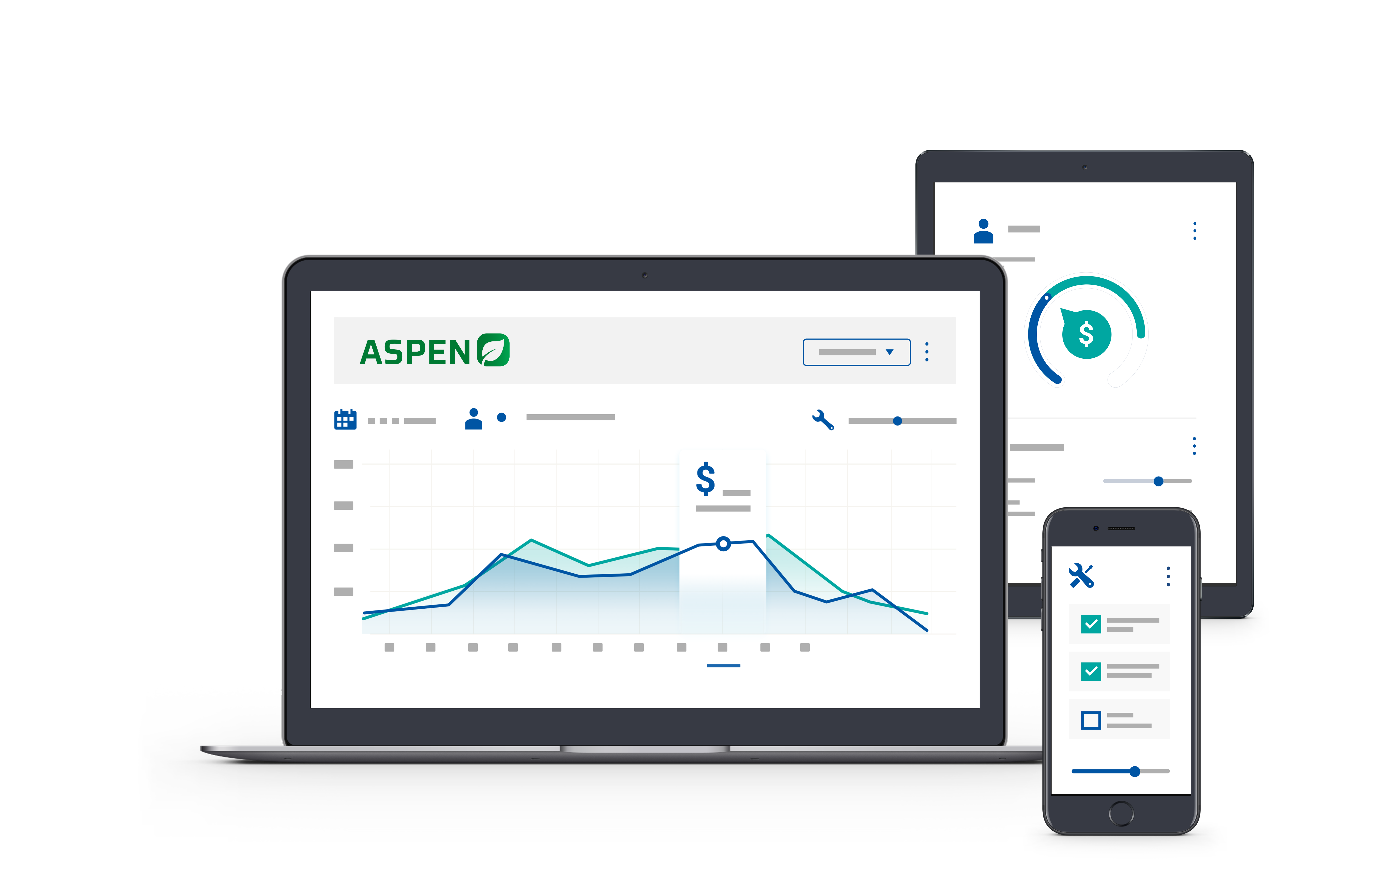


2025 User Conference
Learn & Grow at our User Conference
in Jacksonville!
February 10 - 12th, 2025
Jacksonville, Florida

Slide 2



Report Permissions
How to keep your data on a need-to-know basis

Slide 3


Melissa Cason
Implementation Specialist

Slide 4
Agenda
1.
Basic Review of Security – Users and Roles
2.
Ability to Copy User Settings
3.
Restricting Access and Permissions
4.
Effective Reports

Slide 5
Aspen Users vs Roles
Aspen Users | Aspen Roles
All employees necessary for reports, labor, sales | Consist of a grouping of permissions related to a particular role within a dealership
Username is what displays on invoices | System Roles cannot be changed
Be consistent | You can create a new role from scratch or copy an existing role to modify permissions
Usernames must be unique & cannot be changed once user created | Creating a “Role” with a specific permission is a great way to isolate a particular permission
Users cannot necessarily log into Aspen | Different levels of access: View Maintain Manage
You can review login permissions quickly by sorting | Roles & permissions can be granted by location
Users can be archived at any time

Slide 6
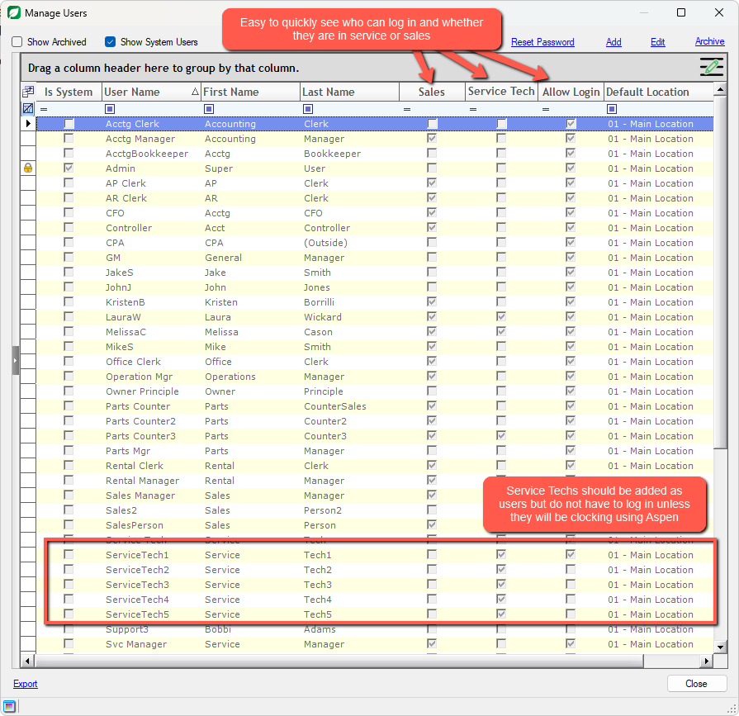
Aspen Users
Typically a username is a combo of first/last name

Slide 7
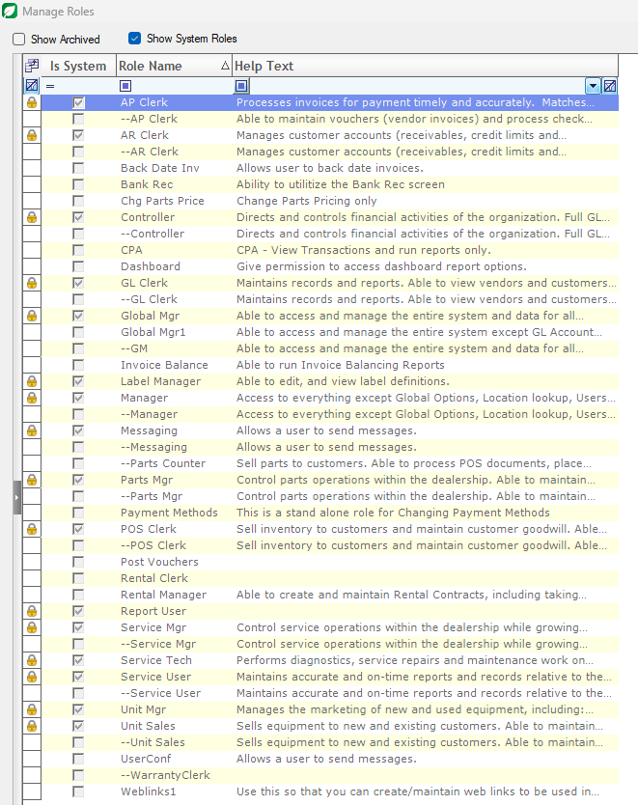

Aspen Roles
Roles are developed with primary job functions in mind
Copying a System Role will allow you to edit or update the associated permissions
Pulling out an individual permission as its own role will allow you to isolate that permission individually

Slide 8
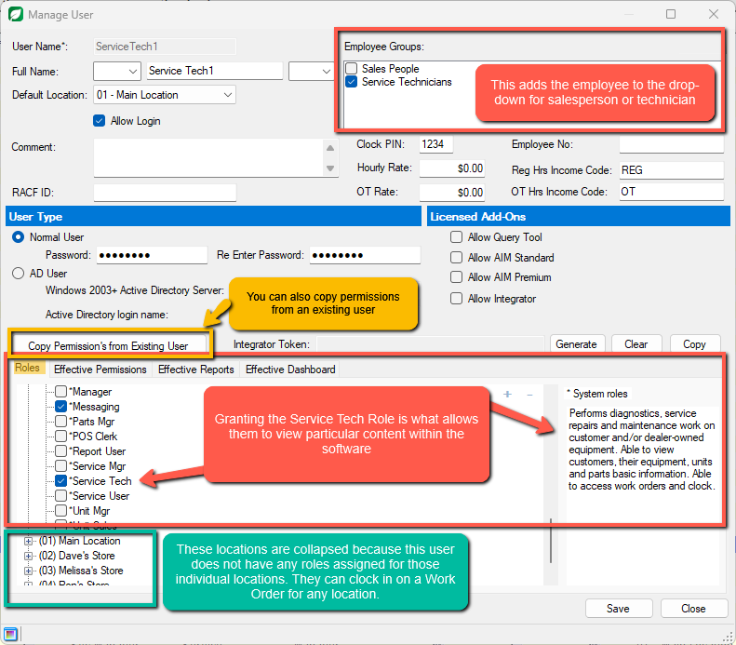


Slide 9
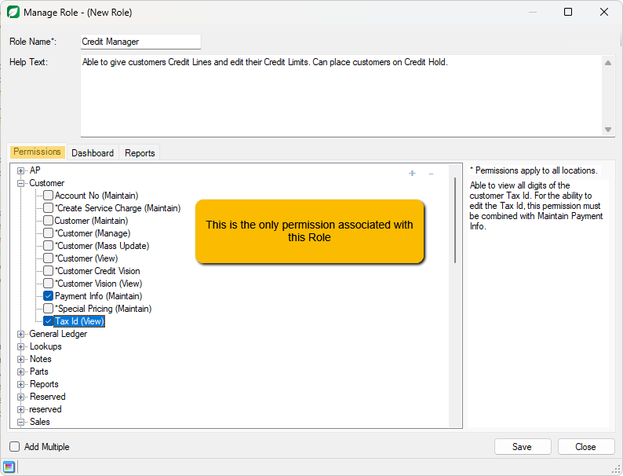
Creating isolated permissions
Helpful Permissions to Isolate Using Roles:
Credit Manager
Back Date Invoices
Customer Special Pricing
Change Parts Pricing
Messaging
Finalize Invoices or Work Orders

Slide 10
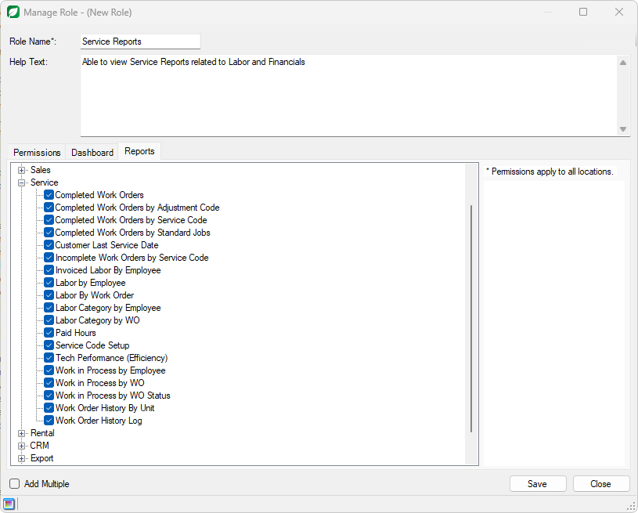
Isolating Reporting Features
Helpful Reports to Isolate Using Roles:
Financial Reports
Departmental Reports
Cross-departmental reports
Management Reports

Slide 11
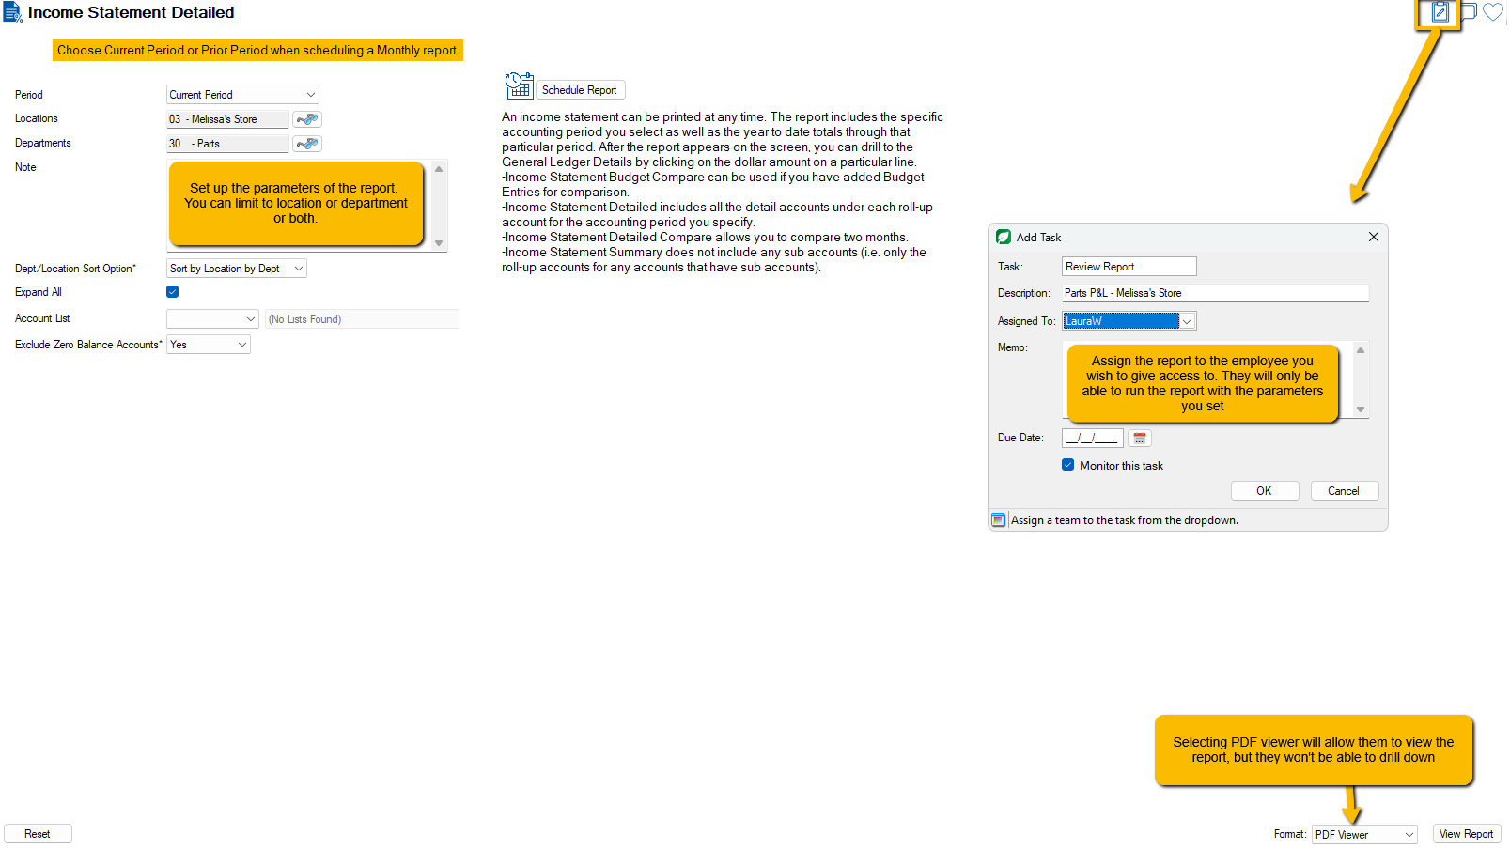
Using Tasks to limit report access

Slide 12

Let’s Review
Create Users for anyone needing to have labor applied or populate on reports – unique and consistent User Names
Roles are groups of permissions that are typically associated with primary job functions
Once you have created a set of permissions for a particular user, you can copy those permissions for a new user
You can utilize Roles to isolate a specific permission (change Credit Limits) or to give access to specific reports
If you do not want to give access to a full report, you can also utilize the Task Manager to assign a report with specific parameters to a user

Slide 13
Questions?

Slide 14
Thank you!

Slide 15



2025 User Conference
Learn & Grow at our User Conference
in Jacksonville!
February 10 - 12th, 2025
Jacksonville, Florida

Slide 16

2025 User Conference
Learn & Grow at our User Conference
in Jacksonville!
February 10 - 12th, 2025
Jacksonville, Florida

