Slide 1



2025 User Conference
Learn & Grow at our User Conference
in Jacksonville!
February 10 - 12th, 2025
Jacksonville, Florida

Slide 2


Time is Money!
Automate Your
Warranty Workflow

Slide 3

Melissa Cason
Implementation Specialist

Slide 4
Warranty Workflow - Track Reimbursement Quickly
1.
Best Practices for System-Assisted Warranty
2.
Warranty Setup
3.
Warranty Workflow
4.
Tracking and Finalizing
5.
Recording Credits

Slide 5


Best Practices
  Warranty submission type for major vendors​
  Service codes by vendor – optional​
  Finalize as soon as work is completed​
  Parts Pricing – Consultants recommend using Retail​
  WO Status to Communicate Stages​ / Task for Requested Action

Slide 6

Warranty Setup
Service Codes​
Work Order Priority​
Payment Methods​
Submission Types​

Slide 7
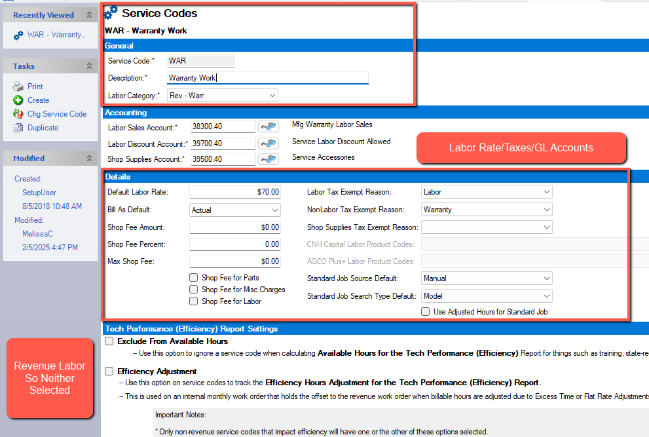
Warranty Service Code
Note: Can set up a Service Code for each vendor if reimbursement rates differ

Slide 8
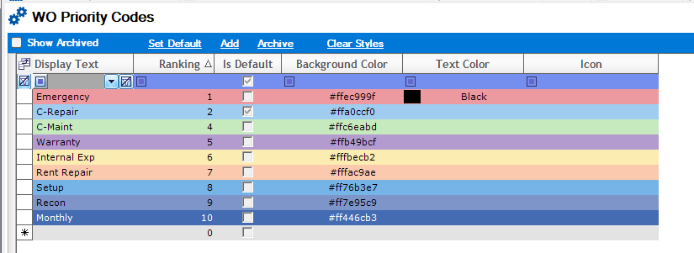
Work Order Priority Code

Slide 9
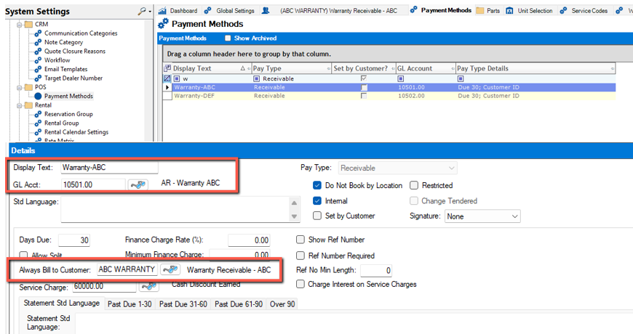
Payment Methods – Receivable Type

Slide 10
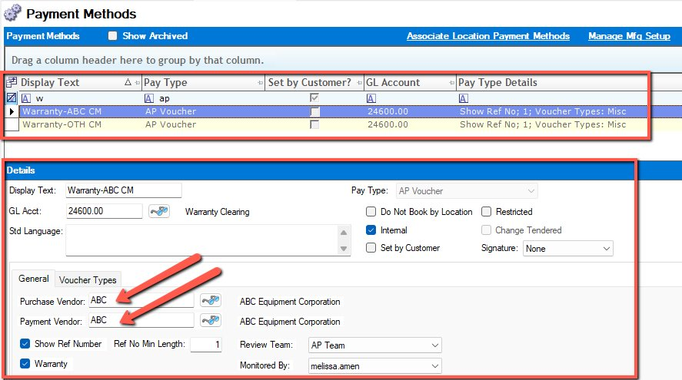
Payment Methods – AP Voucher Type

Slide 11
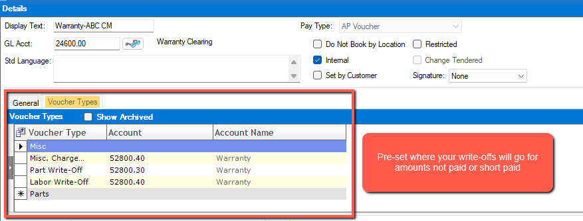
Payment Methods – AP Voucher Type

Slide 12
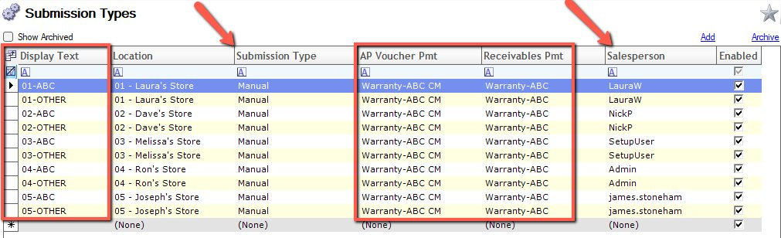
Submission Types

Slide 13
Warranty Workflow
Step 1 – Create the WO
Step 2 – Adjust Labor and Close WO
Step 4 – Track Claims
Select correct WO Priority
Claims can be tracked using Warranty Request Selection
Make labor adjustments
Warranty Credit is applied using the Claim Request
The claim request is created when clicking Accept from the Finalize Screen
Step 3 – Create Claim Request
Step 5 – Apply Credit and close claim
Select correct Warranty Submission Type
Select correct Service Code
Close the WO using the Warranty Payment Method for the particular manufacturer
You will add the claim number when you click Submit from the Claim Request
Can apply partial payment and leave open for additional payment or apply credit and close
You do not have to submit the claim at the time that the claim request is created
*Notes
When creating the claim request, you can leave in Draft status until you are ready to submit the claim
Once the Accept button is pressed, the total will move from your WIP to your Accounts Receivable

Slide 14
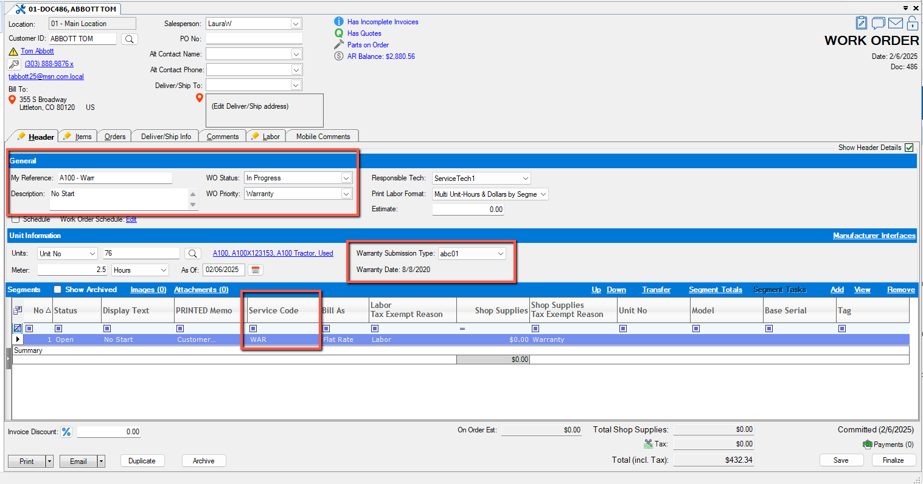
Creating the Work Order

Slide 15
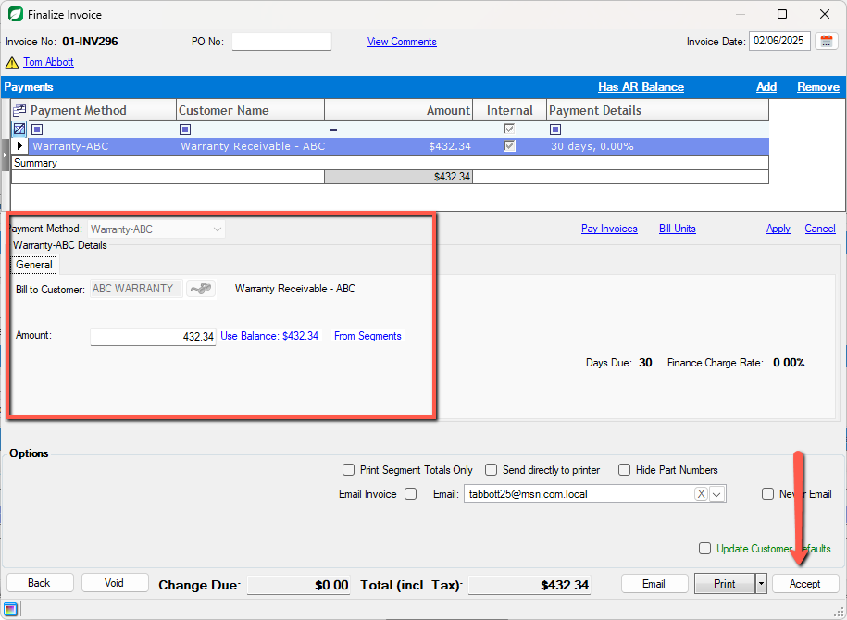
Closing the Work Order
Payment Method = Warranty
Since we set this payment method up to always bill to ABC warranty, the balance will be applied to the ABC Warranty AR Balance instead of the customer’s account.

Slide 16
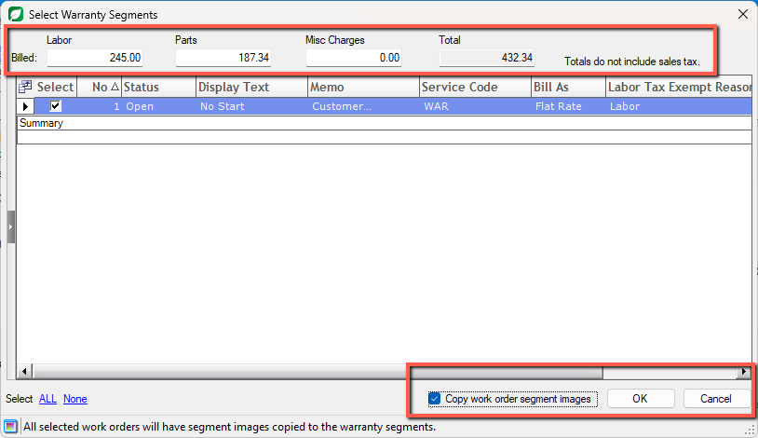
Creating the Claim Request

Slide 17
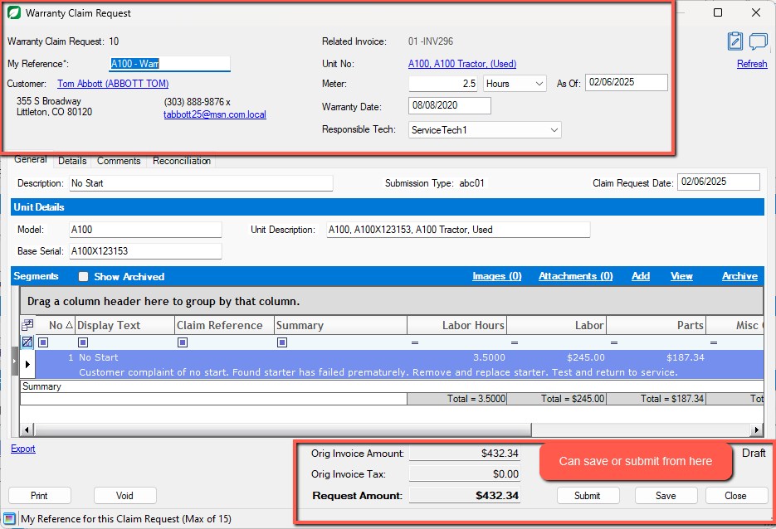
Creating the Claim Request

Slide 18
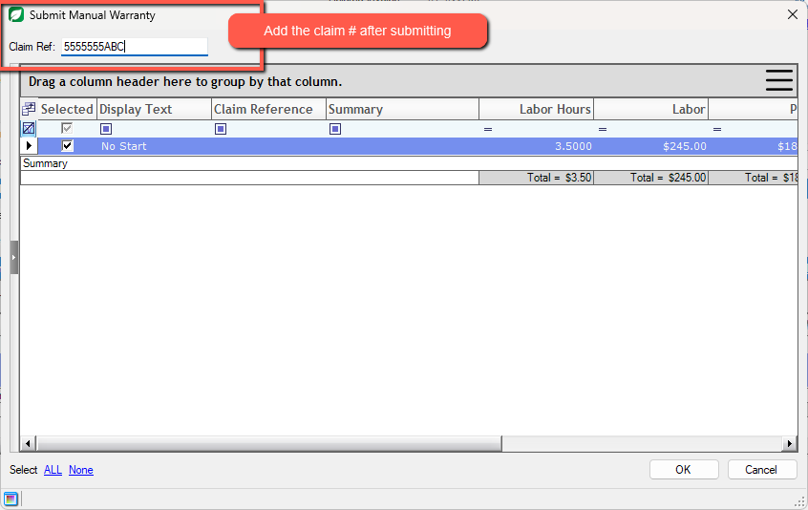
Creating the Claim Request

Slide 19
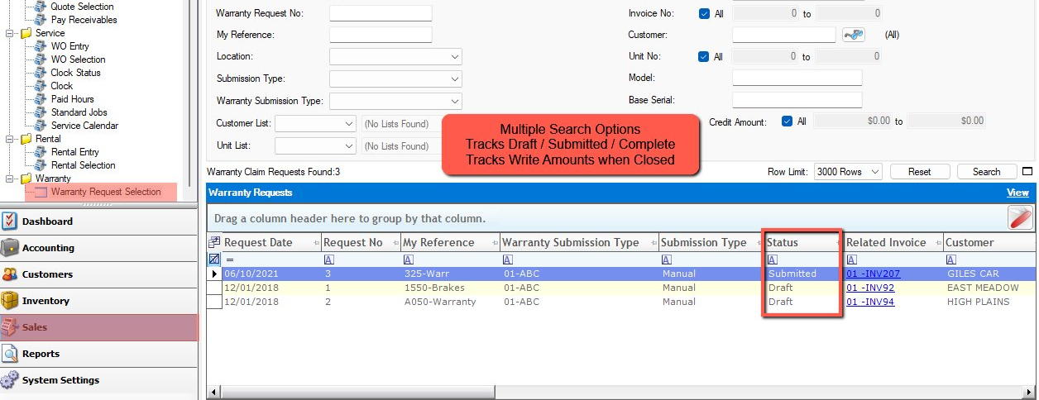
Tracking the Claim Request

Slide 20
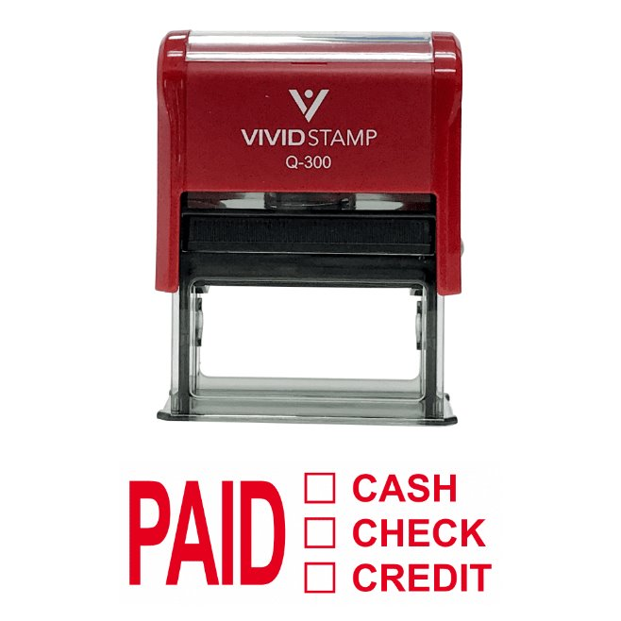
Recording Credits Received
  Reconciliation Tab – Allocate Credit Received
  Record Credit & Leave Open
  Record Credit & Complete Claim
Live ASPEN – Let’s process the payment!

Slide 21
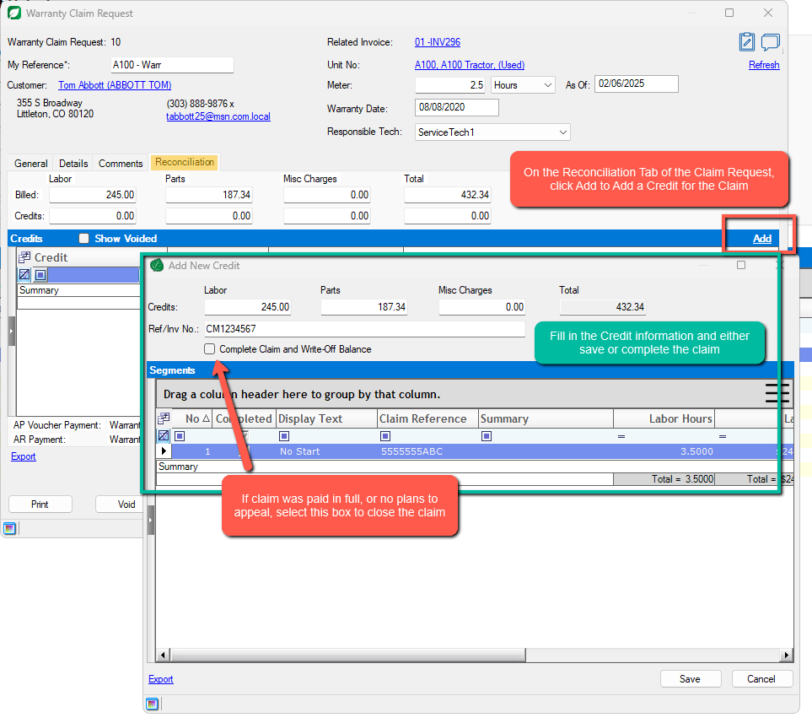
If the claim is short-paid, you can apply the credit and leave the claim open to appeal for more $$
If the claim is paid in full, or if you do not plan to appeal, enter the credit amounts and select the box that says Complete Claim and Write Off Balance

Slide 22
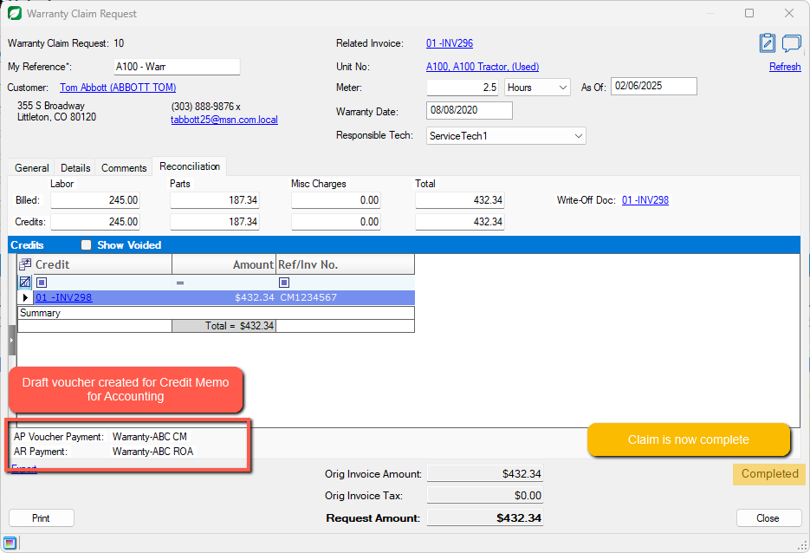

Slide 23

Let’s Review
  Best Practices – Track claims for ALL Vendors
  Warranty Setup – Service Codes - Payment Methods - Submission Types
  Warranty Workflow – Finalize W/O when work is complete
  Tracking & Finalizing – Warranty Request Selection Screen
  Recording Credits Received – Reconciliation Tab & Complete Claim

Slide 24
Questions?

Slide 25



Thank you!
2025 User Conference
Learn & Grow at our User Conference
in Jacksonvlle!
February 10 - 12th, 2025
Jacksonville, Florida

