Slide 1




2025 User Conference
Learn & Grow at our User Conference
in Jacksonville!
February 10 - 12th, 2025
Jacksonville, Florida

Slide 2
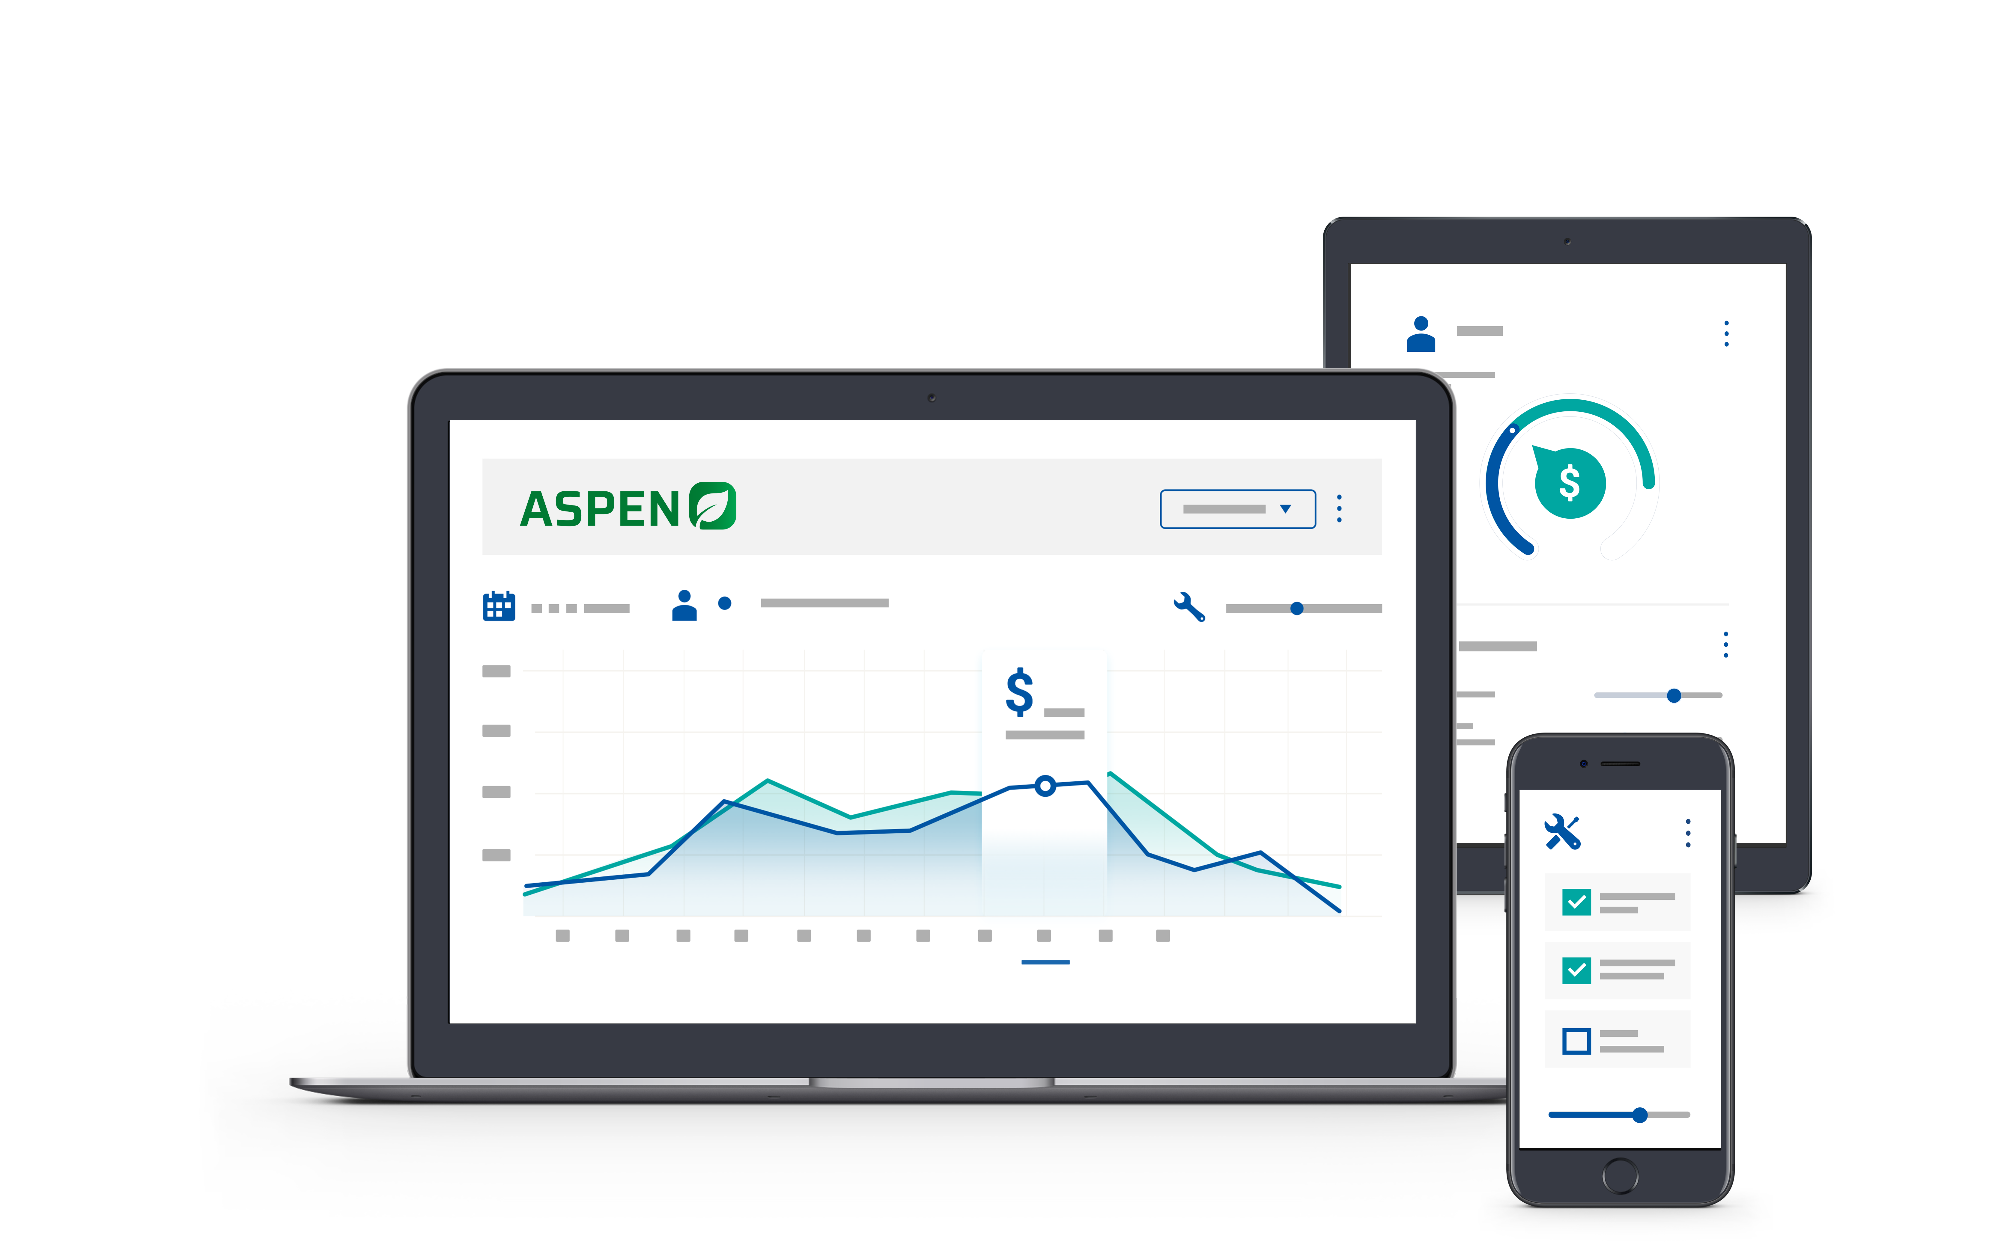

Welcome!
We will get started shortly

Slide 3

Kristen Borrelli
Product Manager

Slide 4
Agenda
1.
25.1 Features Highlights
2.
Pricing Visibility – Discounts and Parts on Order
3.
Improved Deposits
4.
Customer Dashboard
5.
2025 Features Under Review

Slide 5

2025 - 25.1 Highlights
Dealer List Price Roundup
Part Search user-specific Options
Work Order Scrolling
Navigation Menu font and icons
Customer Quick Add
AR Balance Link in Customer Records
ASPEN Mobile and Service Queue
TargetPay early adopters

Slide 6
25.1 Features
Feature | Details
Dealer List Price Roundup | Option to round all parts to end in $.99
Customer Special Pricing Discounts | Dealer List Price visible to show discounts
Parts on Order Pricing | Pricing visible in point of sale and on invoices
Part Search options | User option to choose what/how to search
Work Order Scrolling | Scrolling enabled in point of sale for small screens
Navigation Menu font and icons | Multi-color icons available and font size
Improved Deposits | New button and reference on invoices
Landing Pages | New Dashboards for Customers, Parts, Units
Customer Quick Add – show in landing page | Add customers faster/suggested customer IDs
AR Balance link in Customer Records | Option to display in customer records

Slide 7
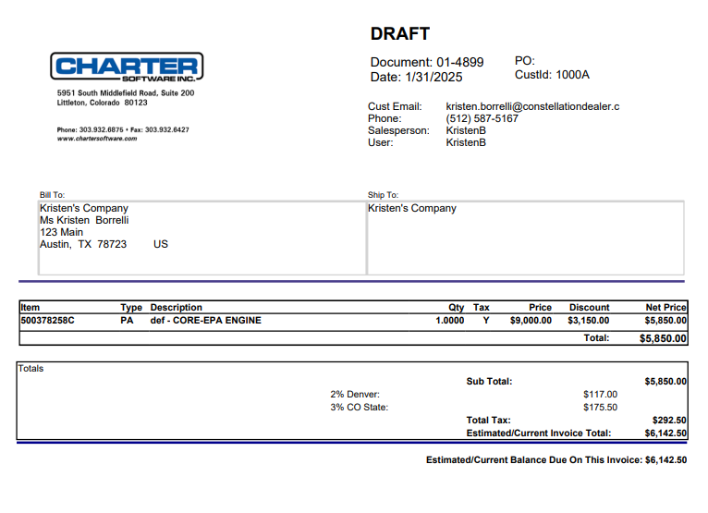
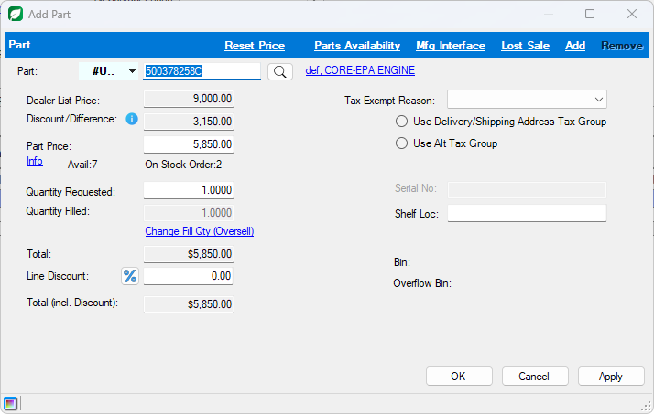
Customer Special Pricing
Goal: Show customers accurate discounts

Slide 8
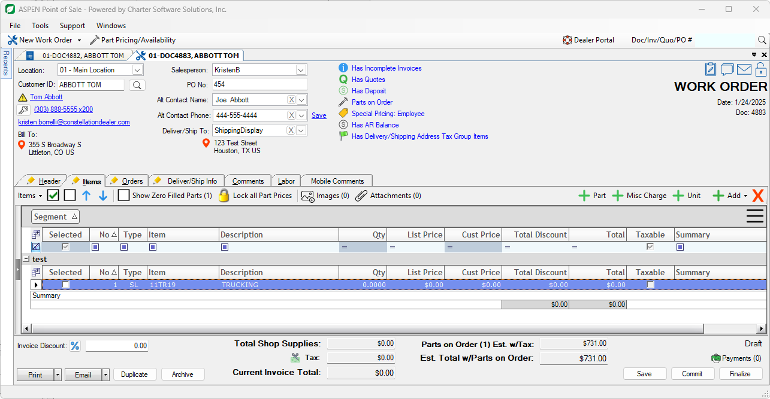
Parts on Order Pricing
Goal: Surface Pricing for Parts on Order for users and customers

Slide 9
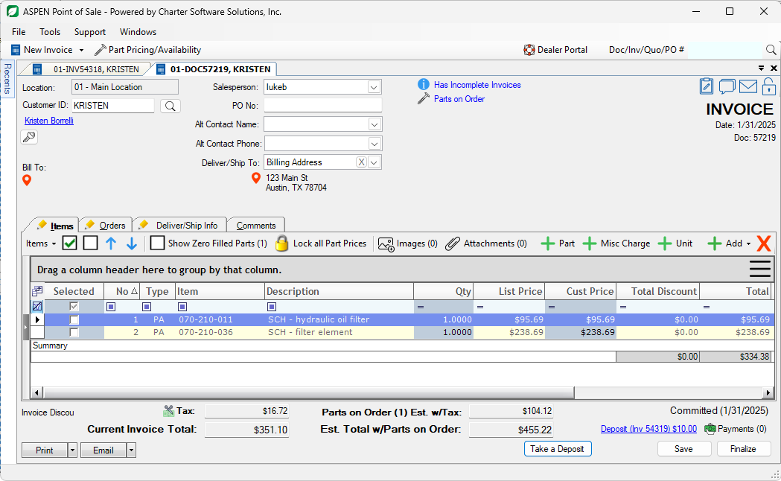
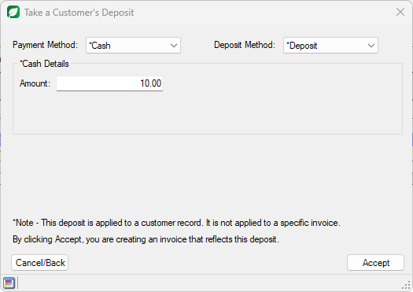
Improved Deposits
Goal: Easier to Take and Reference deposits

Slide 10
Customer Dashboard
Goal: Reduce Clicks and Surface important information
Quick Search
Quick Add
Widget Options – AR Lookup, Customers on Credit Hold, Top Customers, New Customers, more
Parts Dashboard
Units Dashboard
Live Demo

Slide 11
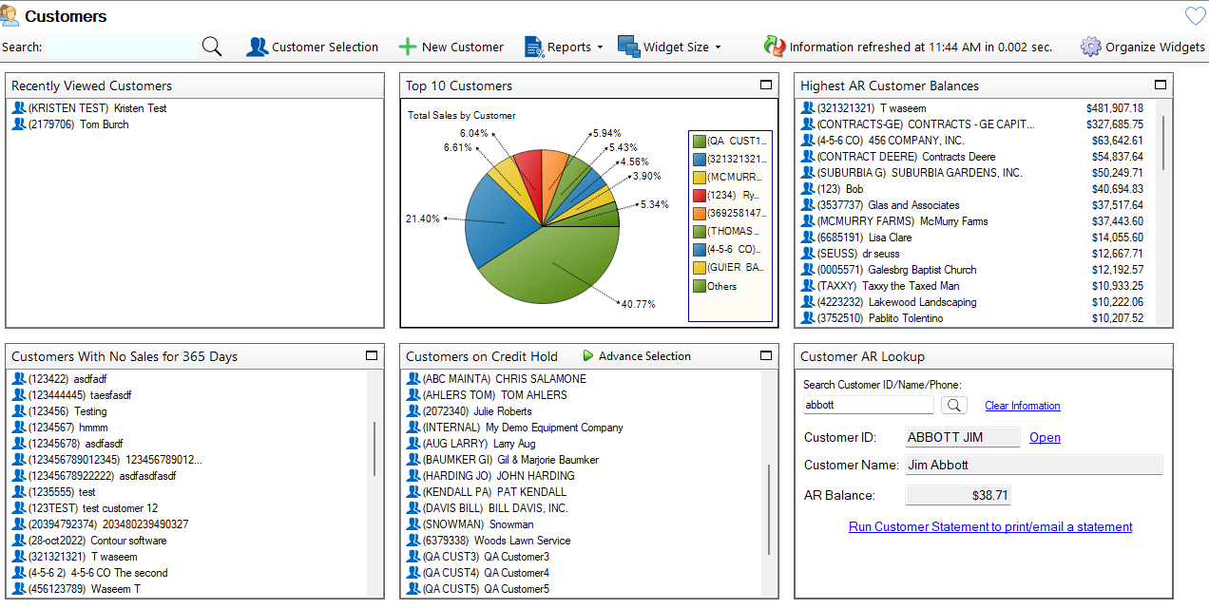

Slide 12
Demo

Slide 13

2025 Features Under Review
Avalara Integration
Email Improvement
Rounding Labor
Parts Order Queue
Improving Quotes and Returns
Increasing Font Sizes
Service Calendar / Contracts
eSign
Tech Efficiency Improvements

Slide 14
Thank you!

