Slide 1




2025 User Conference
Learn & Grow at our User Conference
in Jacksonville!
February 10 - 12th, 2025
Jacksonville, Florida

Slide 2
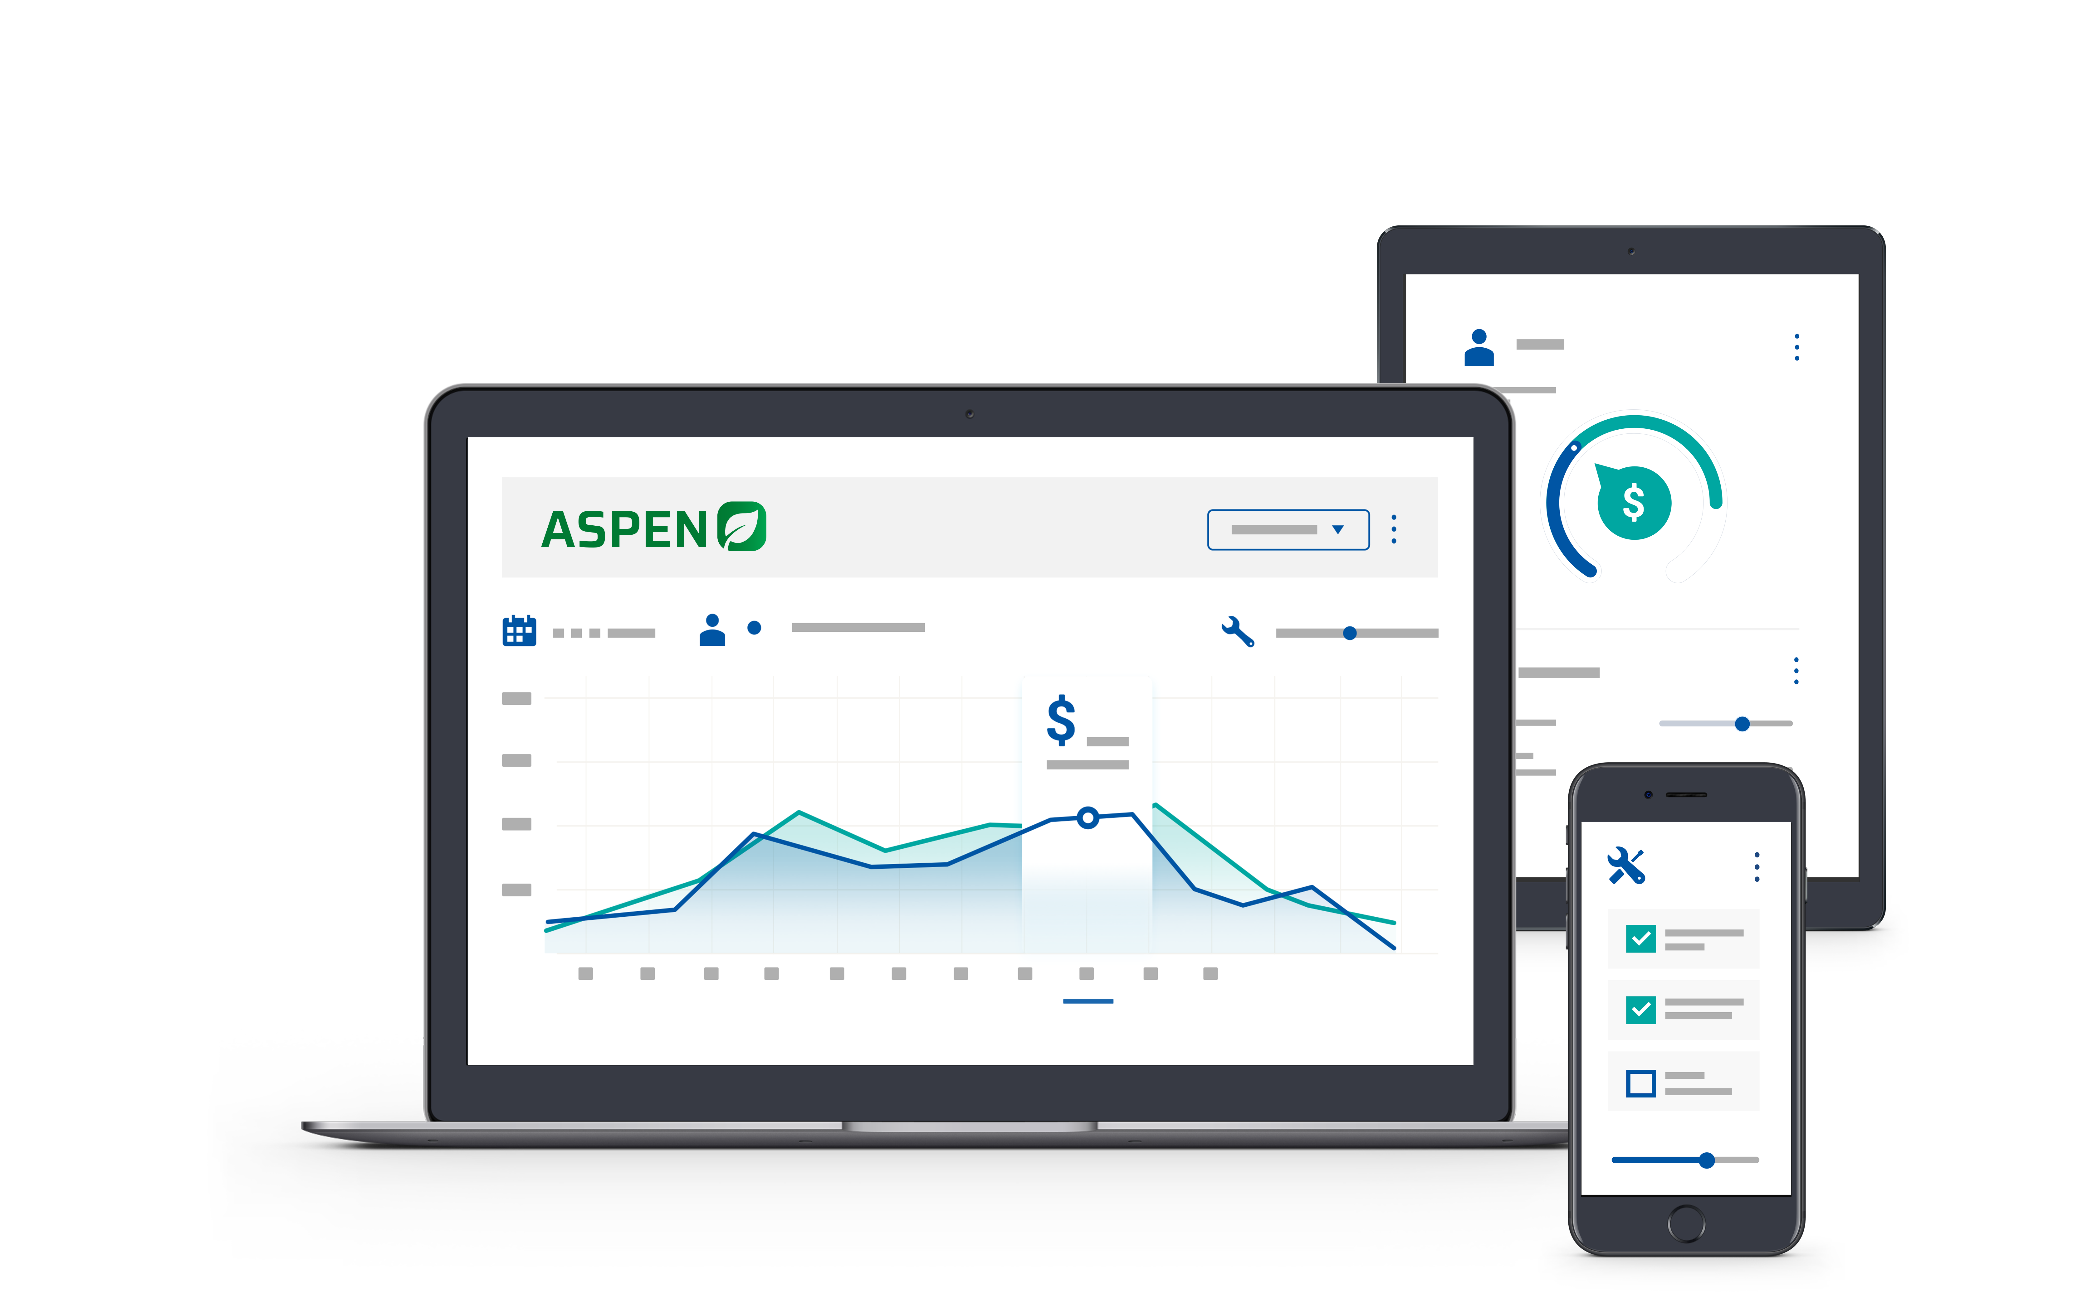

Welcome!
We will get started shortly

Slide 3
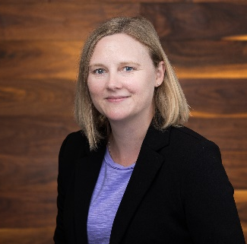
Kristen Borrelli
Product Manager

Slide 4

ASPEN Rental
Getting Started
Rental Availability
Rental Contract Workflow
Managing Rental Contracts
Improvements

Slide 5
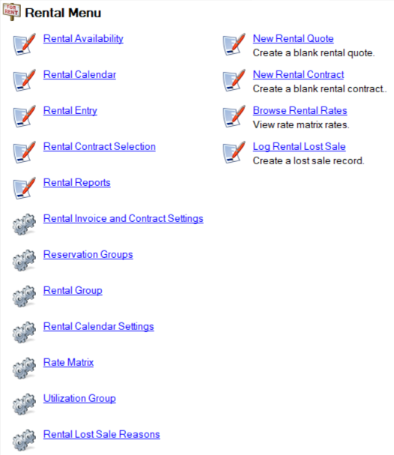

Rental Menu and Quick Start Guide

Slide 6
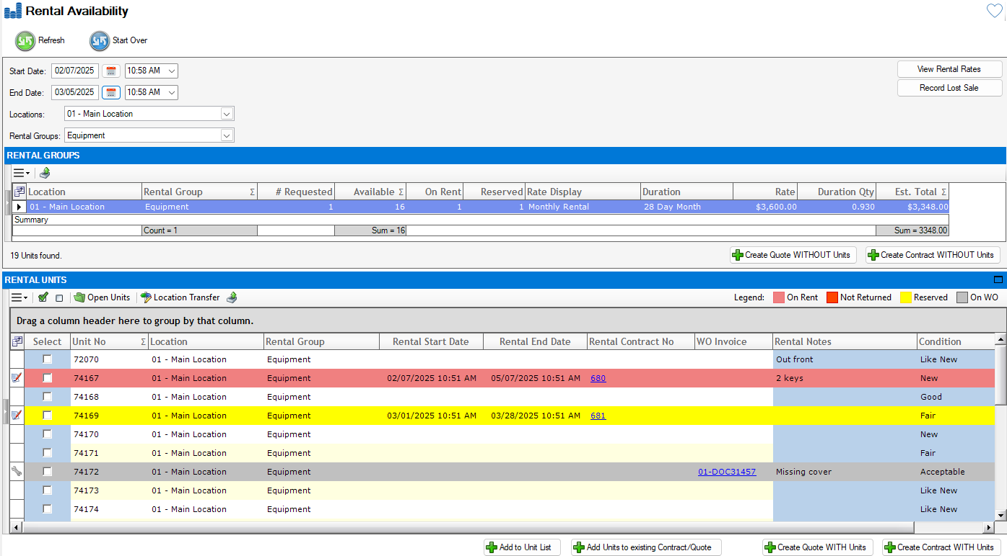
Rental Availability
What is available? What’s the rate? Create a Quote or Contract

Slide 7
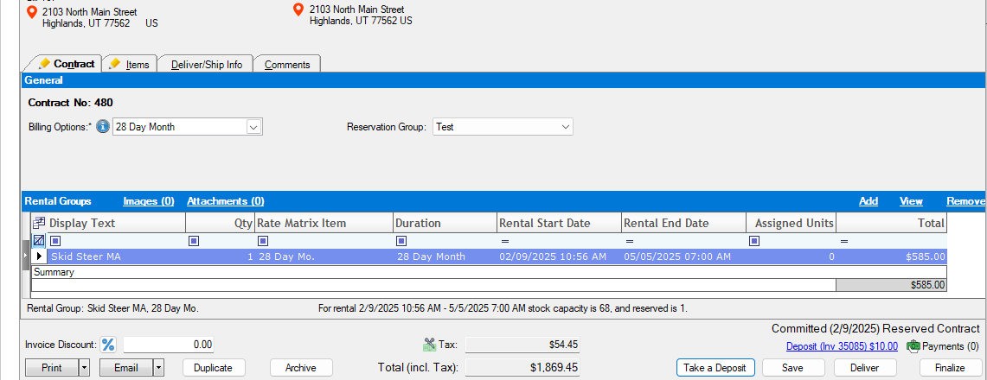
Improved Deposits

Slide 8
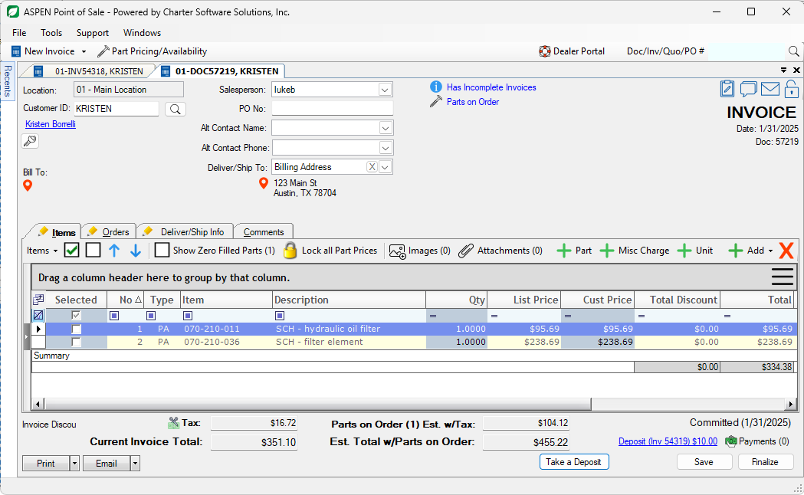
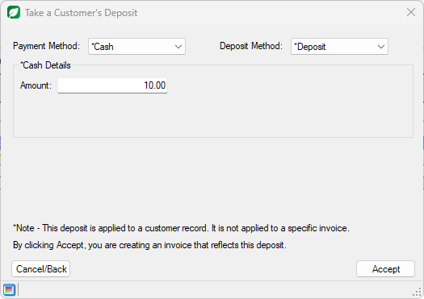
Improved Deposits

Slide 9
Rental Workflow – Improvements
Quotes
Reserved Contracts
Deposits
Deliver Units
Finalize Invoices
Rental Entry
Recurring Billing
Adjustments – Returning Units, Rental Credits, Extending Contracts
Complete

