Slide 1
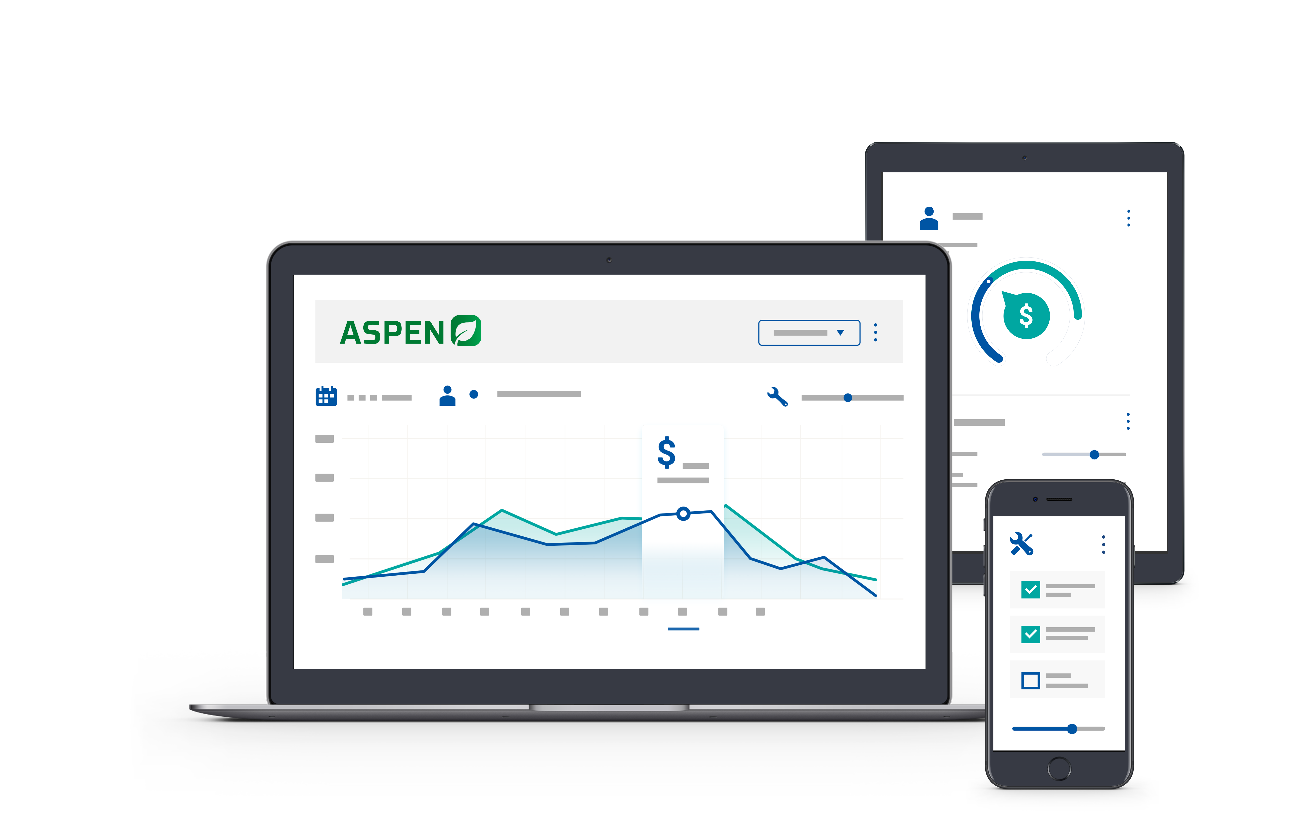


2025 User Conference
Learn & Grow at our User Conference
in Jacksonville!
February 10 - 12th, 2025
Jacksonville, Florida

Slide 2

Welcome!
We will get started shortly

Slide 3
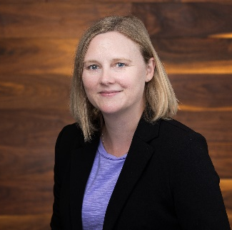
Kristen Borrelli
Product Manager

Slide 4
Agenda
1.
2024 Features Review
2.
Customer Statements Screen
3.
Control User Access to Reports
4.
Scheduled Reports
5.
Point of Sale Improvements

Slide 5

2024 Features
Usability
Rental Improvements
Service
Part Orders and Receipts
Pagination
Universal Search

Slide 6
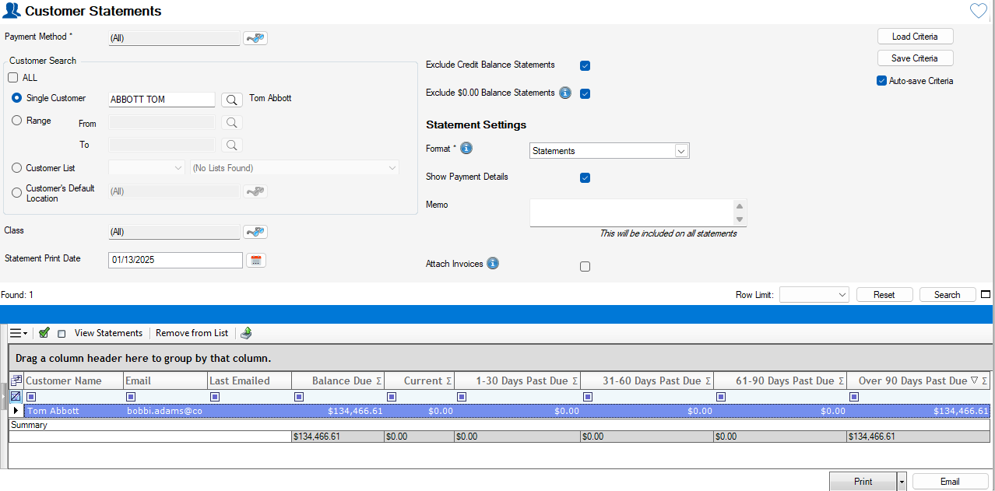
Customer Statements Screen
Goal: Quickly Print or Email statements directly to customers
Search/Filter results – single customer, Customer List, Class
Option to Attach Related Invoices
View Last Emailed By/Date
View Balance Due
View Aging details

Slide 7
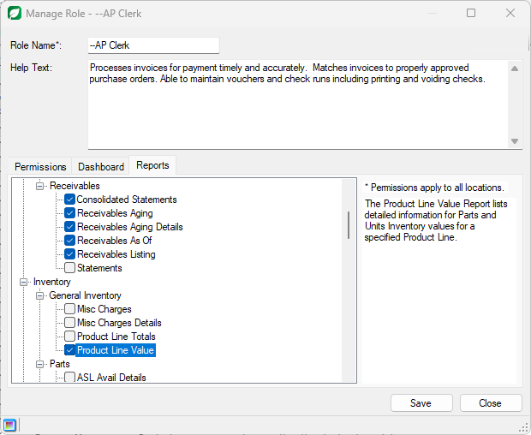
Control User Access to Reports
Goal: Limit Access or Provide Access to sensitive information. **

Slide 8
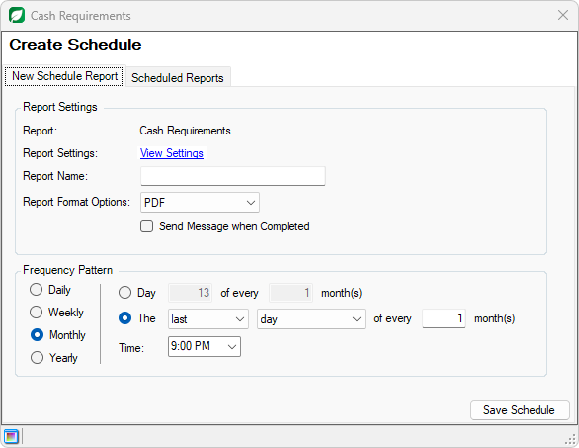
Scheduled Reports
Goal: Schedule any Report to run Automatically
Go to any report screen, select criteria, click Schedule Report
Choose any frequency/day/time
Click on Reports from Navigation to view available reports

Slide 9
Point of Sale Improvements
Goal: Reduce Clicks and Surface important information
Create New Docs Faster
Recents Tab
Search Field
Alternate Contact
Text with Target
Alerts for Deposits, Parts on Order, Quotes, Incomplete Invoices, Special Pricing, Credit Hold, Display AR Balance
Quick links to add Parts, Units, Misc Charges
Add Images/Attachments easier
Display Tax info
Delete multiple lines at once
Print/email/text faster and easier from Finalize window

Slide 10
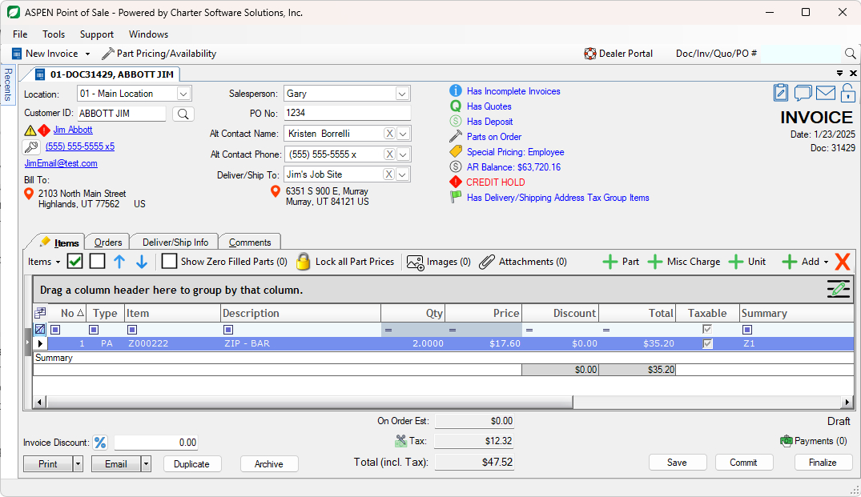

Slide 11
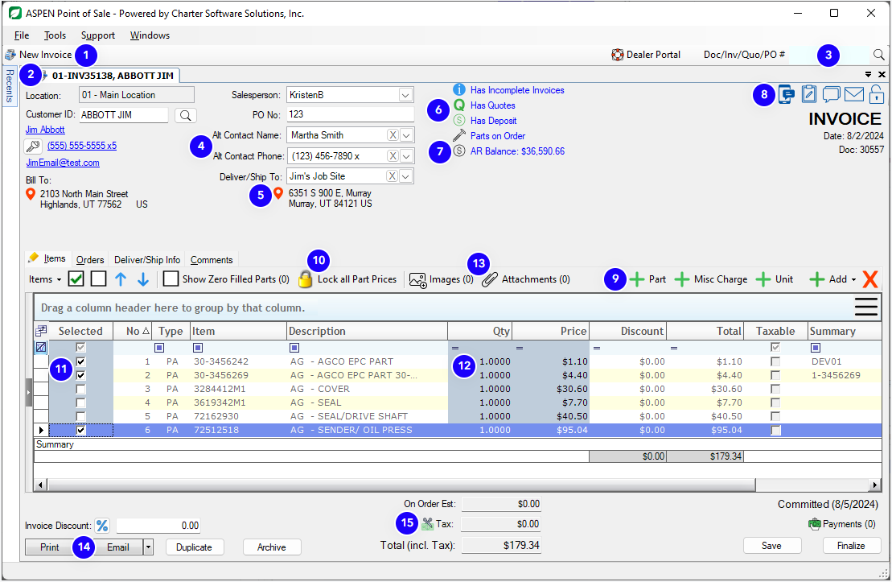

Slide 12
Thank you!

